Slide 1
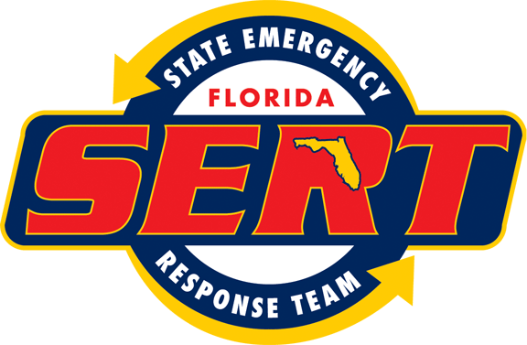

FEMA Public Assistance Grant Program
Applicant Briefing
DR-4283
Hurricane Matthew
’ Briefing
THE FLORIDA DIVISION OF EMERGENCY MANAGEMENT

Slide 2
Overview
The Public Assistance Grant Process
Sequence of Events
Post Declaration Events
Submitting a Request for Public Assistance (RPA)
Eligibility: Applicant, Facility, Work, Costs
Project Worksheet Formulation/Submission
Project Funding Options
Sandy Recovery Improvement Act of 2013/Alternate Procedures
Special Considerations Overview
THE FLORIDA DIVISION OF EMERGENCY MANAGEMENT

Slide 3
The Public Assistance Grant Process
Disaster
Event
PDA
Governor’s
Request
Declaration
Kick-off
Meeting
Submission
of RPA
Applicants’
Briefing
Formulation
of Projects
Project
Review
Approval
Recipient
Funding
Subrecipient
THE FLORIDA DIVISION OF EMERGENCY MANAGEMENT

Slide 4

Sequence of Events
The President may declare that a major disaster or emergency exists and activate a range of Federal programs to assist in the response and recovery effort. A Presidential Declaration will be very specific and will:
List all counties that are eligible for assistance
Bradford, Brevard, Clay, Duval, Flagler, Indian River, Lake, Martin, Nassau, Palm Beach, Putnam, Seminole, St. Johns, St. Lucie, Volusia
Establish the incident period of the disaster
October 3 through October 19, 2016
Specify the eligible assistance programs for the disaster
Public Assistance
Establish the Federal cost share
75%
THE FLORIDA DIVISION OF EMERGENCY MANAGEMENT

Slide 5
Post-Declaration Timelines
Overview
Disaster
Once a disaster has been declared, the State will conduct an Applicants’ Briefing for each county named in the declaration and potential Applicants will have 30 days from the date of the declaration to submit a Request for Public Assistance (RPA).
Once an Applicants’ RPA has been accepted, FEMA will hold a Kickoff Meeting. Applicants have 60 days from the date of the Kickoff Meeting to identify eligible damages.
After damages have been identified and all documentation for a project has been submitted, FEMA will take action on granting funds within 45 days.
After a decision on funding has been made by FEMA, the Applicant may appeal the decision within 60 days of notification.
After FEMA has approved the eligibility of a Applicant, the State will notify the Applicant, via Florida PA.org, to review and execute the State-Applicant Funding Agreement. The Funding Agreement should be submitted in a timely manner, as it must be signed by the Applicant and Grantee prior to receipt of any payments.
THE FLORIDA DIVISION OF EMERGENCY MANAGEMENT
Notes:
FEMA action could involve environmental, historical, insurance, procurement, costs, etc. and does not necessarily mean obligation of funding.

Slide 6
Post-Declaration Events
Overview
Applicants’ Briefing
Held by the State in every declared county and provides overall description of the Public Assistance Program to discuss eligibility issues, cost share, categories of work, and submission of Requests for Public Assistance.
Purpose is to provide high-level information regarding the Public Assistance Program:
  Application Procedures (General)
  Eligibility Criteria
  Project Formulation and Funding
  Administrative Requirements
  Procurement Requirements
  Environmental and Historic Preservation Compliance Requirements
  Debris
  Insurance
  Documentation Requirements and Recordkeeping
THE FLORIDA DIVISION OF EMERGENCY MANAGEMENT

Slide 7
Submission of Request for Public Assistance
The Request for Public Assistance (RPA) is an Applicant’s official notification to FEMA of the intent to apply for Public Assistance.
The Request can be made before all damages have been identified. Federal and State personnel will review each Request to ensure Applicant eligibility.
A Request for Public Assistance must be submitted to the State through:
www.FloridaPA.org
For assistance submitting a Request for Public Assistance, contact:
State Deputy Public Assistance Officer, Jeanette Francis
Jeanette.Francis@em.myflorida.com
(850) 488-3141
THE FLORIDA DIVISION OF EMERGENCY MANAGEMENT

Slide 8
Post-Declaration Events
THE FLORIDA DIVISION OF EMERGENCY MANAGEMENT

Slide 9
Post-Declaration Events
Kickoff Meeting
FEMA and the State will assign their own Public Assistance Coordinator (PAC) to sit down and work with each Applicant. The meeting will be held to explain the PA Grant program in more detail, obtain a list of damages from the Applicant and all pertinent information and documentation.
Attendance: all personnel who will be dealing with projects should attend the Kickoff Meeting. Suggested attendees include employees from public works, utilities, solid waste, law enforcement, administration/finance staff, facilities managers, risk managers and environmental managers.
Preparation: Applicants should have a list of damages, insurance policies, procurement policies, pay policies and issues that may require special consideration, such as environmental/historic preservation, debris and mitigation.
Mutual Aid/EMAC Assistance: if mutual aid assistance was received, make sure both your State and FEMA representatives are made aware. This assistance may be eligible as a Category B project.
THE FLORIDA DIVISION OF EMERGENCY MANAGEMENT

Slide 10
Post-Declaration Events
Overview
Project Formulation
Project worksheets include damage descriptions, scope of work, % work completed, cost line items, special considerations, and project type.
Consider combining multiple recovery efforts into single projects. Projects can be grouped in several ways including: site specific, facility specific, type of damage, method of work, system, jurisdiction, complex, or by special considerations.
Special considerations include: insurance, historical preservation, environmental concerns, flood plain management, cultural and archaeological resources, tribal consultation, and coastal high hazard areas.
Obligation
The signed project worksheets are sent to the Joint Field Office (JFO) for processing and obligation. Once obligated, small projects will be paid immediately. However, large projects need a Request for Reimbursement (RFR) submitted with detailed backup documentation.
Project Closeout
All large projects are verified with backup documentation to ensure all costs incurred comply with the stated scope of work in the project worksheet.
THE FLORIDA DIVISION OF EMERGENCY MANAGEMENT

Slide 11
Overview
Eligibility
THE FLORIDA DIVISION OF EMERGENCY MANAGEMENT

Slide 12
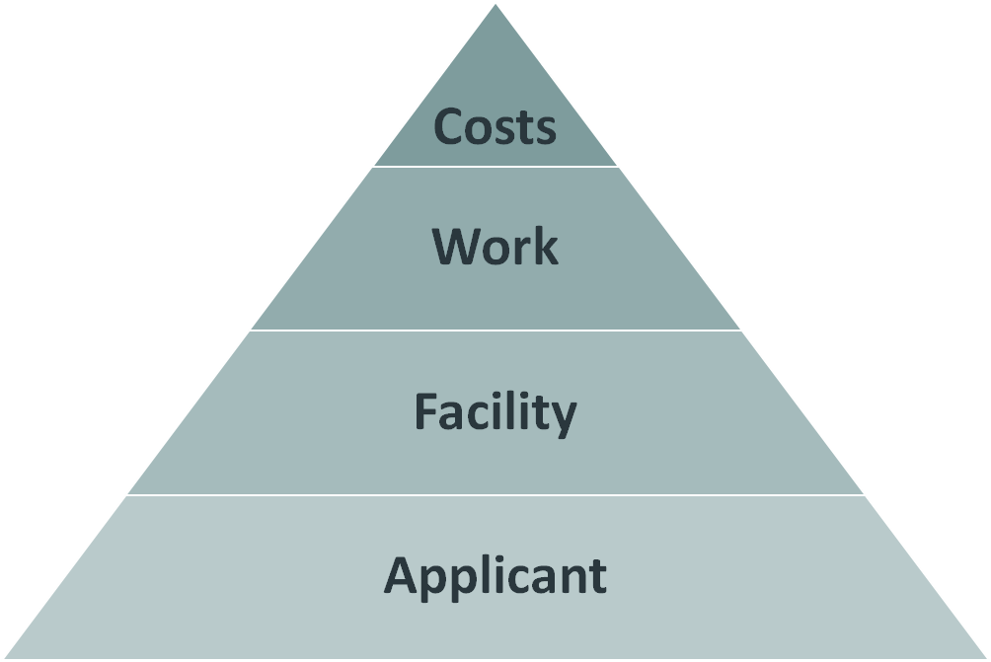
Eligibility
Overview
Reasonable and necessary to accomplish the work; Compliant with Federal, State, and local requirements for competitive procurement; Reduced by all applicable credits, such as insurance proceeds and salvage value.
Debris removal, emergency protective measures, and permanent repairs; Must be a direct result of the disaster, in the designated disaster area, and the legal responsibility of the Applicant.
Public or PNP-owned building, works, system, or equipment; Certain maintained and improved natural features; Applicant must be legally responsible for maintenance and repair.
State, tribal, local governments (counties, cities, towns, school districts, etc.) , certain PNP’s (critical and non-critical).
THE FLORIDA DIVISION OF EMERGENCY MANAGEMENT

Slide 13
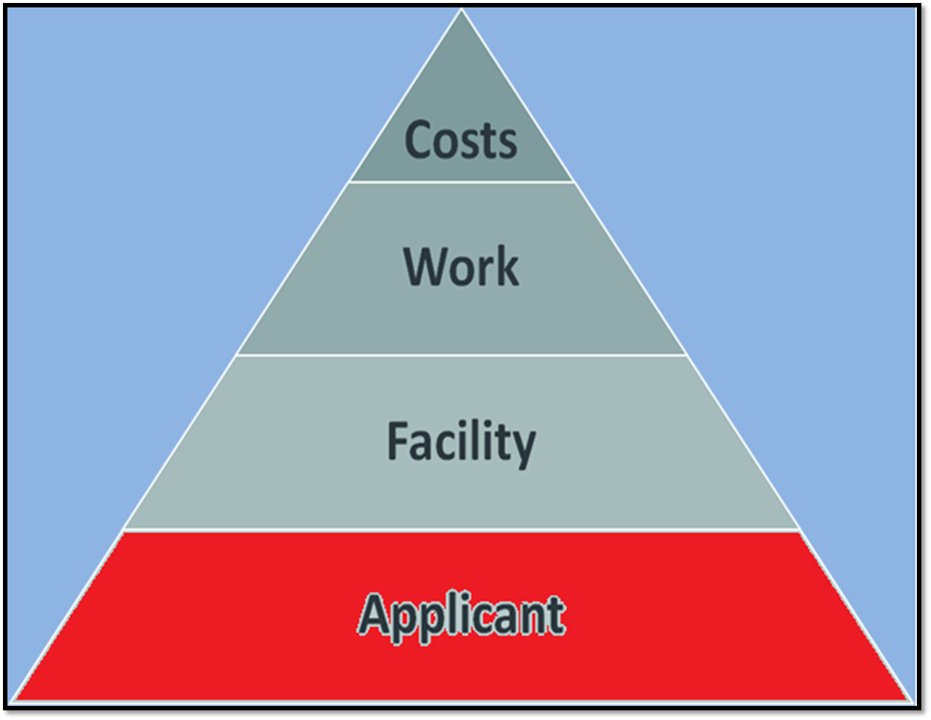
Eligibility: Applicant
THE FLORIDA DIVISION OF EMERGENCY MANAGEMENT

Slide 14
Eligibility: Applicant
Potentially eligible Applicants for assistance under the Public Assistance grant program are:
State Government Agencies
County and Municipal Governments
Special Purpose Districts
School Districts
Private Non-Profit: Critical and Non-Critical Services
Federally recognized Indian Tribal Governments
THE FLORIDA DIVISION OF EMERGENCY MANAGEMENT

Slide 15
Eligibility: Applicant
The application for PNP organizations is slightly different than that for other Applicants.
For emergency work, all eligible PNP organizations apply directly to FEMA through the State for assistance.
For permanent work, the application process depends on whether the PNP’s facility is defined as providing critical or non-critical services.
Critical Services
Non-Critical Services
THE FLORIDA DIVISION OF EMERGENCY MANAGEMENT

Slide 16
Eligibility: Applicant
Homeowners’ Associations and Gated Communities and Community Development Districts
Removal of debris from roadways within the community to create an emergency path of travel, if the activity is performed by an eligible local or State entity
When access is restricted by gates or other security systems, the services and facilities are not considered public and are ineligible for assistance.
THE FLORIDA DIVISION OF EMERGENCY MANAGEMENT

Slide 17
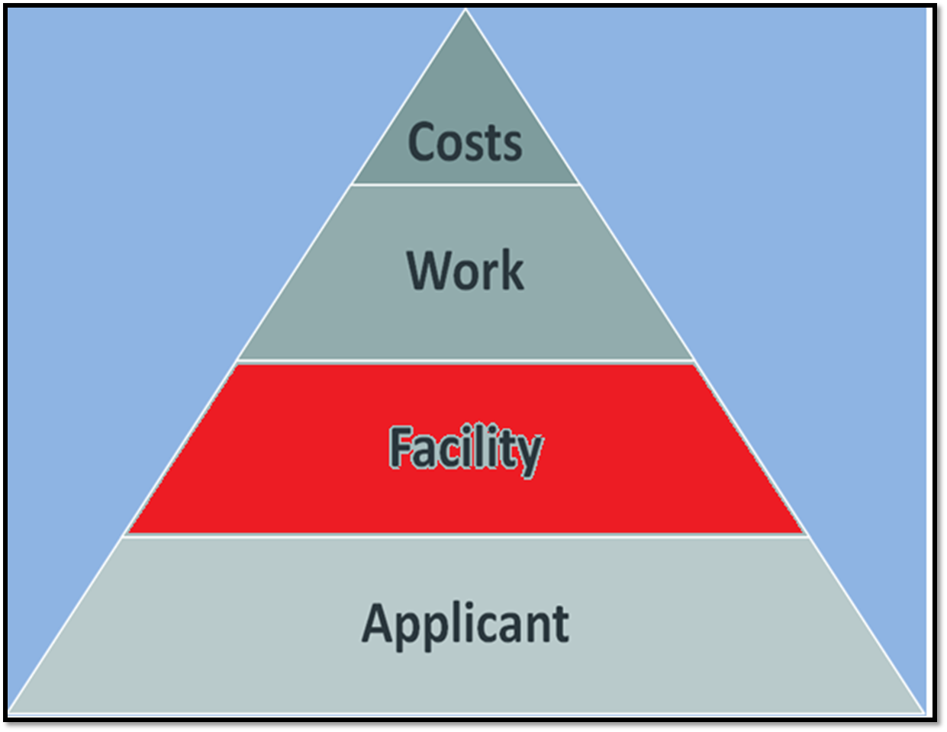
Eligibility: Facilities
THE FLORIDA DIVISION OF EMERGENCY MANAGEMENT

Slide 18
Eligibility: Facilities
Potentially eligible facilities for assistance under the Public Assistance grant program are:
Publically or PNP-owned buildings, works, systems, or equipment
Improved and maintained natural features
Eligible Facilities
-Improved or maintained beaches
-Soil and vegetation used for soil stabilization measures
-Temporary unoccupied building owned by an eligible Applicant responsible for maintenance and repairs
Ineligible Facilities
-Agricultural lands and planted trees and shrubs
-Roads and bridges that are under the control of the FHWA
-Water control facilities under the legal responsibility of the United States Army Corp of Engineers
For facilities, it’s important to note: Legal Responsibility, Active
Use, Alternate Use, and Facilities Under Construction.
THE FLORIDA DIVISION OF EMERGENCY MANAGEMENT

Slide 19
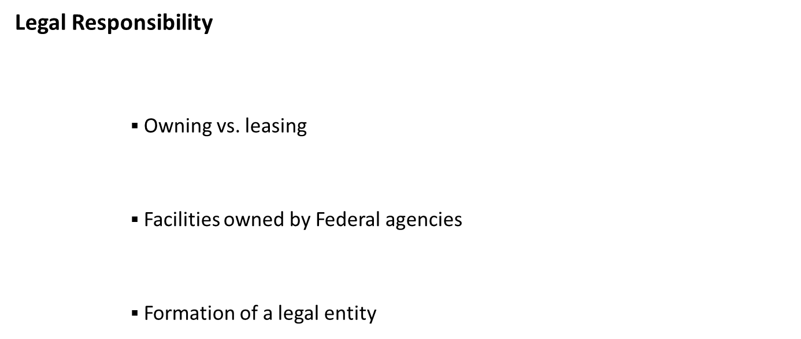
Eligibility: Facilities
The facility must be owned by the legal entity, and not an individual, to be eligible.
THE FLORIDA DIVISION OF EMERGENCY MANAGEMENT

Slide 20
Eligibility: Facilities
Active Use
Exceptions to active use
the facility was only temporarily inoperative for repairs or remodeling
the facility was unoccupied for a short time between tenants
active use by the Applicant was firmly established in an approved budget
the Applicant can clearly demonstrate to FEMA that there was intent to begin use within a reasonable amount of time
THE FLORIDA DIVISION OF EMERGENCY MANAGEMENT

Slide 21
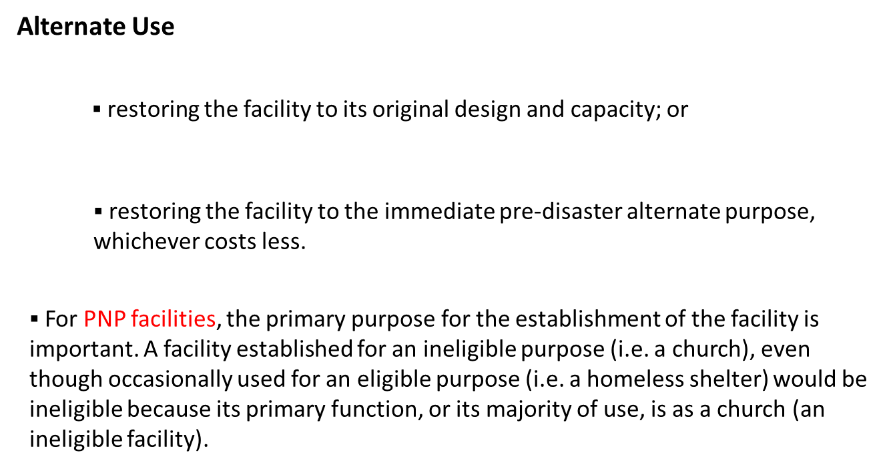
Eligibility: Facilities
THE FLORIDA DIVISION OF EMERGENCY MANAGEMENT

Slide 22
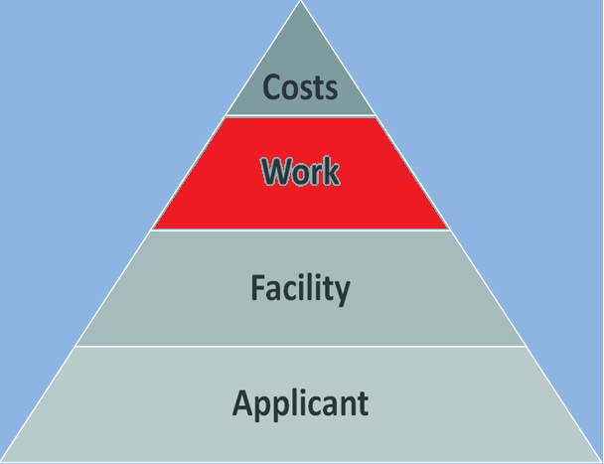
Eligibility: Work
THE FLORIDA DIVISION OF EMERGENCY MANAGEMENT

Slide 23
Eligibility: Work
For work to be eligible for assistance under the Public Assistance program, it must:
Be directly related to the declared disaster
Performed within the designated disaster area
Legal Responsibility of the Applicant
Eligible Work
-Sandbagging and temporary levees set up before the disaster
-Road damage caused by heavy equipment used for emergency protective measures
-Temporary/permanent relocation of facilities, with exceptions
Ineligible Work
-Interior water damage caused by the Applicant failing to take steps to cover roof damages
-Repairs to a damaged facility by an agency that is legally responsible for the repairs if that agency is an ineligible Applicant
THE FLORIDA DIVISION OF EMERGENCY MANAGEMENT

Slide 24
Eligibility: Work
Direct Result: work must be required as a direct result of the declared disaster.
Only damages that occur during the incident period are eligible.
Protective measures and other preparation activities performed within a reasonable and justified time in advance of the event may also be eligible.
Damage that occurs after the close of an incident period that can be tied directly to the declared event may also be eligible.
THE FLORIDA DIVISION OF EMERGENCY MANAGEMENT

Slide 25
Eligibility: Work
Designated Disaster Area: eligible work must be located within a designated disaster area.
The declaration will include the counties or Tribal areas within the State that are eligible for assistance.
If an owner from within the designated disaster area has a damaged facility located outside the designated area, that facility is not eligible, even if damaged by the same event.
Legal Responsibility: as with facilities, work must be the legal responsibility of the Applicant at the time of the disaster to be eligible.
THE FLORIDA DIVISION OF EMERGENCY MANAGEMENT

Slide 26
Eligibility: Work
Several factors are considered when determining whether or not work to a damaged facility will be eligible for assistance under the PA Program are:
Negligence
Codes and Standards
Maintenance
Mold
Repair vs. Replacement
Temporary and Permanent Relocation
THE FLORIDA DIVISION OF EMERGENCY MANAGEMENT

Slide 27
Eligibility: Work
Negligence: damage caused by negligence on the part of the Applicant after the event is not eligible.
Mold: mold remediation may be eligible under the PA Program, either as an emergency protective measure in the immediate aftermath of a disaster, or as part of the permanent repair work.
Maintenance: normal maintenance items that existed prior to the disaster, and deferred maintenance are not eligible because they do not meet the criterion of being disaster-related.
THE FLORIDA DIVISION OF EMERGENCY MANAGEMENT

Slide 28
Eligibility: Work
Codes and Standards: when a facility must be repaired or replaced, FEMA may pay for upgrades that are necessary to meet specific requirements of reasonable current codes and standards (i.e. ADA requirements).
For an upgrade to be eligible, the code or standard requiring the upgrade must meet the following 5 criteria:
The code or standard must apply to the repair work or restoration required.
The code or standard must be appropriate to the pre-disaster use of the facility.
The code or standard must be reasonable, in writing, and formally adopted, and implemented prior to the disaster declaration date or be a legal Federal requirement.
The code or standard must apply uniformly to all facilities of the type being repaired within the Applicant’s jurisdiction.
The code or standard must have been enforced during the time that it was in effect.
THE FLORIDA DIVISION OF EMERGENCY MANAGEMENT

Slide 29
Eligibility: Work
Temporary Relocation: the costs associated with the temporary relocation of essential services (i.e. school classrooms, fire department facilities, government offices, etc.) are eligible if the facilities are inaccessible or cannot be used until repaired, but are subject
to cost comparisons of alternate methods of providing facilities.
The rental or purchase of temporary space and equipment
Utilities, maintenance, and operating costs of the temporary facility are not eligible.
The period of time for which temporary relocation assistance may be provided is 6 months. Time extensions may be granted in extenuating circumstances.
THE FLORIDA DIVISION OF EMERGENCY MANAGEMENT

Slide 30
Eligibility: Work
Permanent Relocation: FEMA will provide assistance for relocation project costs if regulations require the damaged facility to be relocated, or if the damaged facility is subject to repetitive heavy damage because of its location. FEMA will only provide relocation assistance if it is cost effective and not barred by any other FEMA regulation or policies. Eligible costs for relocation projects include:
Demolition and removal of the old facility
Land acquisition
Construction of the new facility, including compliance with environmental requirements
Construction of ancillary facilities, such as roads and utilities
THE FLORIDA DIVISION OF EMERGENCY MANAGEMENT

Slide 31
Overview
Types and Categories of Work
Temporary/Emergency Work: work performed to reduce or eliminate an immediate threat to life, protect health and safety, and to protect improved property that is threatened in a significant way as a result of the disaster. From the declaration date, Applicants have 6 months to complete Category A and B work (can be extended an additional 6 months beyond this point if a request is submitted to the State.)
Permanent Work: work required to restore a damaged facility, through repair or restoration, to its pre-disaster design, function, and capacity in accordance with applicable codes or standards. From the declaration date, Applicants have 18 months to complete Category C-G work (can be extended an additional 30 months or beyond if a extension request is submitted to the State.)
Category of Work | Description
A | Debris Removal
B | Emergency Protective Measures
C | Roads and Bridges
D | Water Control Facilities
E | Buildings and Equipment
F | Utilities
G | Parks, Recreational, and Other
THE FLORIDA DIVISION OF EMERGENCY MANAGEMENT

Slide 32
Documentation: Categories of Work
Temporary/Emergency Work
THE FLORIDA DIVISION OF EMERGENCY MANAGEMENT

Slide 33
Documentation: Categories of Work
Category A: Debris Removal
THE FLORIDA DIVISION OF EMERGENCY MANAGEMENT

Slide 34
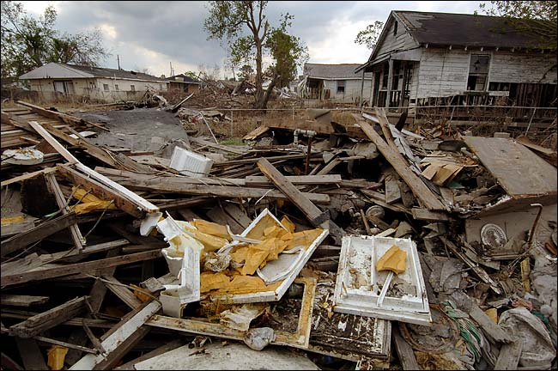
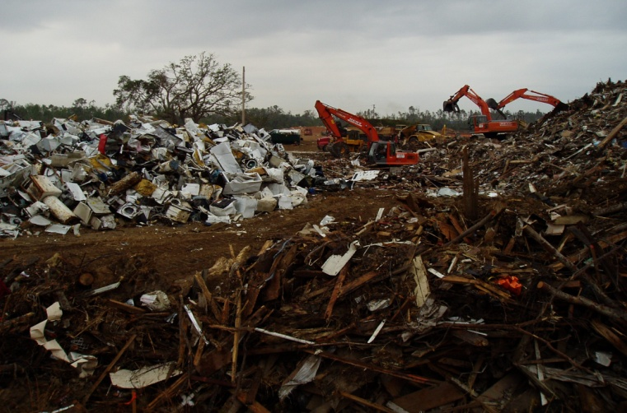
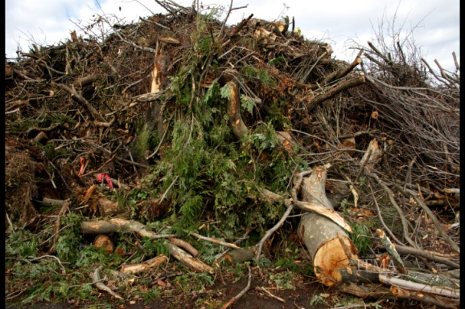
Documentation: Categories of Work
Category A - Debris Removal
Removal of debris that resulted from a disaster is generally eligible under the PA Program if it:
Eliminates threats to lives, public health, and safety.
Eliminates an immediate threat of significant damage to improved public or private property.
Ensures the economic recovery of the affected community to the benefit of the community at large.
THE FLORIDA DIVISION OF EMERGENCY MANAGEMENT

Slide 35
Documentation: Categories of Work
Category A - Debris Removal
There are common types of debris that are generally eligible under the PA Program:
Vegetative (trees, sand, mud, silt, gravel)
Building Components (drywall, cinder blocks, rebar)
Household Goods (cleaning solutions and other chemical items)
White Goods (refrigerators, stoves, air conditioners)
Disaster-related wreckage from emergency protective measures (eroded road material and asphalt)
THE FLORIDA DIVISION OF EMERGENCY MANAGEMENT

Slide 36
Documentation: Categories of Work
Category A - Debris Removal
When estimating the cost of debris removal, there are several factors to consider:
Impacts to Consider for Estimating Costs
Amount | More debris equals more land clearing for debris removal sites, equipment, and manpower costs.
Type | Household goods cost more to remove- refrigerators must have the Freon removed before disposal.
Location | Widespread debris increases travel costs of debris removal equipment; Beach debris requires special types of equipment.
Debris Site | Construction of new, temporary debris sites costs more due to clearing of land, placement of public facilities, and rental fees.
Other Entities | Other entities legally responsible for debris removal- private property issues.
THE FLORIDA DIVISION OF EMERGENCY MANAGEMENT

Slide 37
Documentation: Categories of Work
Category A - Debris Removal
Private Property Debris Removal: debris removal is generally the responsibility of the property owner, but debris removal from private property may be eligible if certain criterion are met:
The debris poses a hazard to public safety.
The debris poses a threat of significant damage to public or private property.
the debris removal aids in the economic recovery of the community.
Any debris removal from private property must be approved by FEMA prior to the removal. This approval will require a public interest determination, documentation of legal responsibility, authorization for debris removal, and an indemnification of the federal government.
THE FLORIDA DIVISION OF EMERGENCY MANAGEMENT

Slide 38
Documentation: Categories of Work
Category B: Emergency Protective Measures
THE FLORIDA DIVISION OF EMERGENCY MANAGEMENT

Slide 39
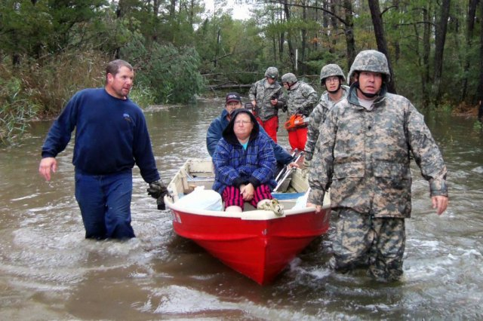
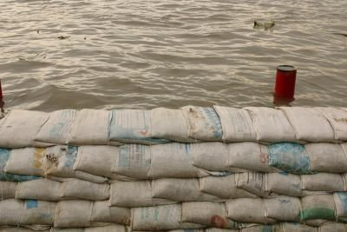
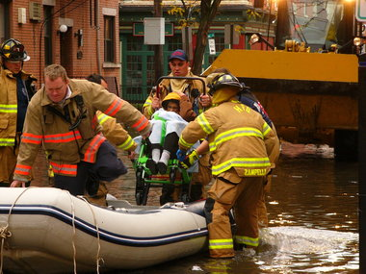
Documentation: Categories of Work
Category B- Emergency Protective Measures
Activities undertaken by a community before, during, and after a disaster to eliminate or reduce an immediate threat to life, public health, or safety or eliminate an immediate threat of significant damage to improved public or private property may be eligible for reimbursement.
Staff overtime costs
Mutual aid claims
Search and rescue operations
Staffing of the EOC
THE FLORIDA DIVISION OF EMERGENCY MANAGEMENT

Slide 40
Documentation: Categories of Work
Category B - Emergency Protective Measures
When collecting data to submit to the State, the following will be important:
Start/end dates for work: Record the time started on any work related to emergency protective measures and the time when the work ended.
Be sure to differentiate between regular and overtime hours.
Nature of the protective measures: What was the purpose of the work? Temporary construction of levees or sandbagging? Emergency evacuations of affected residents? Temporary repairs to eligible buildings and roofs?
Type of labor used: Were they force account labor or volunteer labor?
THE FLORIDA DIVISION OF EMERGENCY MANAGEMENT

Slide 41
Documentation: Categories of Work
Category B - Emergency Protective Measures
Vector Control measures may be eligible for assistance in a disaster area as an emergency protective measure when there is a serious health hazard.
Although vector control costs may not be available during the Initial Damage Assessment, documentation of vector control activities conducted in the aftermath of a disaster will be necessary for FEMA to fund them in the event a declaration is received.
Data that will need to be presented to the State and FEMA includes:
A documented increase in operating expenses
Evidence of an outbreak after an event
A documented increase in the disease carrying mosquito population
THE FLORIDA DIVISION OF EMERGENCY MANAGEMENT

Slide 42
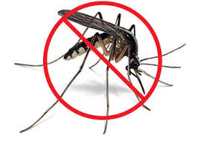
Documentation: Categories of Work
Category B - Emergency Protective Measures
Vector control documentation continued:
A significant increase in the biting mosquito population that causes a threat to emergency workers.
A letter from the Department of Health as well as three years of trap or dip data.
Spray or dip area maps detailing the zones affected by the disaster.
Dates of application as well as documentation of the chemical used, the application method applied, and the concentration.
Eligibility and documentation questions: Florida Greenbook
http://www.dot.state.fl.us/rddesign/FloridaGreenbook/FloridaGreenbook.pdf
THE FLORIDA DIVISION OF EMERGENCY MANAGEMENT

Slide 43
Documentation: Categories of Work
Permanent Work
THE FLORIDA DIVISION OF EMERGENCY MANAGEMENT

Slide 44
Documentation: Categories of Work
Category C: Roads and Bridges
THE FLORIDA DIVISION OF EMERGENCY MANAGEMENT

Slide 45
Documentation: Categories of Work
Category C - Roads and Bridges
Under the Public Assistance program, roads and bridges that are the legal responsibility of an eligible Applicant are potentially eligible for assistance.
FEMA will not pay to repair damages to roads or bridges that are not a direct result of a declared disaster.
Roads |  | Bridges
Eligible | Surfaces, bases, shoulders, ditches, drainage structures, low water crossings. | Decking and pavement, piers, girders, abutments, slope protection, approaches.
Ineligible | Unmaintained or pre-disaster damaged roads and bridges; Roads and bridges under a separate federal aid program or jurisdiction; Private roads (with exceptions).
THE FLORIDA DIVISION OF EMERGENCY MANAGEMENT

Slide 46
Documentation: Categories of Work
Category C - Roads and Bridges
When collecting data to submit for writing Project Worksheets, the following will be important:
Collecting Data on Damaged Roads and Bridges
Identify the Responsible Agency | Who is legally responsible for the repairs? Does the road or bridge fall under the FHWA program? Is it a service road maintained by the National Resources Conservation Service (MRCS) or the United States Army Corp of Engineers (USACE)?
Note Features | Identify the road surface materials (dirt, asphalt, gravel, etc.), how many lanes, and classification. Identify the bridge size and type (steel, concrete, timber, truss).
Describe Impacts | What is the damage to the road? Does it affect the county as a whole or specific residents? Are there any alternative routes?
Take Measurements | Take dimensions if possible of the affected area of the road or bridge.
Calculate Costs | If costs cannot be determined by consulting the local department responsible for repairs, use FDOT historical costs data or other standardized cost formulas.
THE FLORIDA DIVISION OF EMERGENCY MANAGEMENT

Slide 47
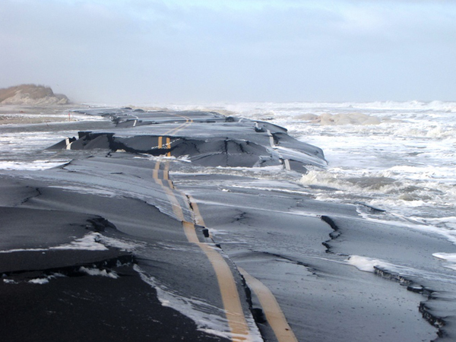
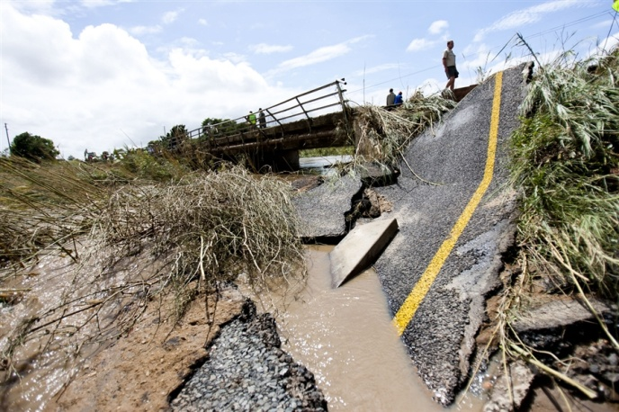
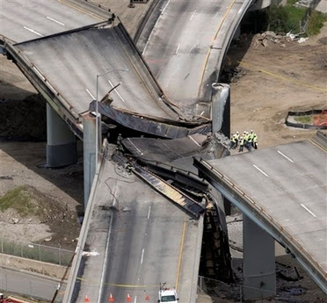
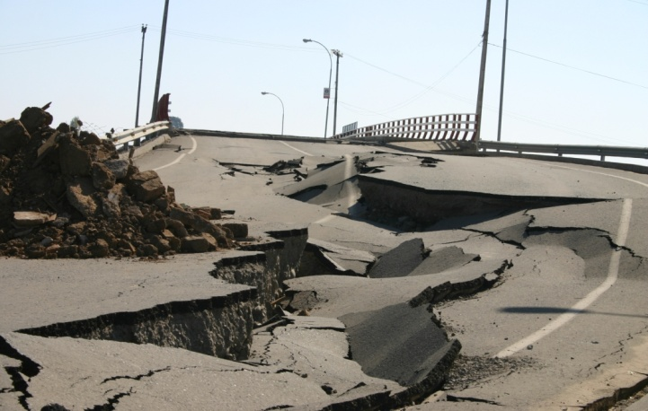
Documentation: Categories of Work
Category C - Roads and Bridges
In addition to measurements and cost estimates, it’s important to document any information related to:
Whether or not the road or bridge has a history of previous damage.
Whether or not the road or bridge required any type of emergency repairs
Equipment, material, and labor rates for conducting the repair work.
THE FLORIDA DIVISION OF EMERGENCY MANAGEMENT

Slide 48
Documentation: Categories of Work
Category C - Roads and Bridges
Although all costs associated with repairing roads and bridges may not be readily available at the time of the Initial Damage Assessment, documentation of those costs/rates can be included in a county’s damage threshold if presented to State and FEMA counterparts during the Joint Preliminary Damage Assessment.
Many of these rates will be available from the Public Works Department and will provide a more accurate estimate of the cost to repair disaster related damages than standard cost estimating formulas.
Maintenance of Traffic (MOT)- warning signs, flagmen, detour setup/signs, regulatory signage, barricades, cones, variable message boards.
Equipment- dump truck, grader, excavator/loader, roller/packer.
Drainage Structure Types- pipe, concrete, metal, size, installation, wingwalls, headwalls.
Ditch Cleaning Costs- excavation, hauling, pulling, cleaning.
Force Account Labor- hourly wage rates, benefit rates, pay policy.
THE FLORIDA DIVISION OF EMERGENCY MANAGEMENT

Slide 49
Documentation: Categories of Work
Category D: Water Control Facilities
THE FLORIDA DIVISION OF EMERGENCY MANAGEMENT

Slide 50
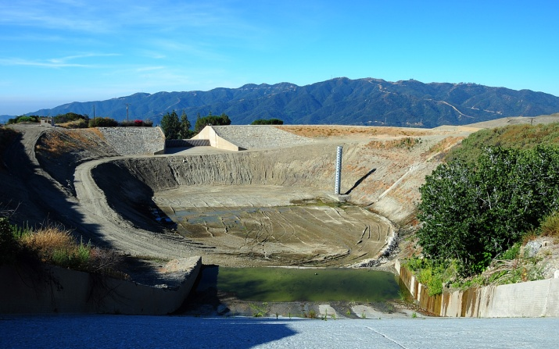
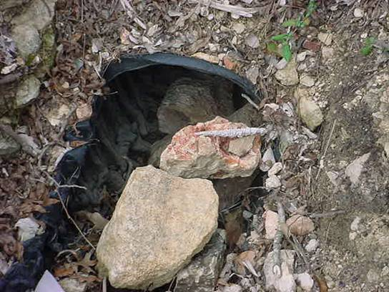
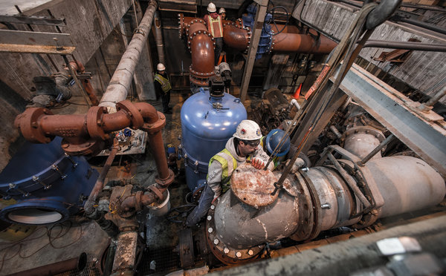
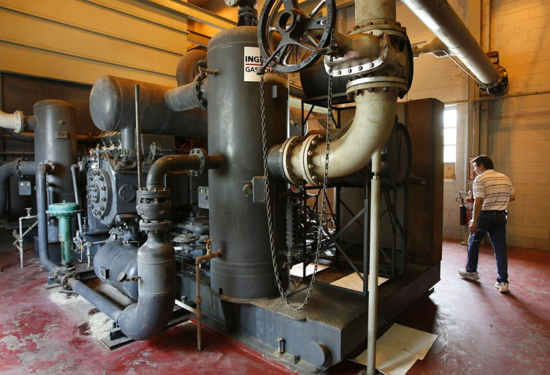
Documentation: Categories of Work
Category D - Water Control Facilities
“The United States Army Corp of Engineers (USACE) and Natural Resource Conservation Service (NRCS) has the primary authority for the repair of flood control works.” -PAPPG
When documenting disaster related damage to flood control works (levees, floodwalls, flood control channels and water control structures that were designed and constructed to have appreciable effects in preventing damage by irregular and unusual rises in water level) it is important to determine the entity legally responsible for those repairs.
THE FLORIDA DIVISION OF EMERGENCY MANAGEMENT

Slide 51
Documentation: Categories of Work
Category D - Water Control Facilities
Water Control Facilities
Eligible | Dams and reservoirs, levees, lined and unlined engineered drainage channels, canals, aqueducts, sediment basins, shore protective devices, irrigation/pumping facilities.
Ineligible | Flood control works that fall under the authority of the USACE and NRCS; Channels or basins restored to an increased capacity from their pre-disaster condition.
When collecting data to present for damages to water control facilities, the following should be included:
Identify the Responsible Agency | Note the agency responsible for the repairs to the damaged water control facility. Be mindful of recovery projects that fall under USACE or NRCS jurisdiction.
Note the Purpose | Describe the overall purpose of the facility. Does it provide clean potable water to the community? Does it prevent flooding and erosion to land? Does it help control water runoff into retention areas.
Describe Damages and Impacts | Describe the damages to the structure or facility and the impact it has on the community. Is the damage primarily underground or above ground? Is it something that is clogged that could be repaired or does it need to be replaced?
THE FLORIDA DIVISION OF EMERGENCY MANAGEMENT

Slide 52
Documentation: Categories of Work
Category D - Water Control Facilities
When it comes to United States Army Corps of Engineers (USACE) and the National Resource Conservation Service (NRCS) controlled flood works, FEMA will consider providing funding under certain circumstances:
FEMA may pay for… | FEMA will not pay for…
Assistance for emergency and permanent repairs if the facility is not eligible for repair assistance from the USAACE or the NRCS | A water control facility that is eligible for repair assistance (including debris removal) by the USACE or the NRCS
Dewatering of areas behind levees and other water control structures by breaching or pumping if there is an immediate threat to health, public safety, or improved property. | Any flood fighting activities or costs incurred after the water level has receded below the flood stage levels.
USACE Rehabilitation and Inspection Program (RIP): inspection and rehabilitation of federal and non-federal flood control works with a focus on urban areas, regardless of watershed sizes.
NRCS Emergency Watershed Program (EWP): responsible for repairing flood control works in watersheds with contributing drainage areas less than 400 miles and assists with the implementation of emergency measures for repair and restoration of eligible EWP facilities.
THE FLORIDA DIVISION OF EMERGENCY MANAGEMENT

Slide 53
Documentation: Categories of Work
Category E: Buildings and Equipment
THE FLORIDA DIVISION OF EMERGENCY MANAGEMENT

Slide 54
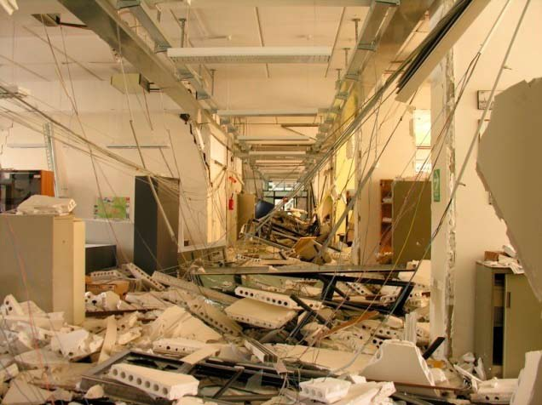
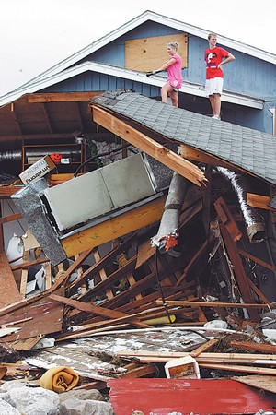
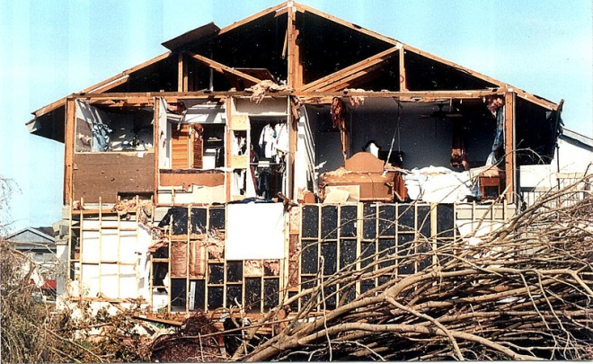
Documentation: Categories of Work
Category E - Buildings and Equipment
In general, under the Public Assistance program, buildings, structural components, interior electrical or mechanical work, and contents of publicly owned and maintained buildings are eligible for assistance.
Also eligible is the replacement of vehicles and other equipment with damages caused as a direct result of a declared disaster.
This does not include any vehicles or equipment covered by insurance or replacement of vehicles/equipment that incurred damage as a result of an accident that could have been avoided.
Ineligible under the program will be any accidental damage, damage due to neglect, upgrading of buildings, or damage to buildings which were in violation of codes before the disaster.
THE FLORIDA DIVISION OF EMERGENCY MANAGEMENT

Slide 55
Documentation: Categories of Work
Category E - Buildings and Equipment
When collecting data to submit for Project Worksheets, it will be important to document the following:
The overall purpose of the damaged facility or equipment.
Whether or not the building was in active use before the disaster. FEMA will not assist in the repairs of building that was vacant or not being actively used.
Whether the structure is a government or Private Non-Profit structure.
Can the damage be repaired or is the building destroyed? If the cost of repairing a building is greater than 50% of it’s value, FEMA may pay for the building to be replaced.
The type of damage that the building has undergone (structural, mold, etc.)
Any anticipated insurance proceeds and the cost of the insurance deductible.
THE FLORIDA DIVISION OF EMERGENCY MANAGEMENT

Slide 56
Documentation: Categories of Work
Category F: Utilities
THE FLORIDA DIVISION OF EMERGENCY MANAGEMENT

Slide 57
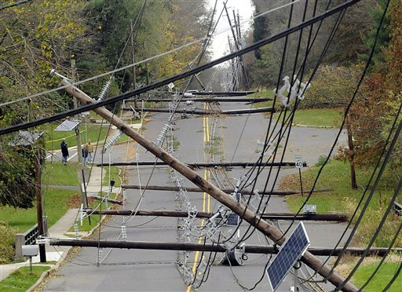
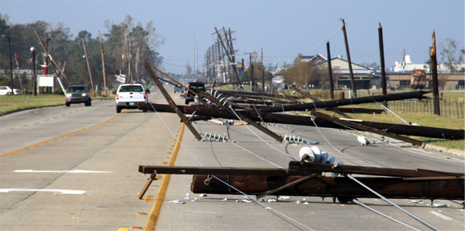
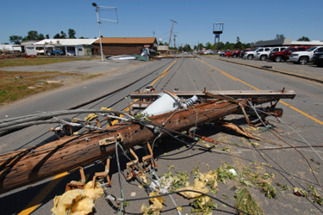
Documentation: Categories of Work
Category F - Utilities
In general, water treatment plants and delivery systems, power generation and distribution facilities (natural gas, wind, power lines, sewage collection systems and treatment plants and communications) are eligible for assistance under the Public Assistance program.
Ineligible items relating to utilities include:
Surveys performed to discover if there are damages to a facility.
Increased operating expenses due to the disaster.
Loss of revenue if a utility is shut down due to the disaster.
THE FLORIDA DIVISION OF EMERGENCY MANAGEMENT

Slide 58
Documentation: Categories of Work
Category F - Utilities
When collecting data for damage to utilities, the following information should be included in your submission:
Collecting Data on Damaged Utilities
Distinguish Categories | Note the difference in work that could be categorized as either emergency or permanent work projects. Any temporary repairs would fall under category B.
Note the Purpose | Describe the overall purpose of the utilities. Is it designed to provide power, lighting, communications, etc.?
Describe Damages and Impacts | Describe if the damaged structure can be repaired or if it will need to be replaced. What portion of the structure is damaged? Is it the physical plant, distribution lines, or collection systems? What are the impacts as a result of the damage or loss of the utility system? How many homes do not have service?
THE FLORIDA DIVISION OF EMERGENCY MANAGEMENT

Slide 59
Documentation: Categories of Work
Category G: Parks, Recreational Facilities, and Other
THE FLORIDA DIVISION OF EMERGENCY MANAGEMENT

Slide 60
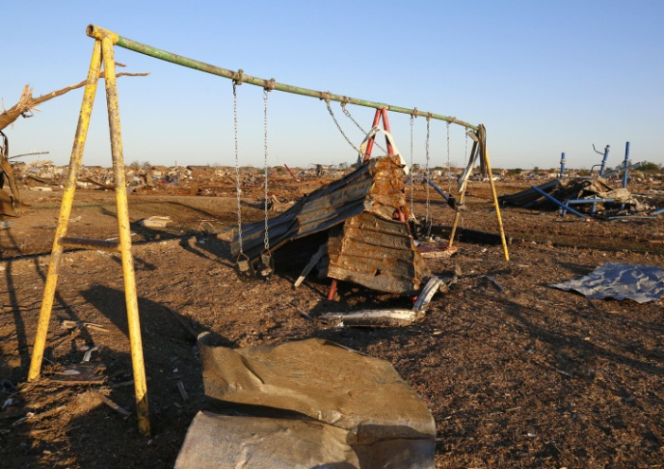
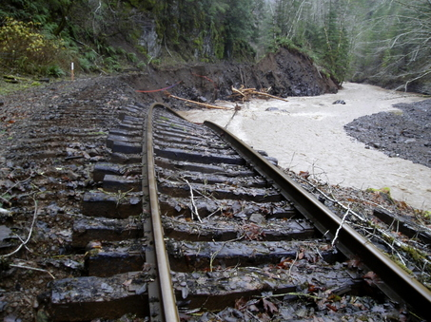
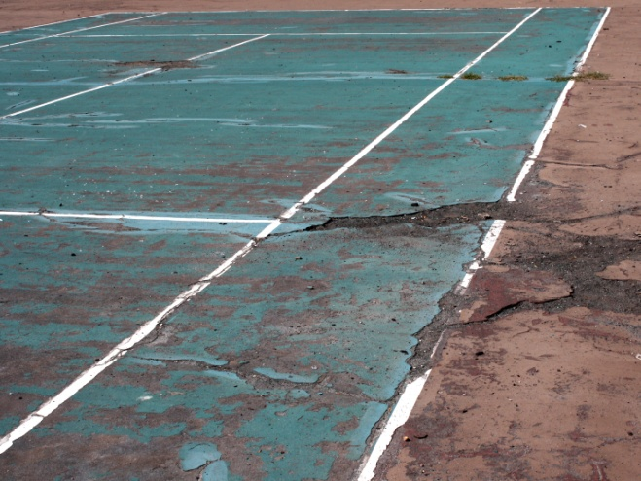
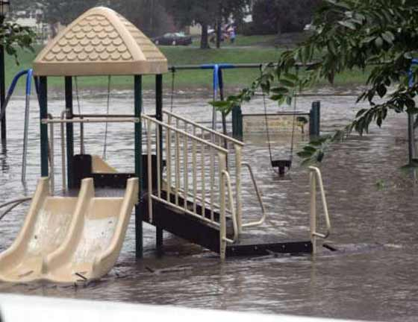
Documentation: Categories of Work
Category G - Parks and Recreation, Other
In general, mass transit facilities such as railways, swimming pools, playground equipment, bath houses, tennis courts, boat docks, piers, golf courses, picnic tables, and other facilities that do not fit into categories C-F are eligible for assistance under the Public Assistance program as category G projects.
Roads, buildings, or utilities located in parks and recreation areas.
Engineered and maintained beaches.
Any grass, trees, or ground cover that is necessary to stabilize slopes and minimize erosion.
THE FLORIDA DIVISION OF EMERGENCY MANAGEMENT

Slide 61
Documentation: Categories of Work
Category G - Parks and Recreation, Other
Ineligible items relating to parks and recreation include:
Replacement of trees, shrubs, or ground cover that is not required for slope stabilization or to minimize erosion.
Private Non-Profit owned parks or recreational facilities and their supporting facilities such as roads, buildings, and utilities.
The replacement of any disturbed ground caused by heavy equipment when any eligible work is performed.
Restoration of sand on natural beaches or berms that is beyond what is necessary for emergency protection.
THE FLORIDA DIVISION OF EMERGENCY MANAGEMENT

Slide 62
Documentation: Categories of Work
Category G - Parks and Recreation, Other
When collecting data for damage to parks and recreation, the following information should be included in your submission:
Collecting Data for Damage to Parks and Recreation, Other
Note the Purpose | Describe the overall purpose of the facility. Is it a park, beach, or recreational facility? What services does it provide to the community?
Describe Damages | Distinguish between damages as a result of the disaster and those that were unmaintained prior to the disaster. Identify any of the structures that are part of the facility including roads or utilities.
Damages to improved or maintained beaches may be eligible for assistance as a category G project. However, there are guidelines that must be followed for beach damages to be eligible.
THE FLORIDA DIVISION OF EMERGENCY MANAGEMENT

Slide 63
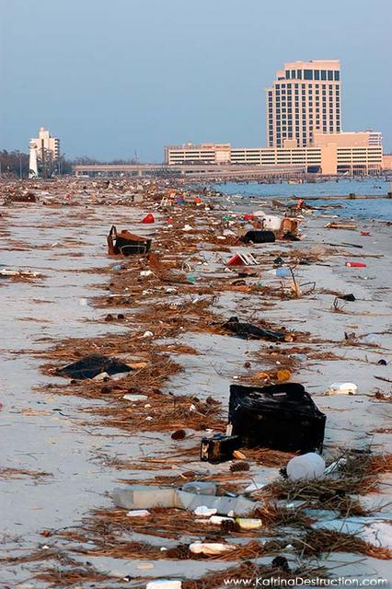
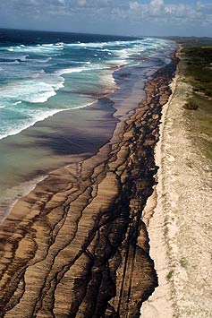
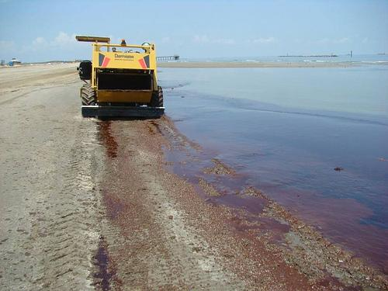
Documentation: Categories of Work
Category G - Parks and Recreation, Other
Damage assessments on beaches are typically a special process performed by the Department of Environmental Protection and the FDEM.
To submit beach damages for assistance, the following documentation will be required:
Design documents and specifications, including analysis of grain size.
“As-built” plans.
Pre and post-storm cross sections of the beach
Documentation related to the regular maintenance and nourishment of the beach.
THE FLORIDA DIVISION OF EMERGENCY MANAGEMENT

Slide 64
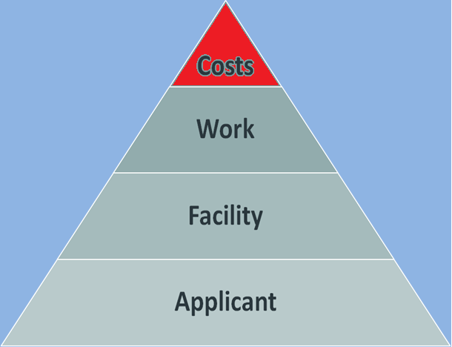
Eligibility: Costs
THE FLORIDA DIVISION OF EMERGENCY MANAGEMENT

Slide 65
Eligibility: Costs
For costs to be eligible for assistance under the Public Assistance program, they must:
Be reasonable and necessary to accomplish the work
Compliant with Federal, State, and local requirements for competitive procurement
Reduced by all applicable credits, such as anticipated insurance proceeds, salvage values and purchase discounts
Eligible Costs
-Costs determined by historical data or national databases
-Replacement materials/equipment used for disaster response
-Mutual Aid reimbursements from assisting governments
-Donated resources/labor, equipment and materials to offset non-Federal share of costs
Ineligible Costs
-Duplication of benefits due to anticipated/actual insurance proceeds
-Loss of normal revenue due to the impacts of the disaster
-Surveys to discover if there are damages to an eligible facility
THE FLORIDA DIVISION OF EMERGENCY MANAGEMENT
Notes:
Costs of surveys to determine building safety may be covered.

Slide 66
Eligibility: Costs
For costs to be considered eligible, it is important that normal procedures are not altered because of the potential for reimbursement from Federal funds.
Reasonable costs can be established through:
the use of historical documentation for similar work
average costs for similar work in the area
published unit costs from national cost estimating databases
FEMA cost codes, equipment rates, and engineering and design services curves
THE FLORIDA DIVISION OF EMERGENCY MANAGEMENT
Notes:
In most cases, the FEMA cost codes are being utilized

Slide 67
Eligibility: Labor Costs
Force Account Labor is performed by the Applicant’s employees, rather than by a contractor. Force account labor costs may be claimed at an hourly rate and include actual wages with fringe benefits.
Although similar, different criteria apply to labor rates for different kinds of employees and work:
Backfill Employees
Temporary Employees
Davis-Bacon Act
Permanent Employees
Regular and Overtime
Fringe Benefits
Contract Supervision
Compensatory Time
Force Account Mechanics
Foremen and Supervisors
Seasonal Employees
National Guard and
Prisoner Labor
Reassigned Employees
THE FLORIDA DIVISION OF EMERGENCY MANAGEMENT

Slide 68
Eligibility: Labor Costs
Permanent Employees
For permanent employees performing debris removal or emergency protective measures only overtime is eligible for reimbursement, regardless of the employee’s normal duties.
For permanent employees performing permanent work (Categories C-G), both regular and overtime costs are eligible for reimbursement.
Overtime or compensatory time for “exempt” employees is not eligible, except where allowed for in written policies.
Seasonal Employees
When covered under existing budgets and used for a disaster during the normal season of employment, seasonal employees are considered permanent employees for the purpose of cost reimbursement.
THE FLORIDA DIVISION OF EMERGENCY MANAGEMENT

Slide 69
Eligibility: Labor Costs
Reassigned Employees
As long as a reassigned employee is performing eligible work during a disaster, the labor costs associated with their reassignment are eligible for reimbursement.
For reassigned employees performing permanent work
(Categories C-G), both regular and overtime costs are eligible for reimbursement. For emergency work, only overtime is eligible.
Labor costs associated with reassigned employees will be paid based off of the employee’s normal rate of pay, not the pay level of the work being performed.
Backfill Employees
Backfill employees are those persons tasked to perform the normal duties of a permanent employee while that employee is performing eligible disaster-related work.
THE FLORIDA DIVISION OF EMERGENCY MANAGEMENT

Slide 70
Eligibility: Labor Costs
Backfill Employees Continued…
If the backfill employee is an extra hire, the cost of the employee represents an extra cost to the Applicant. Therefore, straight time salary, benefits, and overtime costs associated with the employee are eligible for reimbursement.
If the backfill employee is a regular employee of the Applicant, there is no extra cost incurred by the Applicant. Therefore, only the overtime costs associated with the employee are eligible for reimbursement.
If the employee is called in on a weekend or other day off, this represents an extra cost to the Applicant. In those instances, straight time, benefits, and overtime costs are eligible for reimbursement.
If the employee is called in from vacation, no extra cost is being incurred by the Applicant. In those instances, only overtime costs are eligible for reimbursement.
THE FLORIDA DIVISION OF EMERGENCY MANAGEMENT

Slide 71
Eligibility: Labor Costs
Temporary Employees
Temporary employees are extra personnel hired as a direct result of the disaster to perform eligible work.
Regular and overtime costs are eligible for reimbursement for both emergency and permanent eligible work.
Force Account Mechanics
Time spent maintaining and repairing Applicant-owned equipment is not eligible.
Foremen and Supervisors
Labor for both foremen and supervisors may be eligible if their workforces are engaged in disaster-related field activities. Salaries of commissioners, mayors, department directors, police and fire chiefs, and other administrators are not eligible for reimbursement.
THE FLORIDA DIVISION OF EMERGENCY MANAGEMENT

Slide 72
Eligibility: Labor Costs
Contract Supervision
Reasonable costs of contractors hired to accomplish emergency work
are eligible for reimbursement.
Regular time salaries of the Applicant’s employees overseeing
contractors performing emergency work are not eligible.
Regular time salaries of force account labor for overseeing contractors performing permanent work are eligible.
National Guard Labor and Prisoner Labor
Costs of using National Guard personnel to perform eligible work are eligible to the extent that those costs are being paid by the State.
Prisoner labor costs are eligible at the rate normally paid to prisoners (which includes transportation, extraordinary costs of guards, food, and lodging).
THE FLORIDA DIVISION OF EMERGENCY MANAGEMENT

Slide 73
Eligibility: Labor Costs
Employee
Emergency
Emergency
Permanent
Permanent
Regular
OT
Regular
OT
Permanent Employees
N
Y
Y
Y
Part Time Employees
N
Y
Y
Y
Reassigned Employees
N
Y
Y
Y
Temporary Employees
Y
Y
Y
Y
THE FLORIDA DIVISION OF EMERGENCY MANAGEMENT

Slide 74
Eligibility: Labor Costs
Compensatory Time
If the Applicant has a written policy in place prior to the disaster for providing compensatory time in place of overtime, FEMA reimbursement will be based on that policy.
Fringe Benefits
Fringe benefits that are actually paid or credited as part of an established policy are eligible. Due to the fact that certain items in a benefit package are not dependent on hours (i.e. health insurance), regular and overtime rates are generally different.
THE FLORIDA DIVISION OF EMERGENCY MANAGEMENT

Slide 75
Eligibility: Materials and Equipment
Materials
The cost of supplies that were purchased or taken from an Applicant’s stock and used during the performance of eligible work is eligible for reimbursement.
Equipment
Equipment will be reimbursed using an hourly rate, with the exception of automobiles and pick-up trucks which may be reimbursed based upon mileage (if less costly than the hourly rate).
Equipment rates include operation (including fuel), insurance, depreciation, and maintenance. They do not however include the labor of the operator.
Stand-by time for equipment may be eligible.
THE FLORIDA DIVISION OF EMERGENCY MANAGEMENT

Slide 76
Eligibility: Materials and Equipment
Equipment Rates: FEMA recognizes three types of equipment rates-
FEMA Rates- if an Applicant does not have established local or State rates, FEMA rates will be applied to all equipment costs. FEMA rates are published and applicable nation wide.
State Rates- an Applicant may claim rates that were developed using State guidelines up to $75 per hour. Rates over $75 per hour will be approved on a case-by-case basis.
Local Rates- established rates developed by local governments can be used for the purpose of reimbursement.
THE FLORIDA DIVISION OF EMERGENCY MANAGEMENT

Slide 77
Eligibility: Materials and Equipment
Equipment and Supplies Purchased for Disaster Use
In instances where an Applicant does not have sufficient equipment and supplies to respond to a disaster in an effective manner, it may be necessary to purchase equipment and supplies.
Equipment: tangible, non-expendable, personal property having a useful life of more than one year and an acquisition cost of $5,000 or more per unit.
Supplies: all tangible personal property other than equipment.
Items > $5,000: the Applicant will be required to compensate FEMA for the federal share of the costs at a current fair market value when the items are no longer needed for the disaster.
Items < $5,000: the Applicant may sell or dispose of the items with no compensation to FEMA.
THE FLORIDA DIVISION OF EMERGENCY MANAGEMENT

Slide 78
Eligibility: Project Supervision and Management Costs
Project Supervision and Management Costs
Eligible supervisory and management costs need to be identified and claimed separately. FEMA recognizes the following items as eligible management costs:
Supervision and Management by Force Account
Project Management Activities
Master Service Agreements
Administrative Allowances
THE FLORIDA DIVISION OF EMERGENCY MANAGEMENT

Slide 79
Eligibility: Project Supervision and Management Costs
Supervision and Management by Force Account
Expenses for administration, management activities and costs associated with second level supervisors must be attributable to a specific project to be eligible for reimbursement.
Regular time salaries of permanent personnel who supervise or manage emergency work are not eligible. Only overtime costs for emergency work are eligible for reimbursement.
Costs associated with first line supervisors of permanent work are eligible for reimbursement.
THE FLORIDA DIVISION OF EMERGENCY MANAGEMENT

Slide 80
Eligibility: Project Supervision and Management Costs
Project Management Activities
Project management is oversight of an eligible project from the design phase to the completion of work. These activities must coincide with activities that would be performed in the absence of Federal funding.
direct management of projects in the concept and design phases that are being designed by in-house or contracted personnel
procurement activities for architectural/engineering services and performance of work
review and approval of the project design regardless of who performs the design work
management of construction work by contractors
THE FLORIDA DIVISION OF EMERGENCY MANAGEMENT

Slide 81
Eligibility: Project Supervision and Management Costs
Administrative Allowances
Applicants are allowed to claim reasonable administrative costs associated with administering their PA Program grants.
Administrative allowance covers both direct and indirect costs incurred in requesting, obtaining, and administering PA grants:
identifying damage
attending the Applicants’ Briefing
establishing files, and providing copies of documentation
working with the State during project monitoring, final inspection, and audits
THE FLORIDA DIVISION OF EMERGENCY MANAGEMENT

Slide 82
Eligibility: Project Supervision and Management Costs
Administrative Allowances (Post 2007 Events)
Direct Administrative Costs (DAC): costs incurred by the Subrecipient that can be identified separately and assigned to a specific project.
If a project is completed when written, the actual direct administrative costs will be included in the PW.
If a project is not complete at the time the PW is written, an estimate will be included in the PW. Estimates can not be based upon a percentage of project costs.
“The Subrecipient is requesting direct administrative costs that are directly chargeable to this specific project. Associated eligible work is related to administration of this PA project only and in accordance with 44 CFR 13.22. These costs are treated consistently and uniformly as direct costs in all Federal awards and other Subrecipient activities, and are not included in any approved indirect cost rates.” – FEMA Project Worksheet
THE FLORIDA DIVISION OF EMERGENCY MANAGEMENT

Slide 83
Eligibility: Mutual Aid Agreements and Contracts
Mutual Aid Agreements
FEMA will reimburse mutual aid costs for eligible emergency work, when requested by the Applicant (the receiving entity) if:
reimbursement to the providing entity is not contingent on the receipt of Federal funding;
the assistance is for the performance of eligible work;
the claimed costs are reasonable;
the work accomplished, the billing for assistance, and the payment for the assistance can be documented; and
the claimed costs are in accordance with FEMA’s mutual aid policy.
THE FLORIDA DIVISION OF EMERGENCY MANAGEMENT

Slide 84
Eligibility: Mutual Aid Agreements and Contracts
Mutual Aid Agreements Continued…
If a pre-event agreement provides for reimbursement after an initial period of unpaid assistance, FEMA will pay the eligible costs of assistance after the initial unpaid period.
When a pre-event mutual aid agreement provides for reimbursement and there is a consistent record of reimbursement without Federal funds, FEMA reimbursement will follow the provisions set forth in the agreement.
EMAC Agreements
Under EMAC agreements, there are two types of work that may be eligible: grant management and emergency work. All reimbursement must be requested by the receiving entity.
THE FLORIDA DIVISION OF EMERGENCY MANAGEMENT

Slide 85
Eligibility: Engineering and Design Services
Engineering and Design Services
The costs of basic engineering and design services performed by architectural-engineering firms on construction projects are eligible for reimbursement. Such costs include:
preliminary engineering analysis
preliminary design
final design
construction inspection
Costs can be estimated during project formulation using a percentage of the construction cost, and then verified during final inspection.
THE FLORIDA DIVISION OF EMERGENCY MANAGEMENT

Slide 86
Project Worksheet Formulation and Submission
THE FLORIDA DIVISION OF EMERGENCY MANAGEMENT

Slide 87
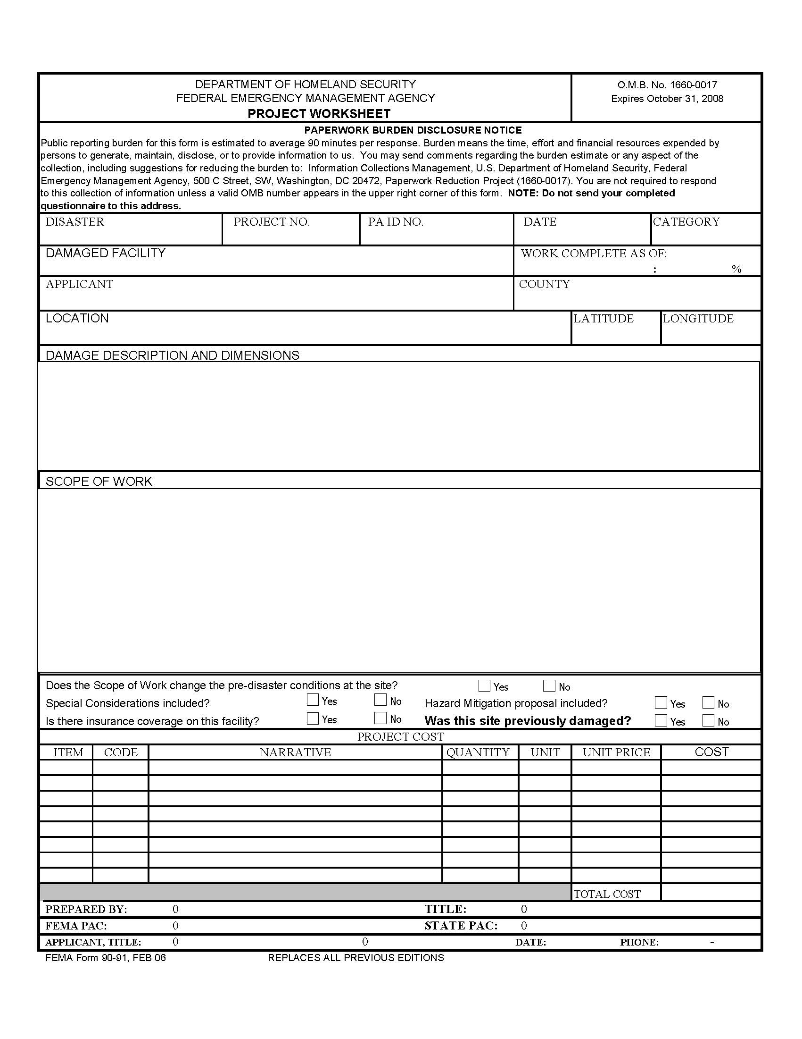
The Project Worksheet
Includes:
  Location (latitude & longitude)
  Category of Work
  Applicant
  County
  Specific Project Number
  Damage Descriptions
  Scope of Work
  % Work Complete
  Cost Line Items
  Special Considerations
THE FLORIDA DIVISION OF EMERGENCY MANAGEMENT
Notes:
This is just the first page of a project worksheet. Usually developed in electronic form, it has additional pages that include other pertinent information.
SOW – if any deviation from FEMA Approved version – new version is needed and FEMA approval must be given

Slide 88
Special Considerations
THE FLORIDA DIVISION OF EMERGENCY MANAGEMENT

Slide 89
Project Formulation
Project Formulation
Combining Work and Creating Projects
Applicants may combine work items into projects in a way that is organized around the Applicant’s needs.
Projects may consist of one item of work or work that occurs at multiple sites.
Method | Explanation
Type of Facility | An Applicant could combine all sewer pump stations or gravel roads together
System | An Applicant could combine repair of several breaks in a water distribution system together
Boundaries | An Applicant may have divided power lines into sectors or a road department into divisions for ease of operations
Method of Work | One contract could be a project or a group of contracts let to one contractor could be a project
THE FLORIDA DIVISION OF EMERGENCY MANAGEMENT

Slide 90
Project Formulation
Damage Description and Dimensions
All damage must be documented and damage sustained as a direct result of the disaster should be differentiated from pre-existing or non-disaster related damage.
The specific cause of damage must relate to the incident for which the disaster was declared.
The damage must be described in terms of the facility, features, or items requiring repair. They must also be described in quantitative terms with physical dimensions.
In instances where emergency protective measures were performed, the project will need to contain a brief description of the threat and of the threatened improved property.
THE FLORIDA DIVISION OF EMERGENCY MANAGEMENT

Slide 91
Project Formulation
Scope of Work
The scope of eligible work necessary to repair disaster related damage must specify actions in quantifiable and descriptive terms. Any costs associated with damages not included in the project’s scope of work will not be reimbursed by FEMA.
Information that is pertinent to the project’s scope of work should also be documented:
eligible codes and standards
evidence of pre-disaster damage and pre-disaster inspection reports
hazard mitigation proposal, if being proposed
whether or not the project is an improved or alternate project
THE FLORIDA DIVISION OF EMERGENCY MANAGEMENT

Slide 92
Project Formulation
Cost Estimates
FEMA may grant funds on the basis of actual costs or on estimates of work to be completed.
There are three primary methods for determining costs:
Time and Materials
Unit Cost
Contracts
If work has already been completed when the project is written, the project should be written based on the actual costs that were incurred by the Applicant.
THE FLORIDA DIVISION OF EMERGENCY MANAGEMENT

Slide 93
Project Formulation
Time and Materials
The time and materials method is used to summarize actual costs of force account labor, equipment, and materials.
Costs must be documented by:
payroll information
equipment logs or usage records
invoices and receipts
work orders
If using the nationally publicized FEMA rates, Applicants will need to account for operator costs separately.
THE FLORIDA DIVISION OF EMERGENCY MANAGEMENT

Slide 94
Project Formulation
Project Formulation
Unit Cost
The unit cost method is used to develop PWs for work to be completed and unit costs are applied to specific elements of a project’s scope of work.
Unit prices are based on in-place costs including site preparation, materials, labor, equipment, insurance, overhead, and profit (if by contract).
Several sources may be used in preparing estimates based on unit costs:
State or local data from previously completed projects
commercial estimating sources
FEMA cost codes
THE FLORIDA DIVISION OF EMERGENCY MANAGEMENT

Slide 95
Project Formulation
Formulation
Contracts
Contract pricing is used to determine the cost of work for which an Applicant has used labor, equipment, and material from an outside source.
All contracts must be awarded following Federal and State procurement guidelines.
If work has not begun on a project, but a contract has been bid or let, the contract price may be used in the development of the project worksheet.
THE FLORIDA DIVISION OF EMERGENCY MANAGEMENT

Slide 96
Project Worksheet Submission
Overview
Project Worksheet (PW): the primary form used to document the location, damage description and dimensions, scope of work, percentage of work completed, cost line items, special considerations, and project type. It is the basis for the grant. Project worksheets are divided into small and large projects.
Once broken into categories, a project is then broken down by size.
Projects are processed as either small or large projects. If the project cost is less than $123,100 the project is processed as a small project. If the project cost equals or exceeds $123,100 the project is processed as a large project. To be eligible for assistance, a project must meet a minimum threshold of $3,100.
Small Projects < $123,100 | Large Projects > $123,100
Federal cost share is paid upon project approval. | Federal cost share is paid as work is accomplished.
Funding is based on an initial cost estimate. | Final assistance is based upon actual costs or an estimate using the Cost Estimating Format.
THE FLORIDA DIVISION OF EMERGENCY MANAGEMENT
Notes:
Minimum project cost is $3,050.00. Several small cost projects can be combined to achieve the minimum cost threshold.

Slide 97
Obligation and Closeout
The signed project worksheets (PW’s) are then sent to the Joint Field Office (JFO) for processing and submission to FEMA.
Once obligated:
  Small projects paid immediately.
  Large projects need Request for Reimbursement (RFR) and back up documentation (checks, invoices, timesheets) on FloridaPA.org website.
Closeout:
  Small projects may be verified for completion.
  ALL large projects are verified with back-up documentation to ensure match with Scope of Work (SOW).
THE FLORIDA DIVISION OF EMERGENCY MANAGEMENT
Notes:
Hold on to your DOCUMENTATION. Audits can take place for projects written on estimates, and actual invoices will be requested and reconciled.
TAKE PICTURES – they really are worth a thousand words.
2) If there’s an insurance adjustment correspondingly there should be an adjustment on the “Anticipated Insurance Proceeds”.
3) GRANTEE must double check to see if FEMA verified O&M on small projects. If FEMA has not, DO NOT advance!

Slide 98
Funding Options
THE FLORIDA DIVISION OF EMERGENCY MANAGEMENT

Slide 99
Funding Options
Overview
Funding Options
An Applicant has the option to use a Public Assistance grant for activities that are outside of the originally approved scope of work. Funding options include:
Improved Projects
Alternate Projects
Mitigation Projects
Sandy Recovery Improvement Act of 2013
Debris Pilot Program
Alternative Procedures for Permanent Work
THE FLORIDA DIVISION OF EMERGENCY MANAGEMENT

Slide 100
Overview
Funding Options: Improved Projects
When performing permanent restoration work on a damaged facility, an Applicant may decide to use the opportunity to make improvements to the facility while still restoring its pre-disaster function and at least its pre-disaster capacity. This is called an improved project.
Applicants can request an improved project for either a small or large project.
Time limits that would be associated with repairing the damaged facility to its pre-disaster design apply to the improved project construction.
Funding is limited to the Federal share of the costs that would be associated with repairing or replacing the damaged facility to its pre-disaster design, or to the actual costs of completing the improved project, whichever is less.
Applicants must obtain approval for an improved project from the State prior to the start of construction.
THE FLORIDA DIVISION OF EMERGENCY MANAGEMENT

Slide 101
Overview
Funding Options: Alternate Projects
In the event that an Applicant determines that the public welfare would not be best served by restoring a damaged site/facility or its function, they may use the PA grant for that site/facility for other eligible purposes. This is called an alternate project.
Applicants can request an alternate project in lieu of either a small or large project, but only on permanent restoration projects.
Alternate project funding may be used to repair or expand other selected public facilities, to construct new facilities, to demolish the original structure, to purchase equipment, to cover NFIP SFHA insurance reductions, or to fund cost-effective hazard mitigation activities.
Funds cannot be used for operating costs or to meet the State or local share requirement on other PA projects.
The alternate project must serve the same general area that was being served by the originally funded project.
The original facility must be rendered safe and secure, sold, or demolished.
All requests for alternate projects must be made within 12 months of the Kickoff Meeting and must be approved by FEMA prior to construction.
THE FLORIDA DIVISION OF EMERGENCY MANAGEMENT

Slide 102
Overview
Funding Options: Alternate Projects
Funds for alternate projects for publicly owned facilities are limited to 90% of the approved Federal share of the estimated eligible costs associated with repairing the damaged facility to its pre-disaster design, or 90% of the Federal share of actual costs of completing the alternate project, whichever is less.
Example: If an Applicant has an obligated project in the amount of $130,000 and applies to FEMA to complete an alternate project, the funding for that project would be adjusted as follows:
$130,000 eligible damage
- $30,000 insurance reduction
$100,000 new eligible amount
x .9 to adjust for 10% reduction
$90,000 new project amount
x .75 Federal cost share
$67,500
maximum amount of Federal funds Applicant may receive. Applicant must spend at least $90,000 on the approved alternate projects to receive $67,500 of Federal funds.
THE FLORIDA DIVISION OF EMERGENCY MANAGEMENT

Slide 103
Overview
Funding Options: Mitigation Projects
Hazard Mitigation: cost effective action taken to prevent or reduce the threat of future damage to a facility.
The Stafford Act provides for two types of funding for hazard mitigation programs: statewide mitigation programs (404) and mitigation for disaster-damages facilities (406).
404 Hazard Mitigation | 406 Hazard Mitigation
Separate program run by the State. | Implemented through the PA Program.
Applies to structural measures and to non-structural measures (such as planning, property acquisition, drainage projects). | Applies only to structural measures and does not apply to buyouts.
Applies throughout the State in most disasters. | Must apply to the damaged element of the facility.
The formula for calculating the HMGP allocation for States with a standard State mitigation plan is based on 15% of the first $2 billion of estimated aggregate amounts of disaster assistance. For amounts greater than $2 billion, a sliding scale is used to make allocation determinations. States with enhanced mitigation plans are eligible for a 20% HMGP formula. | No program-wide limits on funds, but each project must be cost-effective and approved by FEMA.
THE FLORIDA DIVISION OF EMERGENCY MANAGEMENT

Slide 104
Debris and Special Considerations Program
Applicant Briefing
THE FLORIDA DIVISION OF EMERGENCY MANAGEMENT

Slide 105
Debris Management and
Monitoring
THE FLORIDA DIVISION OF EMERGENCY MANAGEMENT

Slide 106
Debris
DEBRIS MANAGEMENT:
Use of FDEP Pre-Authorized DDMS is approved by the FDEP EFO
FDEP must be notified as soon as you begin using the Pre-Authorized DDMS
Document commencement of debris removal
FEMA requires detailed documentation of all debris operations
THE FLORIDA DIVISION OF EMERGENCY MANAGEMENT
Notes:
ON THE ALTERNATIVE PROCEDURES PILOT PROGRAM HANDOUT
PAGE 4
Accelerated Debris Removal:
Applicants may opt to use the Accelerated Debris Removal Increased Cost Share:
This is NOT one time use. It can be used more than once.
Debris removed within 30 days is reimbursed at 85%
Debris removed from 31 to 90 days is reimbursed at 80%
Debris removed from 91 to 180 days is reimbursed at 75%
No Reimbursement after 180 unless FEMA grants an extension

Slide 107
Debris
DEBRIS MANAGEMENT:
Reduction by burning - FEMA requires a burn authorization from the FDOF
Final disposal of debris must be documented
FDEP site closure inspection letter is required by FEMA
THE FLORIDA DIVISION OF EMERGENCY MANAGEMENT
Notes:
ON PAGE 5 OF THE ALTERNATIVE PROCEDURES PILOT PROGRAM HANDOUT
Recycling Revenues:
This can be used more than once.
Subgrantees may retain revenues received through recycling eligible disaster debris.
Notification of revenues received from recycling is to be provided as part of the final accounting of actual costs.
It should include:
The completion date of debris removal operations
Brief description of the quantity and type of debris recycled
The cost for processing debris recycling

Slide 108
Debris
DOCUMENTATION:
FDEP Pre-Authorized DDMS letter
FDEP acknowledgement of use of DDMS
Burn authorization from the FDOF
FDEP site closure inspection letter
Debris Removal Contract
Debris Monitoring Contract
THE FLORIDA DIVISION OF EMERGENCY MANAGEMENT
Notes:
ON THE ALTERNATIVE PROCEDURES PILOT PROGRAM HANDOUT
PAGE 6
Straight Time Force Account Labor:
Can be used more than once
FEMA will now reimburse the base and overtime wages for existing employees and hiring of additional staff.
The subgrantee must use their own force account labor to remove debris.

Slide 109
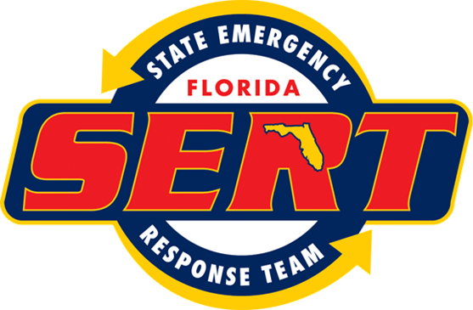

FEMA Supercircular - Procurement 2CFR Part 200
THE FLORIDA DIVISION OF EMERGENCY MANAGEMENT

Slide 110
Procurement
All new procurements must be thoroughly documented and be consistent with 2 CFR Part 200.317-.326 and Appendix 200
2 CFR Part 200.318(a) - The non-Federal entity must use its own documented procurement procedures which reflect applicable State, local and tribal laws and regulations, provided that the procurements conform to applicable Federal law and the standards identified in this part.
THE FLORIDA DIVISION OF EMERGENCY MANAGEMENT

Slide 111
Procurement (Cont’d)
2 CFR Part 200.319(a) – The non-Federal entity must conduct procurements in a manner that prohibits the use of statutorily or administratively imposed state, local, or tribal geographical preferences in the evaluation of bids or proposals
2 CFR Part 200.319(d) - Cost plus percentage of cost contracts must not be used
2 CFR Part 200.319(j)(1) - The non-Federal entity may use a time and materials type contract only after a determination that no other contract is suitable and if the contract includes a ceiling price that the contractor exceeds at its own risk.
THE FLORIDA DIVISION OF EMERGENCY MANAGEMENT

Slide 112
Procurement (Cont’d)
2 CFR Part 200.321(a) - The non-Federal entity must take all necessary affirmative steps to assure that minority businesses, women's business enterprises, and labor surplus area firms are used when possible
2 C.F.R. Part 200.325 - Bonding requirements:
  Bid Guarantee – 5% of the Bid Price
  Performance Bond – 100% of the contract price
  Payment Bond – 100% of the contract price
THE FLORIDA DIVISION OF EMERGENCY MANAGEMENT

Slide 113
Procurement (Cont’d)
FEMA’s PDAT has been activated and will be conducting training
The applicant’s attorney(s) is the best available source of information
FDEM’s legal team is available to answer questions from the applicant’s attorney
Contact:
Michael T. Kennett
Chief Legal Counsel
(850) 922-1676
Michael.Kennett@em.myflorida.com
THE FLORIDA DIVISION OF EMERGENCY MANAGEMENT

Slide 114
FEMA Public Assistance Grant Program - Insurance
Barbara Cartwright
Insurance Specialist
October 2016
THE FLORIDA DIVISION OF EMERGENCY MANAGEMENT

Slide 115
General Insurance – Duplication of Benefits
FEMA cannot provide PA funding that duplicates insurance proceeds per Stafford Act § 312, 42 U.S.C. § 5155, and 2 CFR § 200.406.
Therefore
FEMA reduces total eligible costs by the amount of:
Actual insurance proceeds, if known; 44 CFR §§ 206.252(c) and 253(a)
OR
Anticipated insurance proceeds based on the Applicant’s insurance policy, if the amount of actual insurance proceeds is unknown
THE FLORIDA DIVISION OF EMERGENCY MANAGEMENT
Notes:
Not just insurance - No duplication of any benefits – salvage over $5,000.
The reduction is from the total eligible costs regardless of the insurance deductible.
If Total Eligible Costs are reduced by Anticipated Insurance Proceeds – send in your claim settlement documentation (Statement or Proof of Loss) for a reconciliation of Actual insurance proceeds. DO NOT WAIT for final closeout. Do ASAP in case you’re entitled to additional insurance payments or need to file an additional claim for benefits.

Slide 116
General Insurance – Claim Filing
FEMA requires the Applicant to take reasonable efforts to pursue claims to recover insurance proceeds that it is entitled to receive from its insurer(s)
If the Applicant expends costs to pursue its insurance claim, FEMA offsets the insurance reduction with the Applicant’s reasonable costs to pursue the claim
THE FLORIDA DIVISION OF EMERGENCY MANAGEMENT
Notes:
Insurance comes first. File claim with insurance company ASAP. There have been Applicants who haven’t filed with their insurance company because FEMA funding was available.
Available coverage – Could or should have filed a claim for insurance proceeds for a covered loss OR
A “settlement” was taken for “pennies on the dollar”. An Applicant can make a decision to settle a claim for less than the full amount of insurance coverage for a variety of reasons, but FEMA will reduce the Total Eligible Costs by the dollar amount that was AVAILABLE.
Costs related to pursuing a claim. Must advise FEMA of this action and keep them apprised of on going claim settlement actions and costs must be “reasonable”. Attorney fees vary.

Slide 117
Requirement to Obtain & Maintain
Applicants that receive PA funding for permanent work to replace, repair, reconstruct,
or construct a facility must obtain and maintain insurance to protect the facility against future loss, Stafford Act § 311, 42 U.S.C. 5154, and 44 CFR 206 Subpart I
This requirement applies to insurable facilities or property (buildings, contents, equipment, and vehicles). FP 206-086-1, Public Assistance Policy on Insurance, describes these requirements in detail
THE FLORIDA DIVISION OF EMERGENCY MANAGEMENT
Notes:
If an Obtain and Maintain insurance requirement is placed on a “facility” in a PW then FEMA is required to obtain proof of the purchase of such insurance PRIOR to obligating and releasing funding for the PW.
O&M is facility specific, coverage type specific (wind, flood, earthquake) and $ specific
Keep in mind, compliance with Obtain and Maintain will be verified at the closeout of the PW because a current insurance policy is required closeout documentation. If the coverage is not in effect – funding will be deobligated AND the facility looses its eligibility for the current and future disasters regardless of which type of peril caused the loss. Also, the facility looses its eligibility for any other type of federal funding (HUD – DHS Domestic Preparedness grants)

Slide 118
Requirement to Obtain & Maintain (Cont’d)
The Applicant must insure facilities with the types and extent of insurance reasonably available, adequate, and necessary to protect against future loss to the property Stafford Act § 311, 42 U.S.C. 5154, and 44 CFR 206 Subpart I
The type of insurance refers to the hazard(s) that caused the damage and extent refers to the amount of insurance required, which is calculated based on the eligible costs prior to any reductions (including the non-Federal share reduction)
The Applicant is not required to obtain and maintain insurance on facilities with less than $5,000 in eligible costs (prior to any reductions) 44 CFR § 206.253(d)
THE FLORIDA DIVISION OF EMERGENCY MANAGEMENT
Notes:
O&M is facility specific, coverage type specific (wind, flood, earthquake) and $ specific
Keep in mind, compliance with Obtain and Maintain will be verified at the closeout of the PW because a current insurance policy is required closeout documentation. If the coverage is not in effect – funding will be deobligated AND the facility looses its eligibility for the current and future disasters regardless of which type of peril caused the loss. Also, the facility looses its eligibility for any other type of federal funding (HUD – DHS Domestic Preparedness grants)

Slide 119
Insurance - Prior Loss Reductions
When the Applicant receives PA funding for a facility damaged by the same hazard in a subsequent disaster, FEMA reduces funding in this subsequent disaster by the amount of insurance required from the previous disaster
THE FLORIDA DIVISION OF EMERGENCY MANAGEMENT
Notes:
Again, FEMA pays for insurable property 1 time – in the 2nd disaster there would be insurance but it wouldn’t be sufficient based on the amount of total eligible costs for the PW.
Again, based on insurance payments which are available under the policy.
FEMA does not always fund deductibles (or self-insured retentions) – this is a common misconception.
Applicants tend to insure with either a blanket policy or a scheduled policy, and usually have a deductible that is a percentage of the Total Insured Values (TIV) at a location or a flat property amount. 3%-5% is common.
FEMA will only pay a deductible/SIR if the current declaration is the only time Federal funding has been requested for the location, or if the current deductible/SIR is higher than the amount of damages identified as eligible in a previous disaster.

Slide 120
Vector Control
Henry Hernandez – State Debris & Special Considerations Officer
Ginger Shirah – State Deputy Environmental Officer
October 2016
THE FLORIDA DIVISION OF EMERGENCY MANAGEMENT
Notes:
In the wake of an emergency, mosquitos may present a problem to safety and hamper the response effort.
Take the necessary actions to prevent a health and safety threat as soon as possible, but know the rules for reimbursement following a Presidential Disaster Declaration.
FEMA may provide reimbursement at the written request of the State or local public health officials. Verification of the threat by the State and local health agencies in accordance with established ordinances is required.
The eligible costs are calculated by comparing the disaster-related costs to the most recent 3 non-disaster years of expenses for the same period.

Slide 121
Vector control
DOCUMENTATION:
3 years baseline data: Cost of equipment, labor and materials for the same months of this event
Surveillance trap data that indicates an increase in mosquito populations created by the storm
A letter from the county health department indicating a serious health threat or mosquito nuisance hampering the recovery operations
Aerial maps showing the areas to be sprayed and the trap locations
THE FLORIDA DIVISION OF EMERGENCY MANAGEMENT
Notes:
Three years of baseline data.
Trap data (for adulticide use) or dip data (for larvicide use) must be collected verifying the hazard.
Letter from the health department indicating a serious health threat or a mosquito nuisance that is severely hampering the recovery effort.
Spay/dip area maps detailing the zones affected.
The chemical used, application method and concentration used. Chemical must be an EPA approved chemical for use in Florida.
Dates of application

Slide 122
Vector control (cont’d)
Information on the chemicals and concentrations used. Must be approved for use in Florida by the EPA
The dates of applications
If spraying over State lands authorization from the Florida Dept. of Environmental Protection must be obtained
No spray operation may be conducted in “No Spray Zones” designated by the US Fish and Wildlife Service
THE FLORIDA DIVISION OF EMERGENCY MANAGEMENT
Notes:
“No Spray Zone Maps” are recently updated by the USFWS. Please let us know if you need this information! Comes as a shapefile for GIS program.

Slide 123
Environmental and Historic Preservation
THE FLORIDA DIVISION OF EMERGENCY MANAGEMENT
Notes:
Road and bridge repair is often essential after a storm. Many times, priority is given to roadway repairs for access to emergency and essential services.
Road and bridge work can be critically important, however proper documentation for FEMA reimbursement will be required.
The required documentation includes: Location of borrow pit or stock pile where the fill material was taken from, documentation of whether or not the borrow pit was expanded horizontally, permits or exemption letter from FDEP and the USACE, and public notice if required.

Slide 124
Roads - culverts - Bridges
DOCUMENTATION:
Location of borrow pit or stock pile where fill material was taken (Name of owner, GPS coordinates, physical address)
A statement from the applicant that the borrow pit was not extended horizontally while taking fill material
If in wetlands or a floodplain:
Permit or Exemption Letter from FDEP
Permit or Letter from the USACE acknowledging use of a Nationwide Permit
Possible Consultation with the local Floodplain Manager
Possible requirement for a Public Notice
THE FLORIDA DIVISION OF EMERGENCY MANAGEMENT
Notes:
Road and bridge repair is often essential after a storm. Many times, priority is given to roadway repairs for access to emergency and essential services.
Road and bridge work can be critically important, however proper documentation for FEMA reimbursement will be required.
The required documentation includes: Location of borrow pit or stock pile where the fill material was taken from, documentation of whether or not the borrow pit was expanded horizontally, permits or exemption letter from FDEP and the USACE, and public notice if required.
Under Section 106 of the National Historic Preservation Act, FEMA must consult with the State Historic Preservation Officer (SHPO) for most road work (because of the ground disturbance). In order to do this, details of the fill source for the road work is required for all pits used, including commercial.
Include these details in the Scope Of Work:
Material used (e.g., sand, lime rock, shell rock, etc.).
Location of the borrow pit (latitude/longitude).
Verification of whether the pit has been expanded outside of its original footprint or permitted area

Slide 125
Roads - culverts – Bridges (Cont’d)
DOCUMENTATION:
If replacing culverts:
A detailed scope of work is essential
A change in the size or number of culverts used may trigger a requirement for a hydrology study
May require a permit from the FDEP and/or the USACE
If the work is in or upstream of an endangered/protected species or their critical habitat, there are specific guidelines for size and placement of culverts to be used and certification by a Professional Engineer that the work was conducted in accordance specifications provided in the guidelines
THE FLORIDA DIVISION OF EMERGENCY MANAGEMENT
Notes:
Culvert repair/replacement typically requires permitting from the FDEP/Water Management District. Some exceptions may be covered in the Emergency Final Order issued by FDEP. Important to note that the exemption does NOT apply if the activity involves up-sizing the culvert. Only in-kind replacement is exempt, but even that is applicable, CHECK WITH FDEP NO MATTER WHAT. Even if it is after-the-fact.
The USACE also provides permits or exemptions for culvert replacement. Please keep copies of correspondence with FDEP and the USACE, even if no permit is required. Their exemptions must be verified at close out.
If the project is taking place in the floodplain, a public notice will be required per Executive Order 11988! Keep copies of the public notice and any public comments received.
Each item of documentation will require GPS coordinates of the culverts themselves. This is good information to keep on hand. Be prepared!

Slide 126
Historic preservation
Any structure in the National Register of Historical Sites, any structure 50 years old or older and any structure with unique architectural features
DO NO WORK until FEMA determines if a SHPO consultation is needed
Contact the FDEM DSCP, your assigned FDEM PAC, or a FEMA PAC immediately
Provide the Historic Register ID Number if known
Provide a detailed description of the damages
Provide a full description of the structure including name if it has one
Provide the build date
Physical address and/or GPS Coordinates
THE FLORIDA DIVISION OF EMERGENCY MANAGEMENT
Notes:
FEMA is responsible for initiating consultation with the State Historic Preservation Officer. If adverse effects are identified, FEMA explores alternatives to avoid or minimize these effects to historic properties.
What is a “Historic property”?
Any district, building, structure, site, or object that is listed or eligible to be listed in the National Register of Historic Places;
Can be significant at the national, state, or local level;
Generally over 50 years old; and retains its integrity
Some common activities that may trigger consultation:
Drainage projects
Demolition
Elevation
Communication Towers
Construction
Tree Removal
Utility improvements

Slide 127
Roads - culverts – Bridges (Cont’d)
DOCUMENTATION:
If replacing culverts:
A detailed scope of work is essential
A change in the size or number of culverts used may trigger a requirement for a hydrology study
May require a permit from the FDEP and/or the USACE
If the work is in or upstream of an endangered/protected species or their critical habitat, there are specific guidelines for size and placement of culverts to be used and certification by a Professional Engineer that the work was conducted in accordance specifications provided in the guidelines
THE FLORIDA DIVISION OF EMERGENCY MANAGEMENT
Notes:
Culvert repair/replacement typically requires permitting from the FDEP/Water Management District. Some exceptions may be covered in the Emergency Final Order issued by FDEP. Important to note that the exemption does NOT apply if the activity involves up-sizing the culvert. Only in-kind replacement is exempt, but even that is applicable, CHECK WITH FDEP NO MATTER WHAT. Even if it is after-the-fact.
The USACE also provides permits or exemptions for culvert replacement. Please keep copies of correspondence with FDEP and the USACE, even if no permit is required. Their exemptions must be verified at close out.
If the project is taking place in the floodplain, a public notice will be required per Executive Order 11988! Keep copies of the public notice and any public comments received.
Each item of documentation will require GPS coordinates of the culverts themselves. This is good information to keep on hand. Be prepared!

Slide 128
beaches
DOCUMENTATION:
Name of beach
Beach location
Portion of beach damaged (use R-monuments and GPS coordinates)
Linear feet of beach damaged
Records of maintenance of beach
Engineer drawings depicting original design
THE FLORIDA DIVISION OF EMERGENCY MANAGEMENT
Notes:
Emergency placement of sand on natural or engineered beaches may be eligible when necessary to protect improved property from an immediate threat.
A beach is considered eligible if:
The beach was constructed by the placement of imported sand of proper grain size to a designed elevation, width and slope;
A maintenance program involving periodic renourishment with imported sand has been established and adhered to by the applicant; and
The maintenance program preserves the original design.
Documentation to provide:
Project location (include R monuments and GPS coordinates from beginning of project to end of project - linear ft),
Records of maintenance (to include previous permits and/or engineered drawings)
Any known sand sources

Slide 129
Beaches (Cont’d)
DOCUMENTATION:
Records depicting condition of beach prior to storm activity
Engineer drawings depicting damage with:
  Dune slope ratio
  Cross section of escarpment length and height
  Fill needed for restoration
  Pictures
  Maps
THE FLORIDA DIVISION OF EMERGENCY MANAGEMENT
Notes:
To demonstrate that the beach is an improved/engineered beach, you must prove that the beach has been routinely maintained prior to the disaster.
Pre-and Post-storm profiles are a HUGE asset in determining storm damage. Keep all beach maintenance records, permits, consultation correspondence, etc.
Post-storm engineered drawings should include:
Dune slope ratio
Cross section of escarpment length and height
Fill needed for restoration
Pictures
Maps

Slide 130
Beaches (Cont’d)
PERMITTING
STATE
FDEP Joint Coastal Permit
  Sand source beach compatibility analysis
  Beach sand source approval
  Special Conditions
  Special Studies
  Reporting Requirements
THE FLORIDA DIVISION OF EMERGENCY MANAGEMENT
Notes:
Permitting for beach projects:
FDEP Joint Coastal Permit (JCP) – through the Beaches, Inlets, and Ports Program.
Required information:
•Type of project (e.g., restoration, nourishment, bypassing, groins, maintenance dredging, jetty rehabilitation);
•Number of events requested (once or as-needed);
•Fill template (lengths, dune crest and berm widths, slopes, and corresponding elevations in North American Vertical Datum (NAVD) down to toe of fill);
•Dredge/equipment type and/or construction method;
•Borrow Areas (indicate if it is an offshore site, an ebb shoal or a flood shoal; specify maximum allowable dredgedepths; indicate the vertical datum NAVD, MLW, MLLW, etc.; and maximum depth);
•Approximate volume to be dredged/filled during single event;
•Upland, nearshore or offshore disposal sites;
•Staging areas, stock piling, access corridors;

Slide 131
Beaches (Cont’d)
FEDERAL
USACE 404 Permit
  Special Conditions for Endangered Species
  Special Reports and Studies
  Reporting Requirements
  Restriction during turtle nesting season
Consultation with USFWS (FEMA EHP)
  At USFWS discretion
  May impose separate or stricter conditions
THE FLORIDA DIVISION OF EMERGENCY MANAGEMENT
Notes:
Upon receipt of the application for a JCP, the FDEP will forward your application to the USACE. USACE will issue their own individual permit (404) specific to dredge and fill activities.
USFWS consultation will be required to comply with the Endangered Species Act. Consultation is initiated by FEMA, but the applicant may be asked to provide information as necessary. The USFWS will issue their own conditions, in what is called a “biological opinion”. These conditions, like permit conditions, must be adhered to! At closeout, the applicant will be required to demonstrate compliance. For example, if the activity is taking place during turtle nesting season, daily monitoring logs may be required.

Slide 132
Floodplains & wetlands
If you are working in a floodplain you are very likely to be in a wetland area
Probably covered under the FDEP EFO
May be an exempt activity under FDEP
May be covered under a USACE NWP
May require consultation with USFWS
THE FLORIDA DIVISION OF EMERGENCY MANAGEMENT
Notes:
Each project must be reviewed to determine if it takes place in a flood zone or wetland area. Executive Order 11988 and 11990 regulate federally funded activities in or affecting the floodplain/wetland area.
This applies to ALL permanent construction and other activities, including debris, roads, bridges, culverts, etc that will affect floodplain. The regulatory floodplain is defined by areas inundated by a 100-year or 500-year rain event. For most projects, any activities occurring in the 100-year floodplain will require analysis under EO 11988. For any activities associated with a critical facility, such as a hospital or fire department, the 500- year floodplain triggers this executive order.
Compliance with this EO can mean many things as we will see on the next slide…

Slide 133
Floodplains & wetlands (Cont’d)
May require consultation with SHPO
May require a permit from FDEP
May require a permit from the USACE
May require consultation with county floodplain manager
May require public notice
THE FLORIDA DIVISION OF EMERGENCY MANAGEMENT
Notes:
Some considerations for working in a floodplain and/or wetland:
Activity may be exempt from review under the FDEP EFO
May be covered under a USACE NWP – must contact them to determine if this applies to your project. DO NOT ASSUME.
May require consultation with USFWS – FEMA will consult
May require consultation with SHPO – FEMA will consult but applicant must provide any relevant information
May require a permit from FDEP – Typically an Environmental Resource Permit. May be issued by the water management district also.
May require a permit from the USACE – must contact them to determine. DO NOT ASSUME.
May require consultation with county floodplain manager – The meeting with the FPM must be documented!
May require public notice – Public notice is OFTEN required for work in a floodplain. Public notice must be in local circular/newspaper.
***Copies of ALL of this documentation (as applicable) WILL be required at closeout.***

Slide 134
Asbestos – Lead paint
DOCUMENTATION:
FEMA EHP Requires certain documentation when a facility being restored contains Asbestos or lead Paint:
Asbestos and/or Lead Paint lab results indicating the presence of the material and type
Removal by a contractor licensed by DBPR to remove the material
Name and address of removal contractor
Name and address of disposal contractor, if different
Landfill receipt indicating proper disposal of the material, type of material and amount
Landfill name, address and identification number (WACS ID #)
THE FLORIDA DIVISION OF EMERGENCY MANAGEMENT
Notes:
Asbestos is well recognized as a health hazard and is highly regulated by the Environmental Protection Agency (EPA) and Occupational Safety Health Administration (OSHA).
The Florida Department of Environmental Protection (DEP) administers an asbestos removal program under Chapter 62-257, Florida Administrative Code. The program's intent is to prevent the release of asbestos fibers to the outside air during demolition or renovation activities.
The program requires prior notification to the DEP on the removal of asbestos.
All of the required information for FEMA projects can be found on FDEP’s Demolition/Renovation Asbestos Form, which is also required to be submitted per Florida Statute. The required notification to FDEP can be done ELECTRONICALLY on their website.
Documentation of compliance with the Clean Air Act will be required at close out (if applicable)!!!!!!!!!!

Slide 135
Special Considerations 9 questions
THE FLORIDA DIVISION OF EMERGENCY MANAGEMENT
Notes:
The Special Considerations questionnaire is used to help evaluate what environmental and historic resources might be involved or affected with any given project.
It is very important to complete the 9 Questions Sheet for each and every project.
An FDEM Environmental Specialist will be available to discuss and assist in completing questions 2 thru 8 of the Special Considerations section for your project.
A “Yes” answer to any of the 9 questions does not mean that the project will not be funded, only that any special issues must be reviewed and resolved in a satisfactory manner prior to obligation of funds.
Answer based on known information, do not guess or assume.

Slide 136
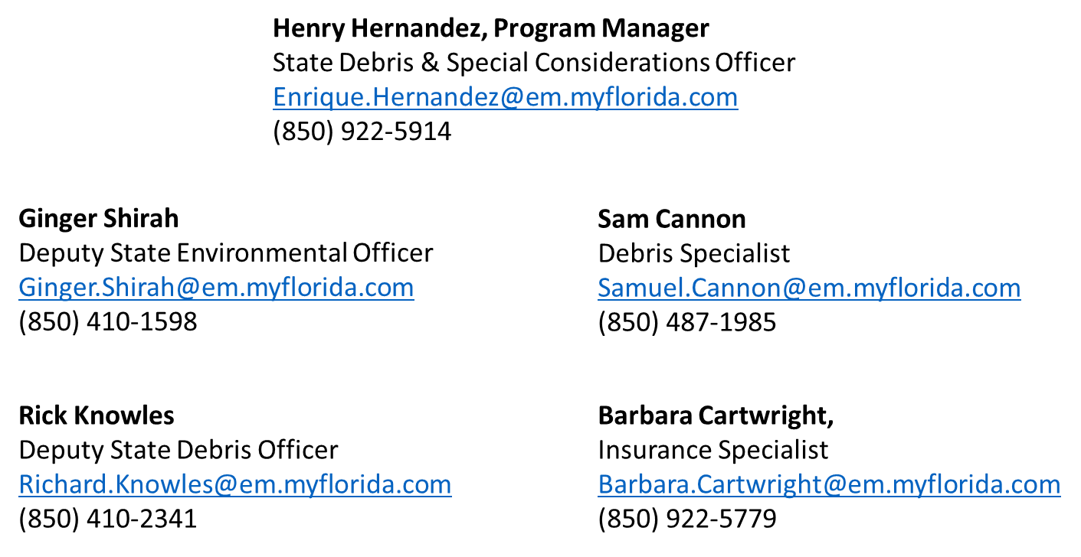
FDEM Recovery DSCP Contacts
THE FLORIDA DIVISION OF EMERGENCY MANAGEMENT

Slide 137
Sandy Recovery Improvement Act of 2013
THE FLORIDA DIVISION OF EMERGENCY MANAGEMENT

Slide 138
Sandy Recovery Improvement Act
On January 29, 2013, President Obama signed into law the Sandy Recovery Improvement Act of 2013 which adds Section 428 to the Stafford Act for alternative procedures which reduce the federal costs of disasters, increases the flexibility of the administration of funding, expedites funding, and provides financial incentives and disincentives for timely completion of projects.
Applicants voluntarily enter into the program, which includes alternative procedures for both debris removal and permanent work projects.
The Debris Removal Pilot includes:
Accelerated Debris Removal Incentive (Sliding Scale)
Retaining Recycling Revenues
Reimbursement for Straight Time Force Account Labor
One-Time Incentive for Debris Management Plan
The Permanent Work Pilot includes:
Grants Based on Fixed Estimates (REQUIRED)
Acceptance of Applicant Cost Estimates
Referral of Cost Estimates to Expert Panel
Consolidated sub-grants
Elimination of Alternate Project Penalty
Use of Excess Funds
THE FLORIDA DIVISION OF EMERGENCY MANAGEMENT

Slide 139
Debris Removal Pilot
THE FLORIDA DIVISION OF EMERGENCY MANAGEMENT

Slide 140
Sandy Recovery Improvement Act
Accelerated Debris Removal Incentive (Sliding Scale)
Under an alternative procedures pilot program, FEMA provides incentives to Applicants who, prior to a disaster, have a FEMA approved debris management plan in place.
Applicants may apply for an increased Federal cost share for the timely removal of debris.
Debris Removal Completed (Days from Start of Incident Period) | Federal Cost Share
0-30 days | 85%
31-90 days | 80%
91-180 days | 75%
Under these alternate procedures Applicants may also be eligible to retain revenue received through recycling eligible disaster debris.
THE FLORIDA DIVISION OF EMERGENCY MANAGEMENT

Slide 141
Sandy Recovery Improvement Act
Retaining Recycling Revenues
Currently, any revenue stream from recycling will reduce the amount of the awarded grant. Under the this procedure, Applicants may retain revenues received through recycling eligible disaster debris. However, the cost of establishing and managing the recycling program or process and additional sorting and processing of the debris for recycling purposes cannot be claimed as a direct project cost.
The revenues from recycling must be used for one of the following approved purposes:
Developing disaster debris management plans
Updating or revising existing plans
Enhancing Applicant landfill-management sites
Installing mechanisms such as debris trash racks, K-Rail debris guards and silt fencing
Buying equipment such as street sweepers, shredders, backhoes, balers and sorting conveyors
Purchasing debris recycling equipment
Purchasing software and hardware products to facilitate quantifying disaster debris
Buying onboard weight measurement systems for debris-collection trucks
Purchasing software systems for debris load management to assist in tracking trucks, drivers and routes
If revenues are not used for an authorized purpose, grant funding will be reduced by the amount of that revenue as program income.
THE FLORIDA DIVISION OF EMERGENCY MANAGEMENT

Slide 142
Sandy Recovery Improvement Act
Reimbursement for Straight Time Force Account Labor
When Applicants use their own labor forces to perform all or part of debris removal operations, FEMA will reimburse, at the appropriate cost share level, the base and overtime wages for existing employees and hiring of additional staff.
One-Time Incentive for Debris Management Plan
When an Applicant has a FEMA-reviewed debris management plan before the date of the disaster declaration incident period, FEMA will provide a one-time incentive of a 2% cost share adjustment applied to debris removal work completed within 90 days.
Plans should include all of the following elements:
Debris management overview
Health and safety requirements
Public Information
Events and assumptions
Use of force account labor
Debris collection and removal plan
Monitoring of debris operations
Debris removal on private property
Use and procurement of contracted services
Environmental considerations and other regulatory requirements
Debris disposal locations and debris management sites
THE FLORIDA DIVISION OF EMERGENCY MANAGEMENT

Slide 143
Permanent Work Pilot
THE FLORIDA DIVISION OF EMERGENCY MANAGEMENT

Slide 144
Sandy Recovery Improvement Act
To participate in the permanent work alternative procedures, an Applicant must agree to participate in the grants based on fixed estimate procedures before having access to other alternative procedures:
REQUIRED-
Subgrants based on fixed estimates
Optional features-
Consolidation of multiple fixed subgrants
FEMA validation of Applicant-provided estimates (prior to acceptance)
Elimination of reduced eligible funding for alternate projects
Use of excess funds
Review of estimates by an expert panel for projects with a Federal share of $5 million or greater (prior to acceptance)
THE FLORIDA DIVISION OF EMERGENCY MANAGEMENT

Slide 145
Sandy Recovery Improvement Act
Grants Based on Fixed Estimates (REQUIRED)
FEMA will approve funding for large, uncompleted, permanent work subgrants on the basis of a fixed estimate. This varies from the current procedure which provides funding based on the actual cost of completing the eligible scope of work.
FEMA, the State, and the Applicant must agree on the eligible disaster-damage dimensions and the description and scope of work for the subgrant prior to completing the cost estimate.
If an Applicant wishes to complete an alternate project, FEMA must be notified prior to the approval of the project. Alternate projects cannot be requested after a scope of work has been completed.
Actual Costs:
If the actual costs are more than the approved fixed estimate, FEMA will not approve additional funds.
If the actual costs are less than the approved fixed estimate, the excess funds may be used for a variety of approved actions.
THE FLORIDA DIVISION OF EMERGENCY MANAGEMENT

Slide 146
Sandy Recovery Improvement Act
Grants Based on Fixed Estimates (REQUIRED)
Excess funds must be used for PA Program-related purposes. These include:
Hazard mitigation activities that will reduce the risk of damage in future disasters. The funds may be used for facilities not damaged in the declared disaster. However, those facilities must qualify as eligible under the general program guidelines.
Activities that improve future PA Program permanent work operations, such as training and planning activities.
Excess funds may not be used for:
Payment of debts
Payment of the non-Federal share of PA Program subgrants or other Federal grants
Operating expenses
Cost overruns on other PA Program subgrants
Incorporation into the community’s General Fund
Restoring or replacing a facility that would otherwise not be eligible for PA Program funding
THE FLORIDA DIVISION OF EMERGENCY MANAGEMENT

Slide 147
Sandy Recovery Improvement Act
Referral of Cost Estimates to an Expert Panel
Applicants may request a FEMA-funded, independent validation of estimates for permanent work subgrants with an estimated Federal share of at least $5 million.
FEMA will direct subgrant estimates to the panel at the request of the Applicant (through the State)
The panel will conduct its review before the acceptance and obligation of funds, and will not be used for appeals
The review will be limited to issues pertaining to the estimated cost; the panel will not make decisions related to the eligible scope of work
The panel may review cost documentation for completed work, if required
In cases where the estimated amount deemed appropriate by the expert panel is less than the Applicant is willing to accept for a fixed estimate, the Applicant may reverse their decision to apply the alternative procedures to the grant in question. In these cases, FEMA will obligate the grant based on the estimate determined by the expert panel and the project will be reimbursed based on actual costs.
THE FLORIDA DIVISION OF EMERGENCY MANAGEMENT

Slide 148
Sandy Recovery Improvement Act
Consolidated Subgrants
A consolidated subgrant is created when an Applicant combines two or more fixed subgrants into a single subgrant.
Consolidating projects will allow Applicants greater flexibility to execute work across multiple facilities or sites in ways that support its post-disaster recovery needs.
This is designed to allow overages on components of the consolidated project to offset underages on other components.
Funding for a consolidated project will be capped at the aggregate amount of the eligible costs for the formerly separate, individual fixed subgrants.
FEMA will not obligate additional funds if the Applicant’s costs exceed the aggregate fixed amount.
Allows Applicants to share funding across any of the facilities within the consolidated subgrant in order to meet its post-disaster recovery needs.
Only permanent work subgrants can be consolidated.
THE FLORIDA DIVISION OF EMERGENCY MANAGEMENT

Slide 149
Sandy Recovery Improvement Act
Elimination of the Reduction in Eligible Costs for Alternate Projects
Currently Sections 406(c)(1) and 406(c)(2) require a reduction of the otherwise-eligible Federal share for alternate projects.
For governmental entities, the reduction is 10%.
For private non-profits, the reduction is 25%.
Under the alternative procedures, FEMA will no longer implement this reduction for subgrants funded under the alternative procedures pilot program.
Alternate projects will be paid at 100% of the otherwise-eligible Federal cost share.
All alternate project scopes of work require FEMA’s review and approval in accordance with PA Program requirements.
THE FLORIDA DIVISION OF EMERGENCY MANAGEMENT

Slide 150
Questions
THE FLORIDA DIVISION OF EMERGENCY MANAGEMENT

Slide 151
Important Points to Remember
Applicant’s Designation of Authorized Representative and floridapa.org Contacts / Maintenance
Authorized – Primary – Alternate – Others (finance, insurance, debris, environmental)
User contacts should be reviewed each quarter when Quarterly Reports are submitted
User contacts in floridapa.org must be updated when staff separate from the agency or are reassigned
THE FLORIDA DIVISION OF EMERGENCY MANAGEMENT

Slide 152
Important Points to Remember
Quarterly Report Review
The Office of the Chief Financial Officer (CFO) is responsible for the oversight of this report. Project inactivity is tracked. When a project has been obligated over 720 days the CFO will recommend an interim inspection reconciliation be performed.
FEMA’s position is that if the Applicant is not completing the work, not recording it, and not requesting reimbursement, the Federal funds can be put to better use until the project is closed. This action is not an appealable action and funding will be reinstated after final inspection and identification of the actual costs.
As a preventative measure, the Grantee will be performing more interim inspections.
THE FLORIDA DIVISION OF EMERGENCY MANAGEMENT

Slide 153
Important Points to Remember
Interim Inspections may also be scheduled and submitted by the Grantee as a request in floridapa.org under other conditions including:
Quarterly Report have not been updated
Requests for Reimbursement (RFR’s) are not being submitted
Time Extension request exceeds Grantee Authority
Issues or concerns are identified by the Grantee that may impact funding
THE FLORIDA DIVISION OF EMERGENCY MANAGEMENT

Slide 154
Important Points to Remember
OTHER FUN FACTS
The Grantee/Recipient will use its authority to submit a request for project closeout if the Applicant/Subrecipient has identified the project to be complete but has failed to submit the request for closeout.
Reimbursement requests must be supported by the FEMA Cost Claim Summary Workbook (found in the Forms section of FloridaPA.org) along with copies of original documents such as contract documents, invoices, change orders, canceled checks (or other proof of expenditure), purchase orders, etc. Failure to complete Quarterly Reports may delay processing of payments.
OMB’s A-133 Audit - Failure to submit this report on time will delay processing of payments by the State of Florida Comptroller.
THE FLORIDA DIVISION OF EMERGENCY MANAGEMENT

Slide 155
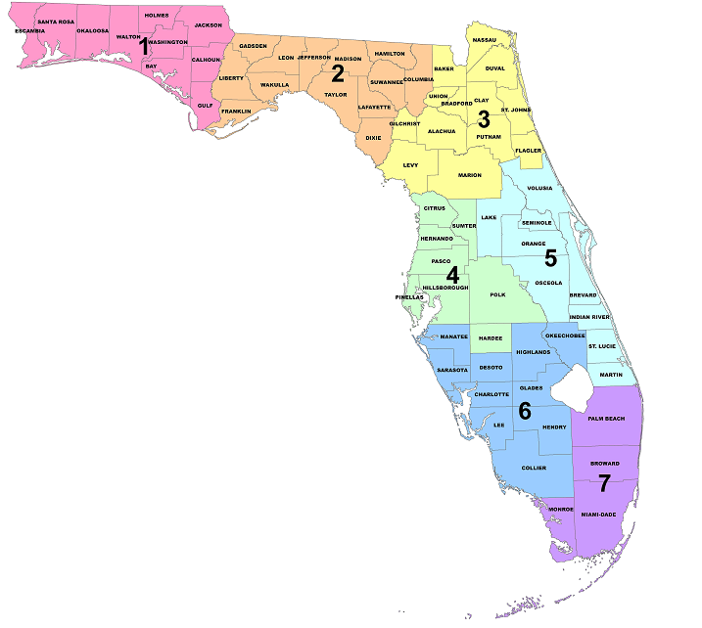
Contact Information
Florida Division of Emergency Management
2555 Shumard Oak Blvd.
Tallahassee, FL 32399
State Public Assistance Officer, Bryan Lowe
Bryan.Lowe@em.myflorida.com
(850) 487-1660
Regional Coordinators:
Region 1: (850) 528-7525
Region 2: (850) 519-8639
Region 3: (850) 591-3855
Region 4: (850) 519-8633
Region 5: (850) 519-6734
Region 6: (850) 519-8635
Region 7: (850) 519-1469
Deputy Public Assistance Officer, Jeanette Francis
Jeanette.Francis@em.myflorida.com
(850) 488-3141
Grants Manager, Pam Hughes
Pam.Hughes@em.myflorida.com
(850) 487-2032
State Environmental and Debris Officer, Henry Hernandez
Enrique.Hernandez@em.myflorida.com
(850) 922-5914
Recovery Bureau Chief, Evan Rosenberg
Evan.Rosenberg@em.myflorida.com
(850) 487-2293
Recovery Deputy Bureau Chief, Cathy Day
Cathy.Day@em.myflorida.com
(850) 487-1312
THE FLORIDA DIVISION OF EMERGENCY MANAGEMENT

Slide 156
References
Debris Removal Guide: www.fema.gov/pdf/government/grant/pa/demagde.pdf
Florida Greenbook: www.floridadisaster.org/Recovery/documents/FLGreenbook.pdf
Federal Emergency Management Agency (FEMA): www.fema.gov
Florida Division of Emergency Management: www.FloridaDisaster.org
FEMA Project Worksheet Template: www.fema.gov/media-library/assets/documents/30257
FEMA Public Assistance Program and Policy Guide:
www.fema.gov/media-library-data/1456167739485-75a028890345c6921d8d6ae473fbc8b3/PA_Program_and_Policy_Guide_2-21-2016_Fixes.pdf
Florida Public Assistance Disaster Relief Thresholds:
www.floridadisaster.org/Recovery/PublicAssistance/documents/Copy%20of%20FY16%20Per%20Capita%20Indicators%20with%202010%20Census%20Pop-All%20states%20r4%20revised%20for%20website.pdf
THE FLORIDA DIVISION OF EMERGENCY MANAGEMENT

