Slide 1
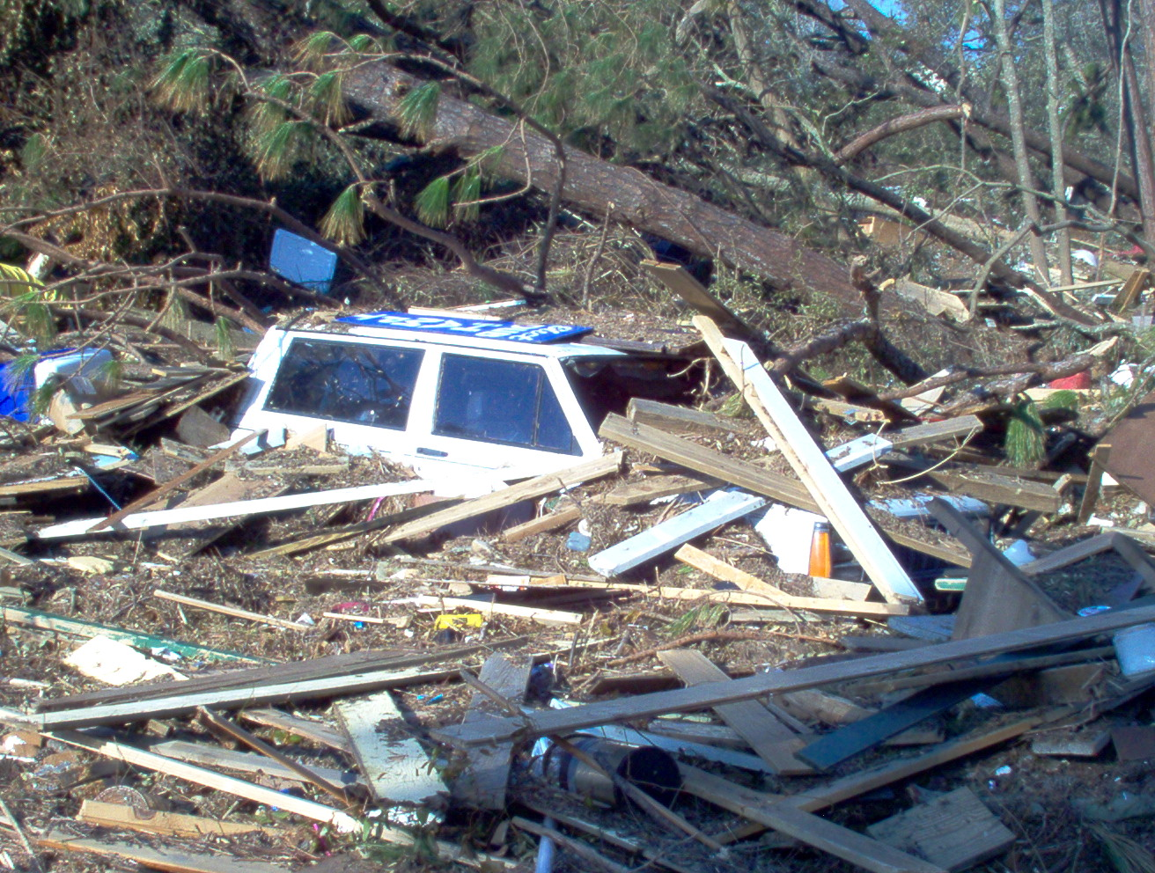

RECON PHOTOS
THE GOOD, THE BAD
AND THE UGLY
Notes:
1

Slide 2
WHY RECON PHOTOS?
Primary Reason – Added description for RECON report
Record of visual damage or lack of damage
Documentation of damage for federal
reimbursement
Public Affairs – Internal and external

Slide 3
RECON PHOTOS - HOW?
Five major things to consider when taking a
digital reconnaissance photo
  Subject
  Framing
  Exposure
  Focus
  Perspective

Slide 4
Subject
Why take a picture of this building or scene?
  Critical Facility
  Visible damage
  Lack of visible damage

Slide 5
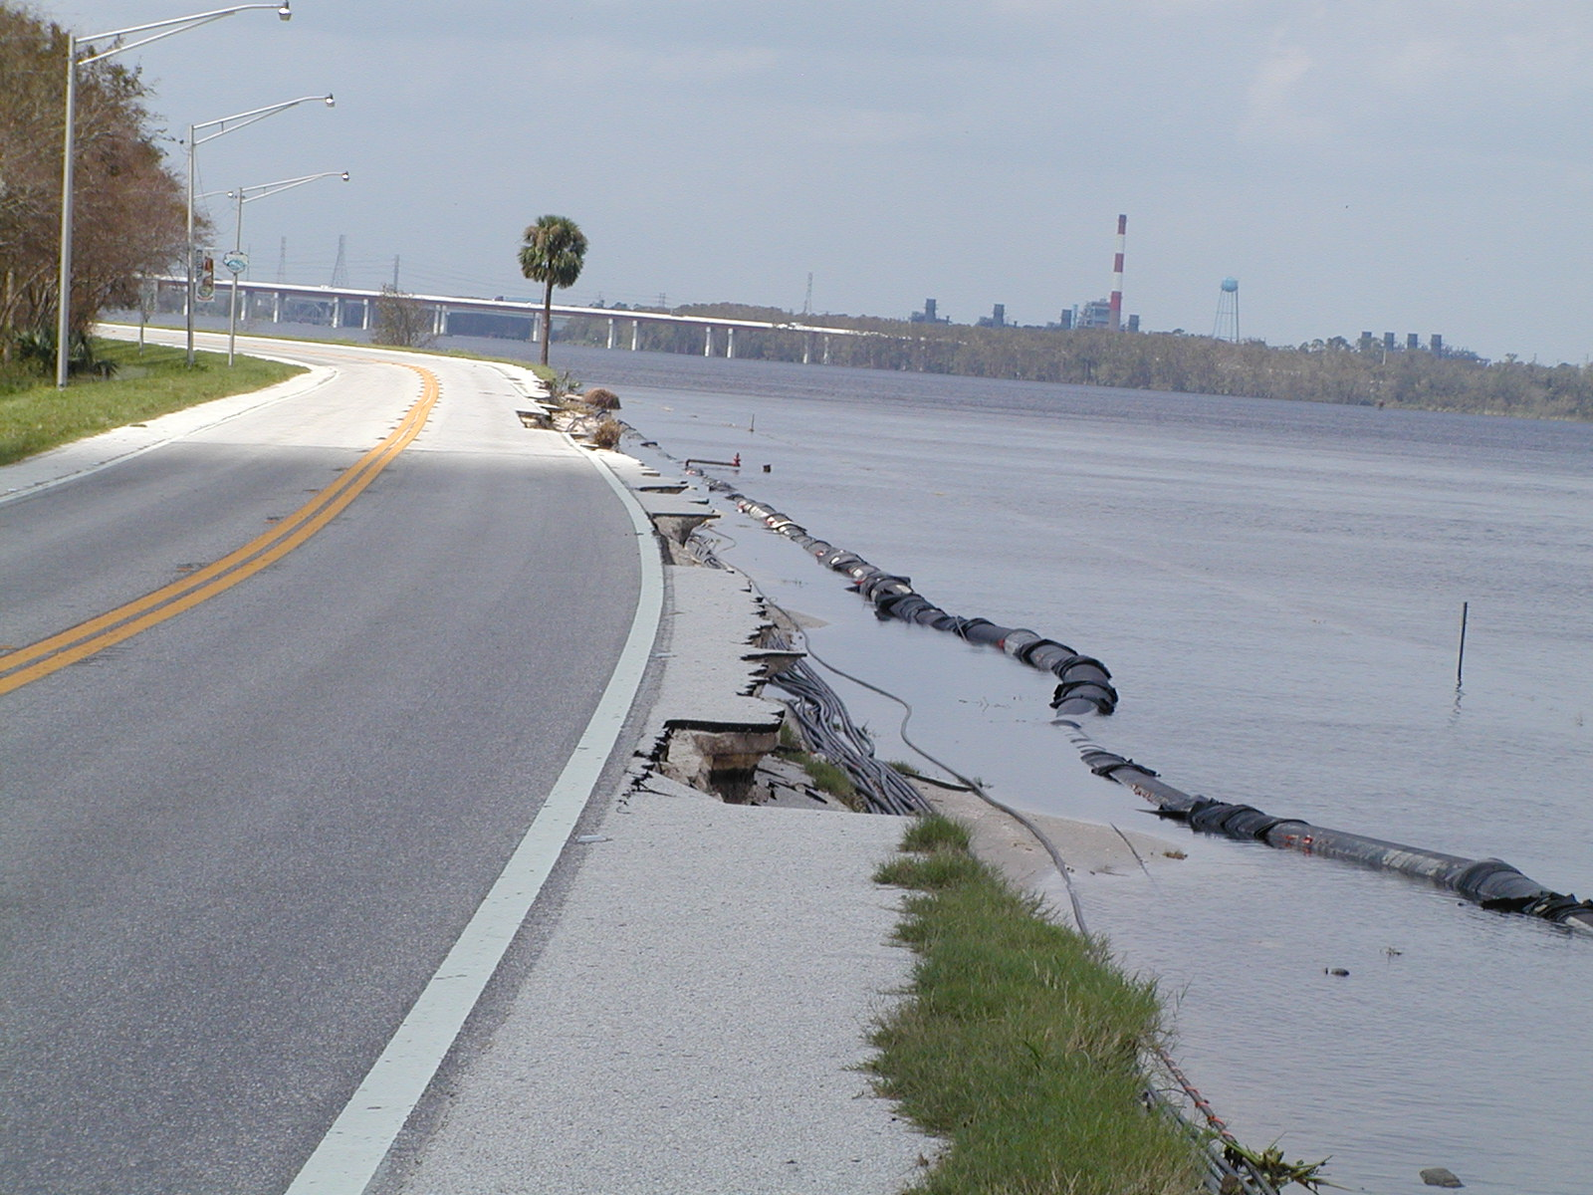
Critical Facility
Subject

Slide 6
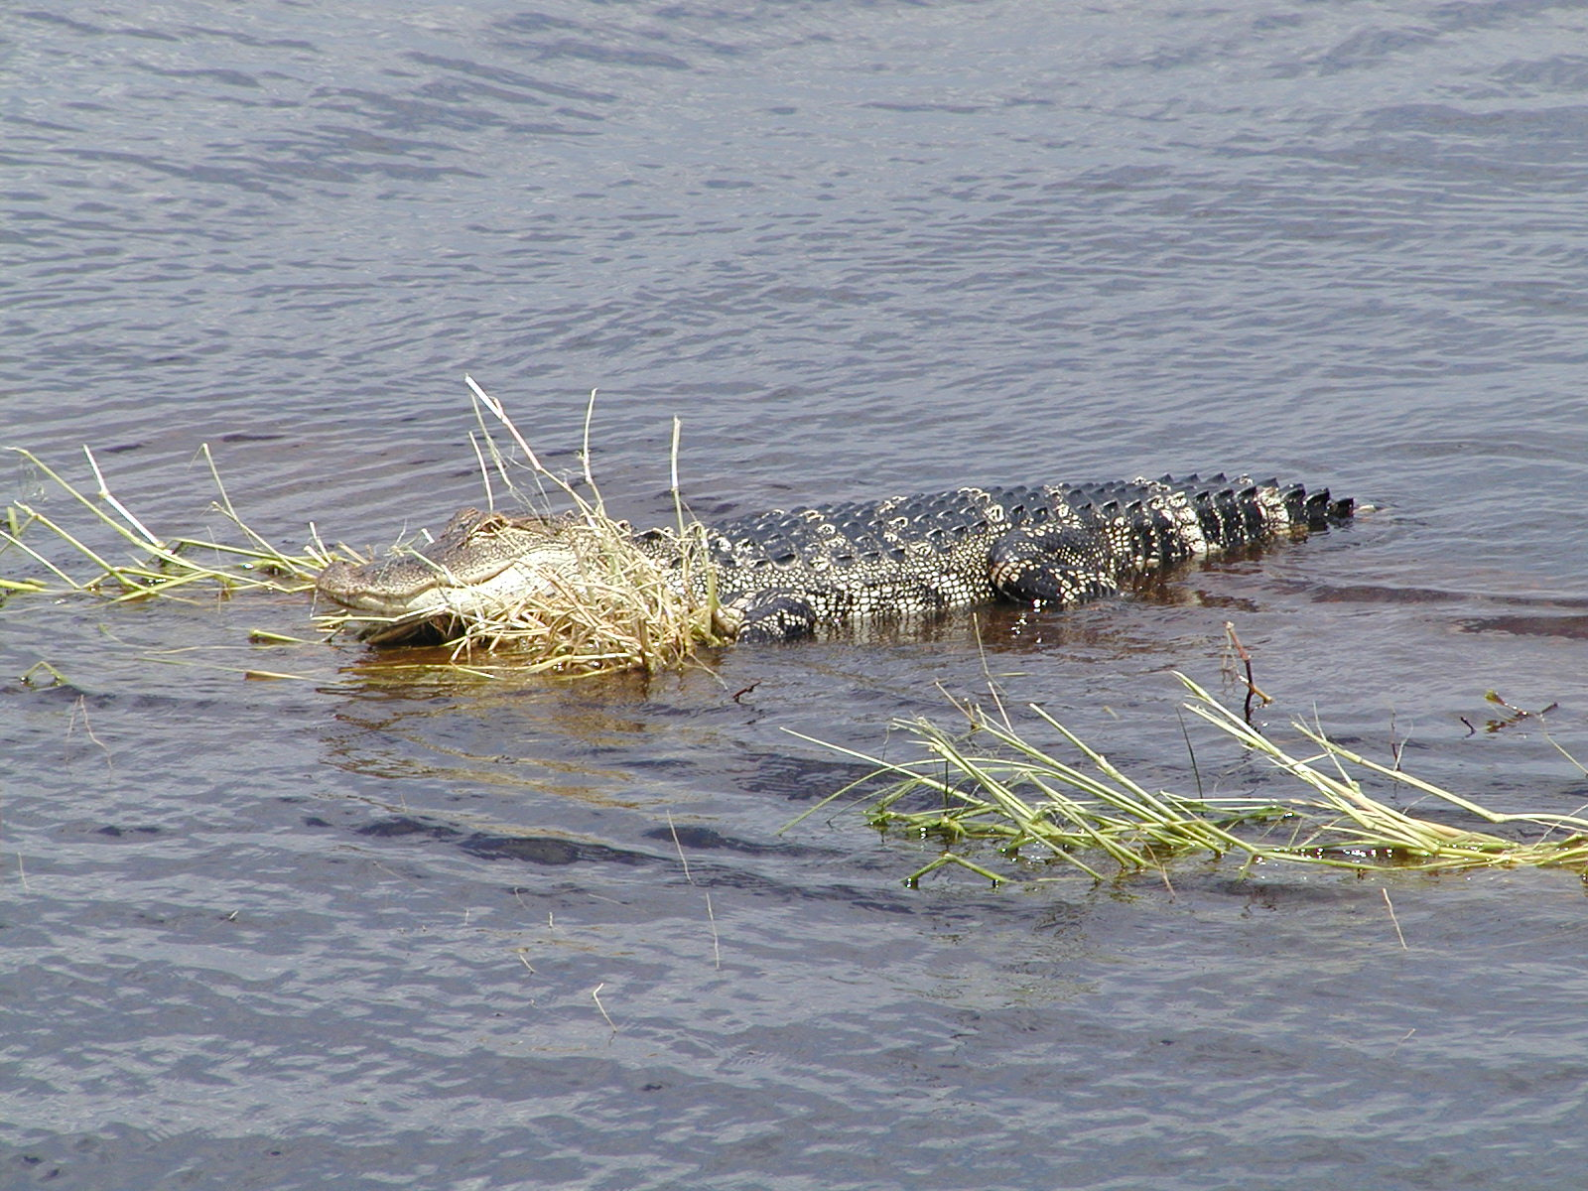

Slide 7
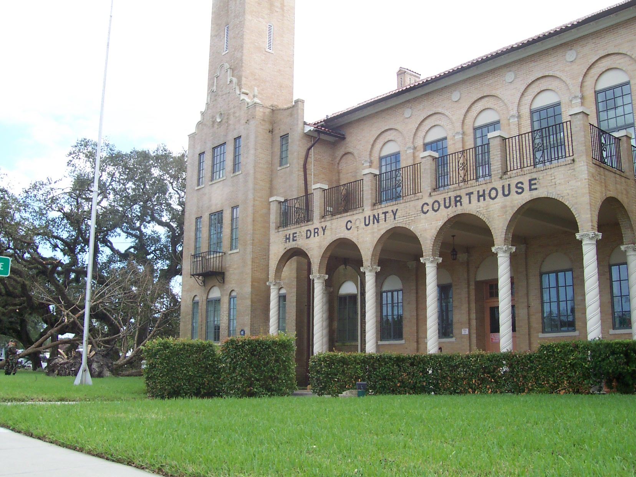

Slide 8
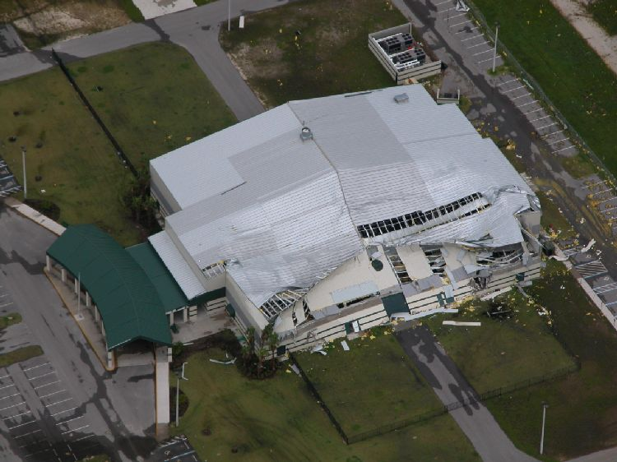
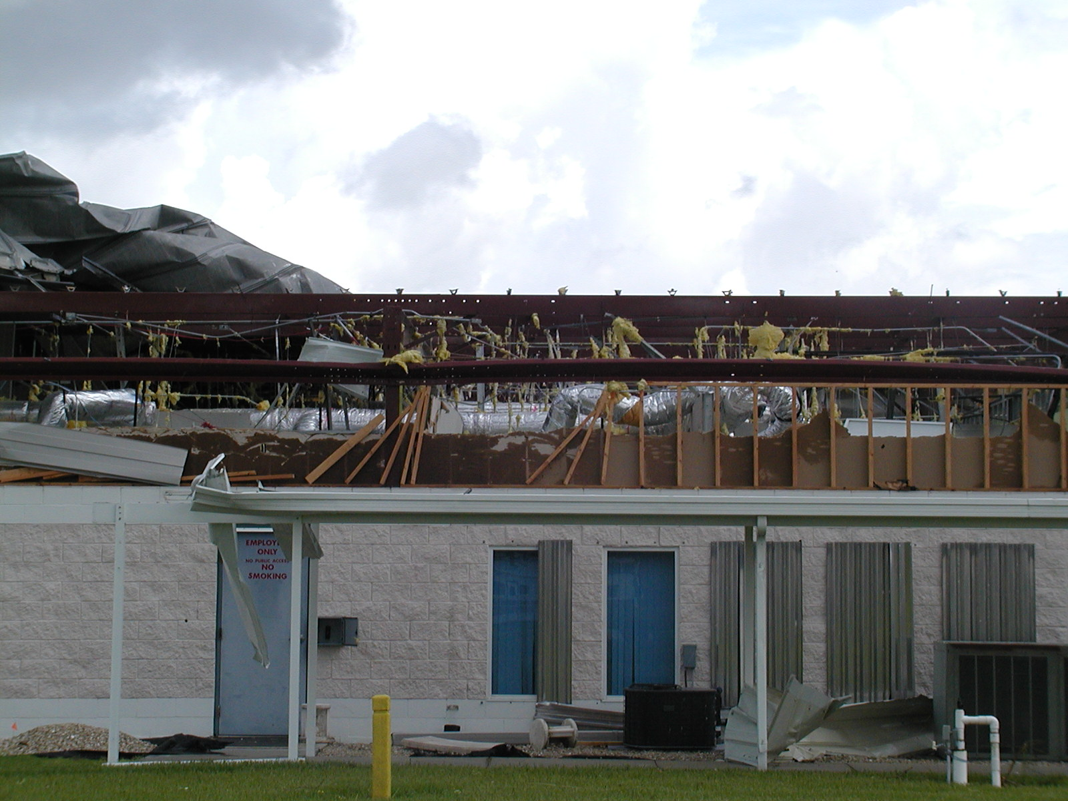
Collapsed EOC
Charlotte County

Slide 9
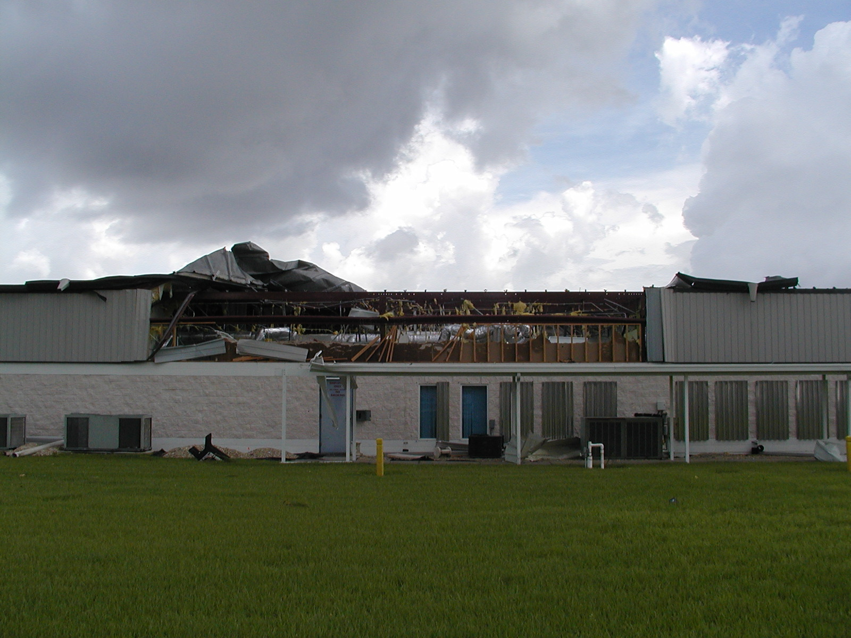

Slide 10
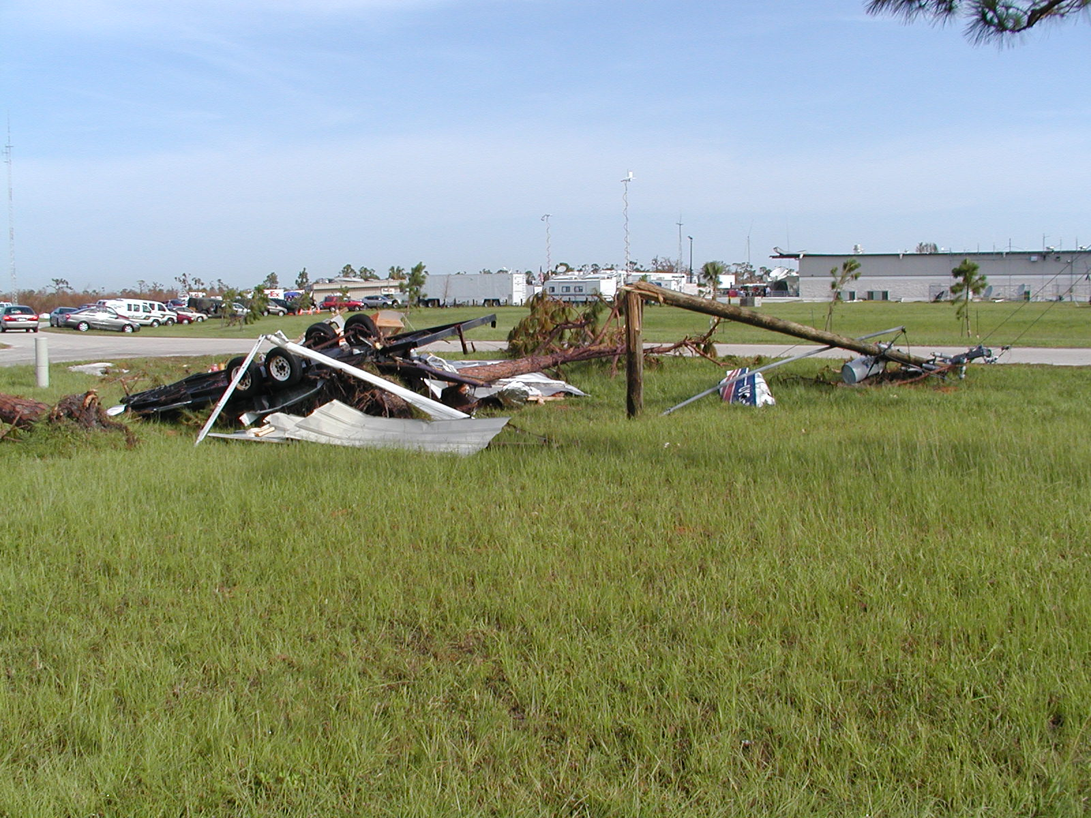

Slide 11
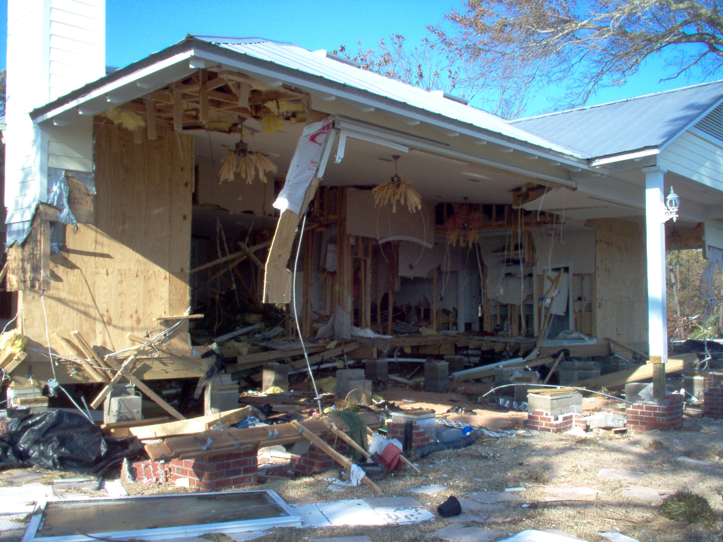
Visible Damage
Subject

Slide 12
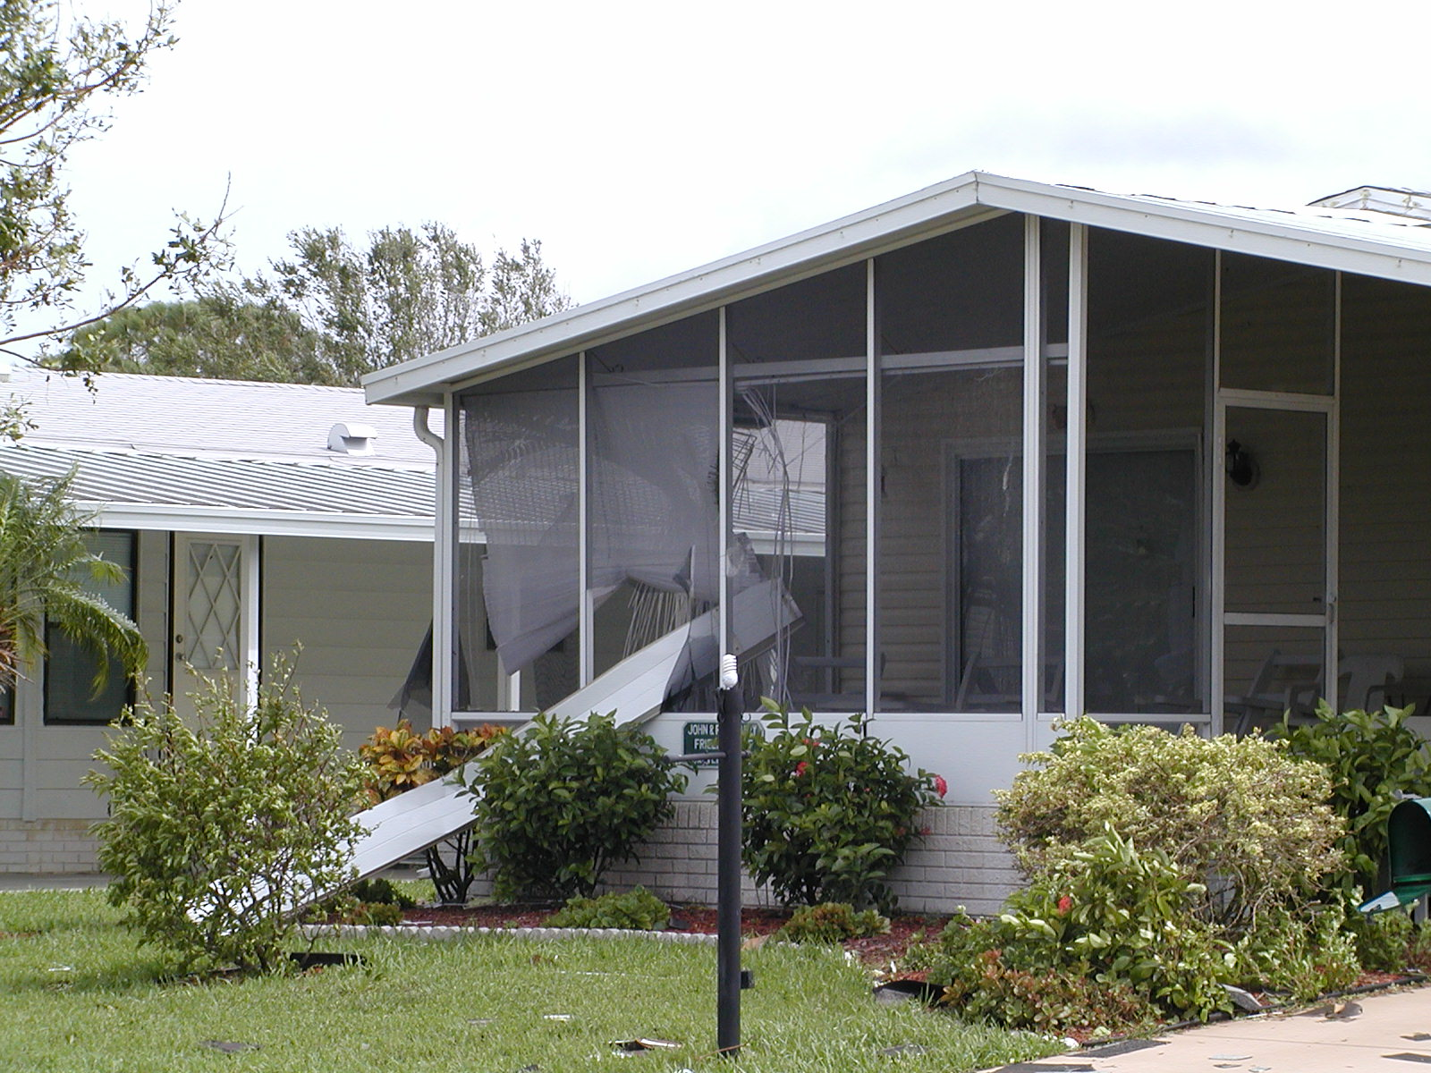

Slide 13
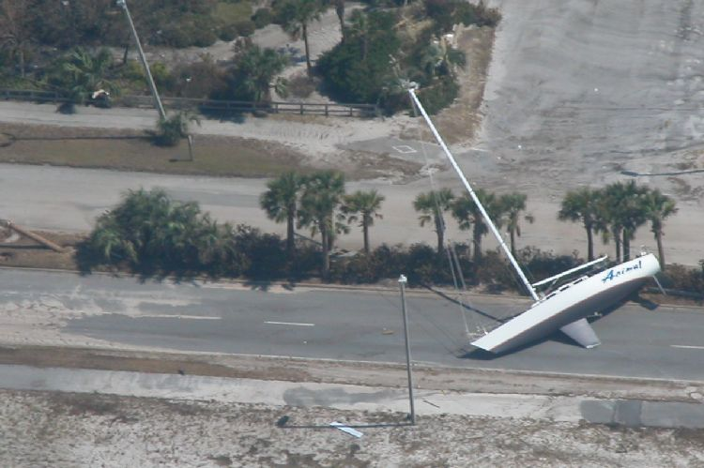
Evidence of the extent of
storm surge

Slide 14
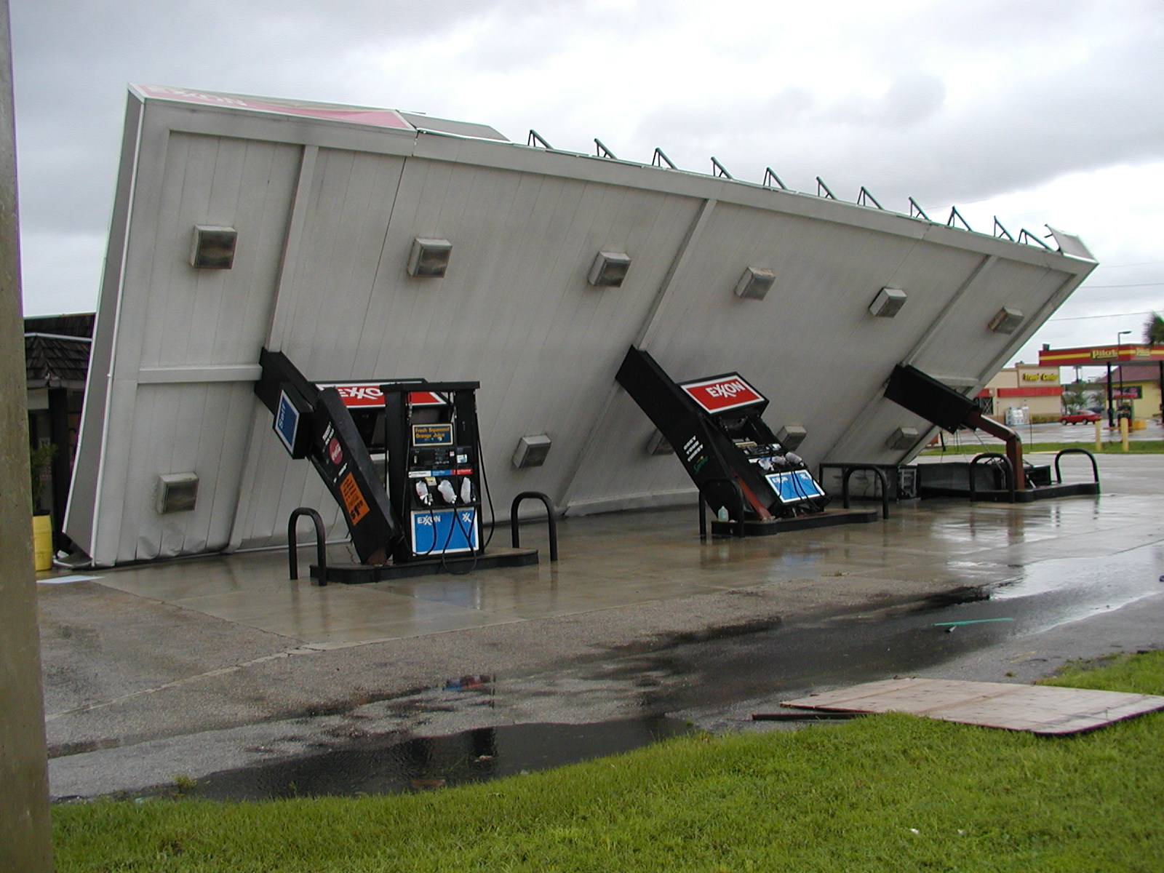
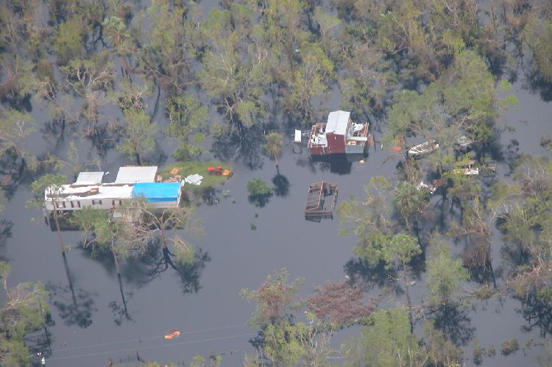
CAP Recon
Wind & Flood Damage – Peace River
DeSoto County

Slide 15
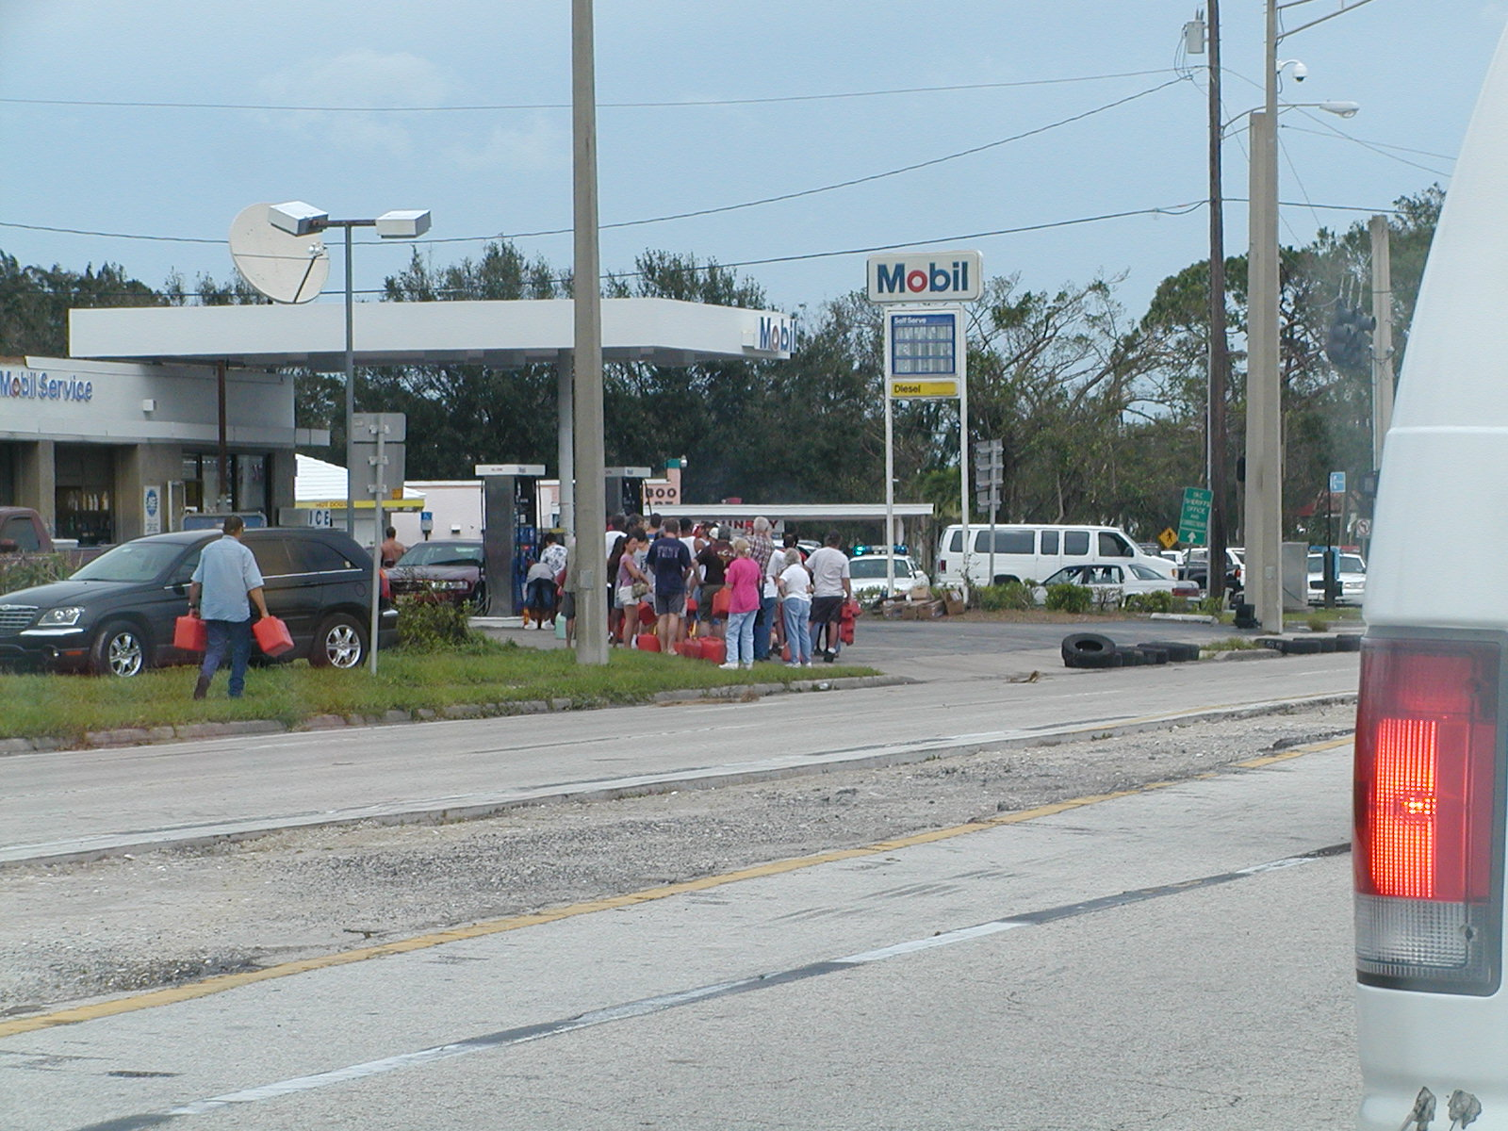

Slide 16
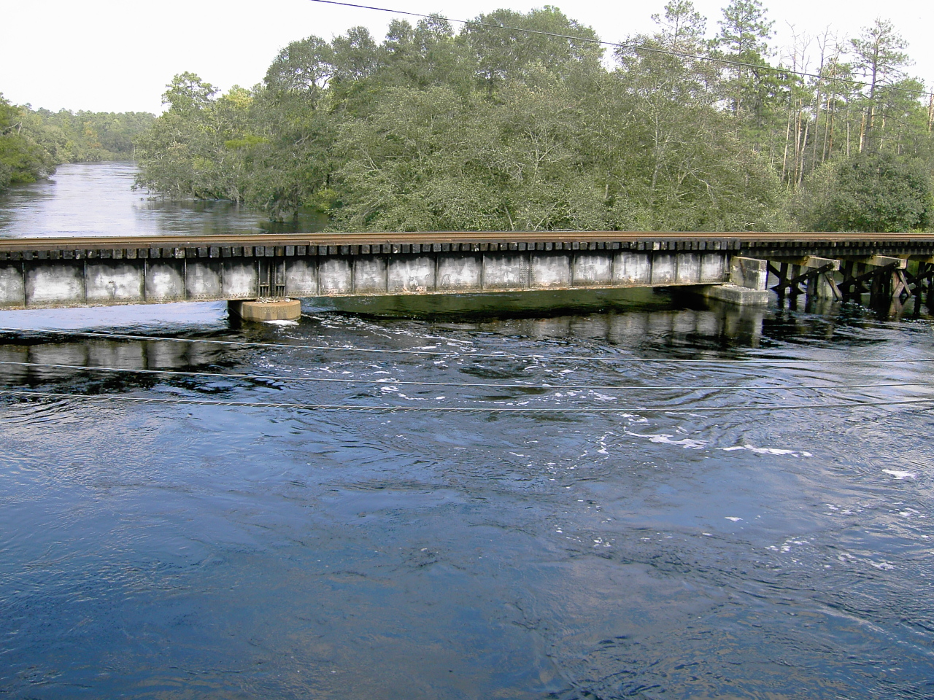

Slide 17
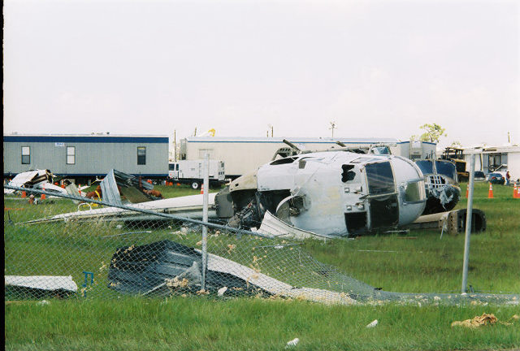

Slide 18
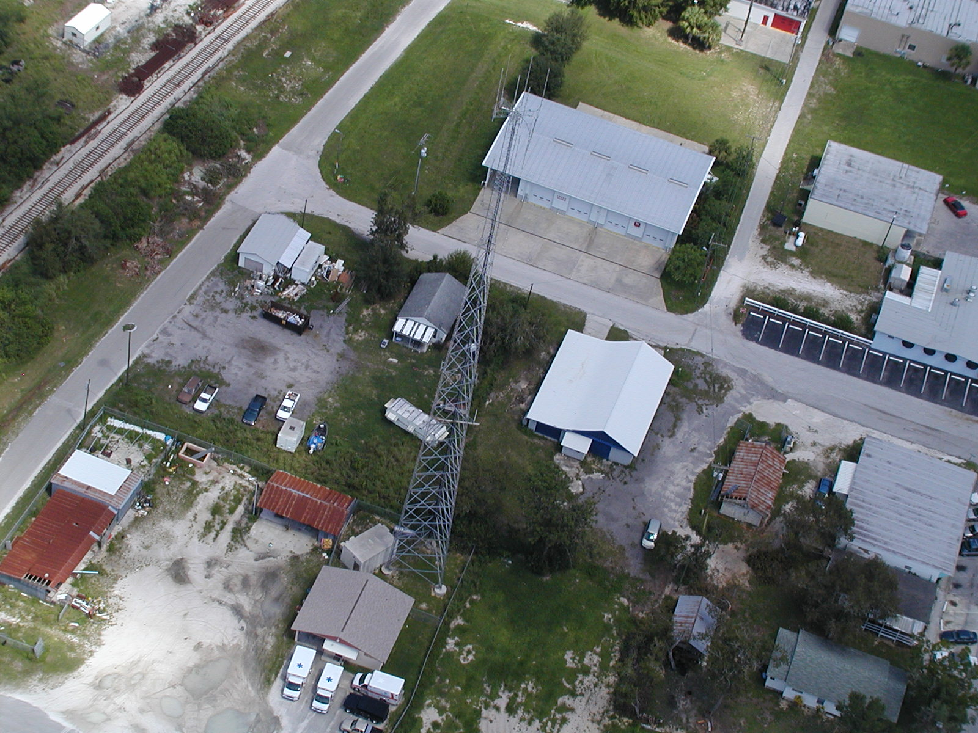
No Visible Damage

Slide 19
Framing
Note what is in the viewfinder!
  Center the subject
  Avoid Clutter
  Avoid non-subject material

Slide 20
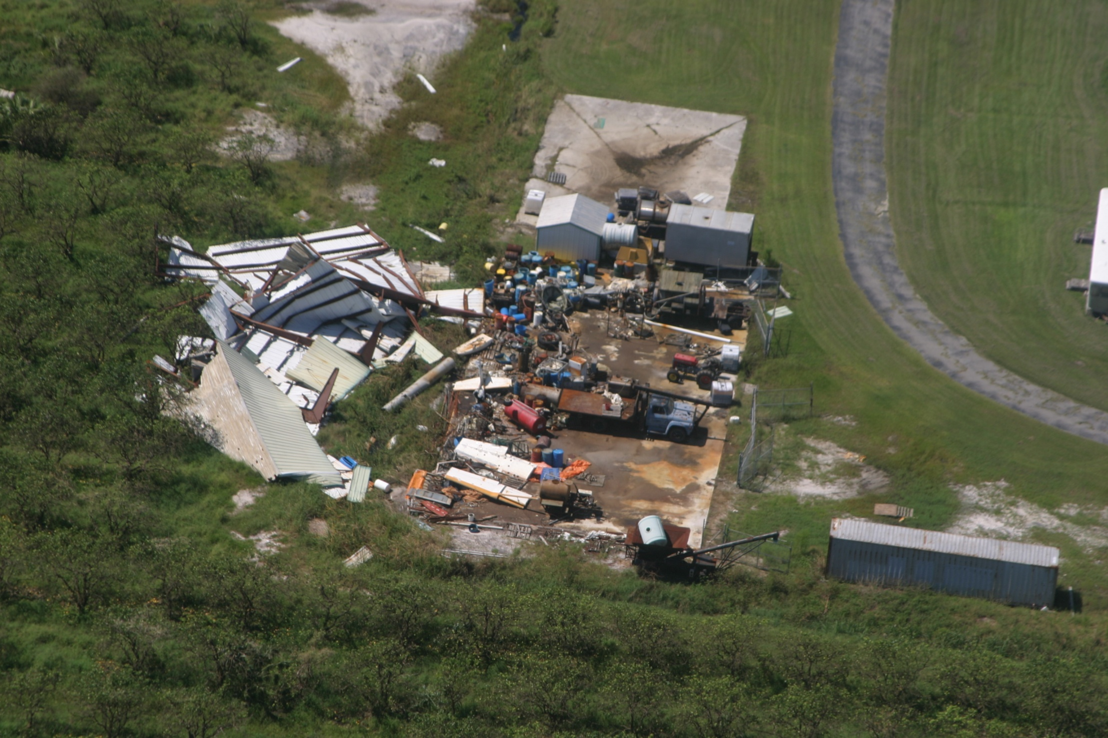
Good Framing

Slide 21
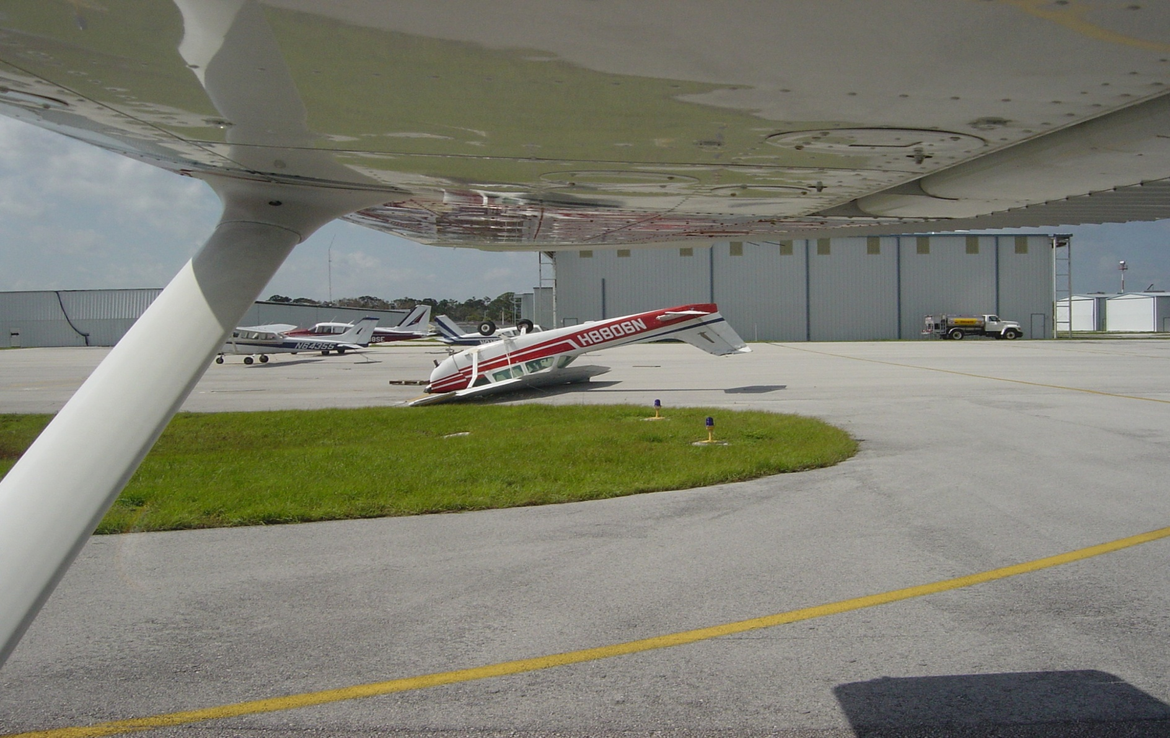
Bad Framing

Slide 22
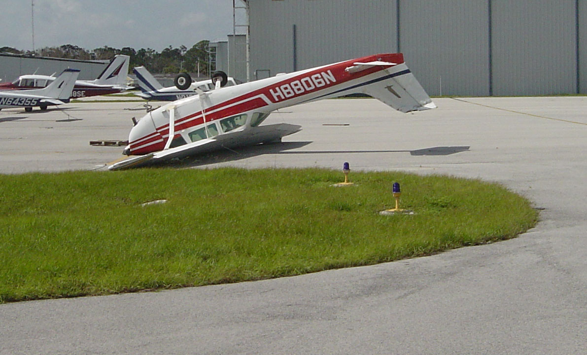
Fixed Framing

Slide 23
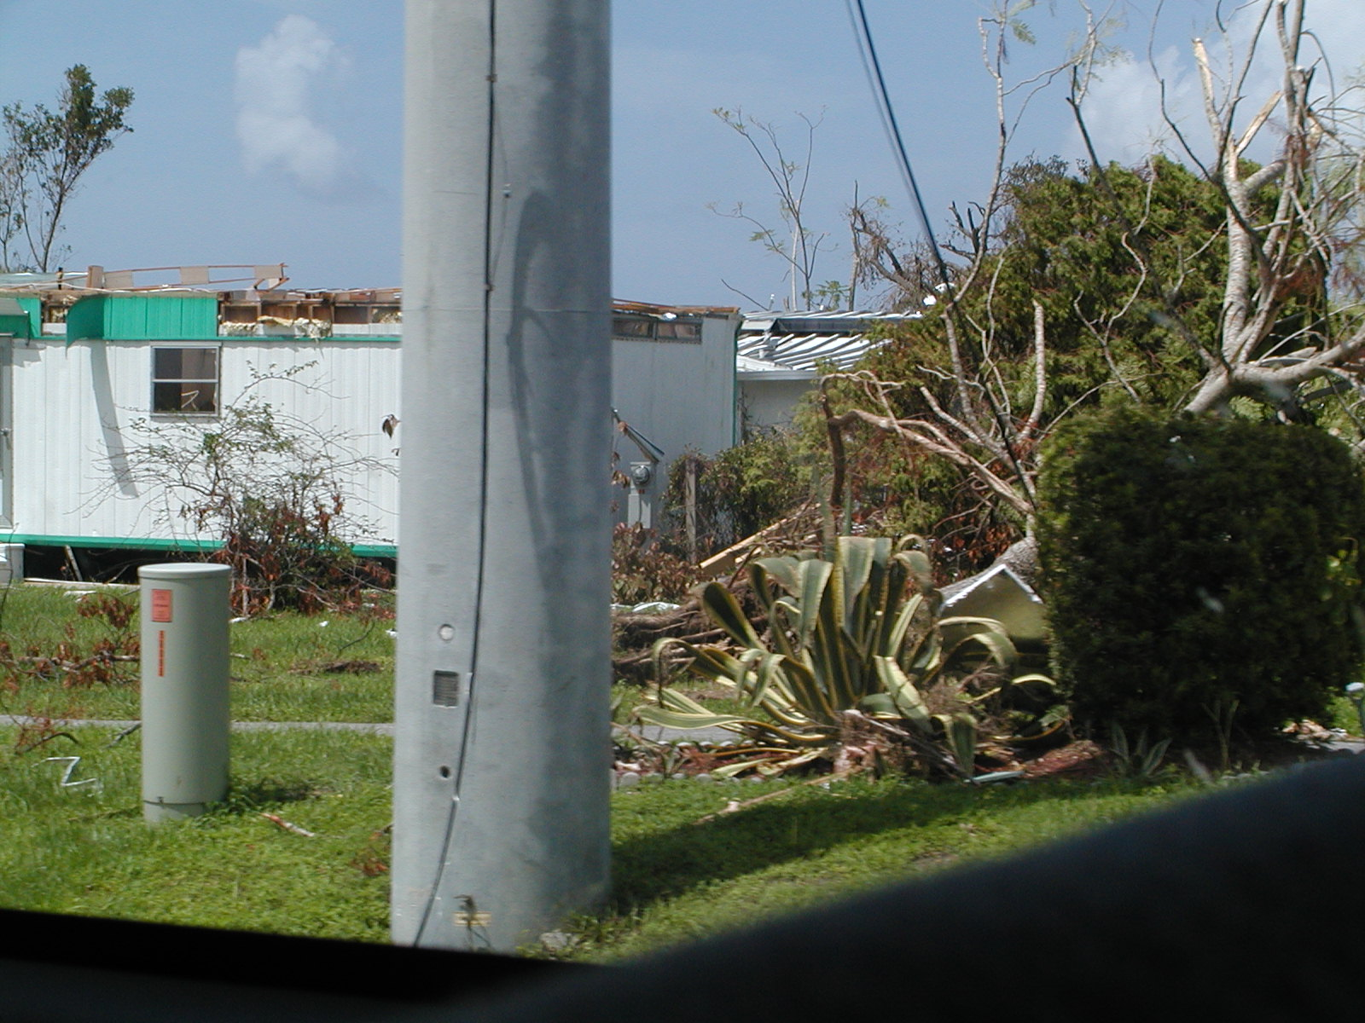
Ugly Framing

Slide 24
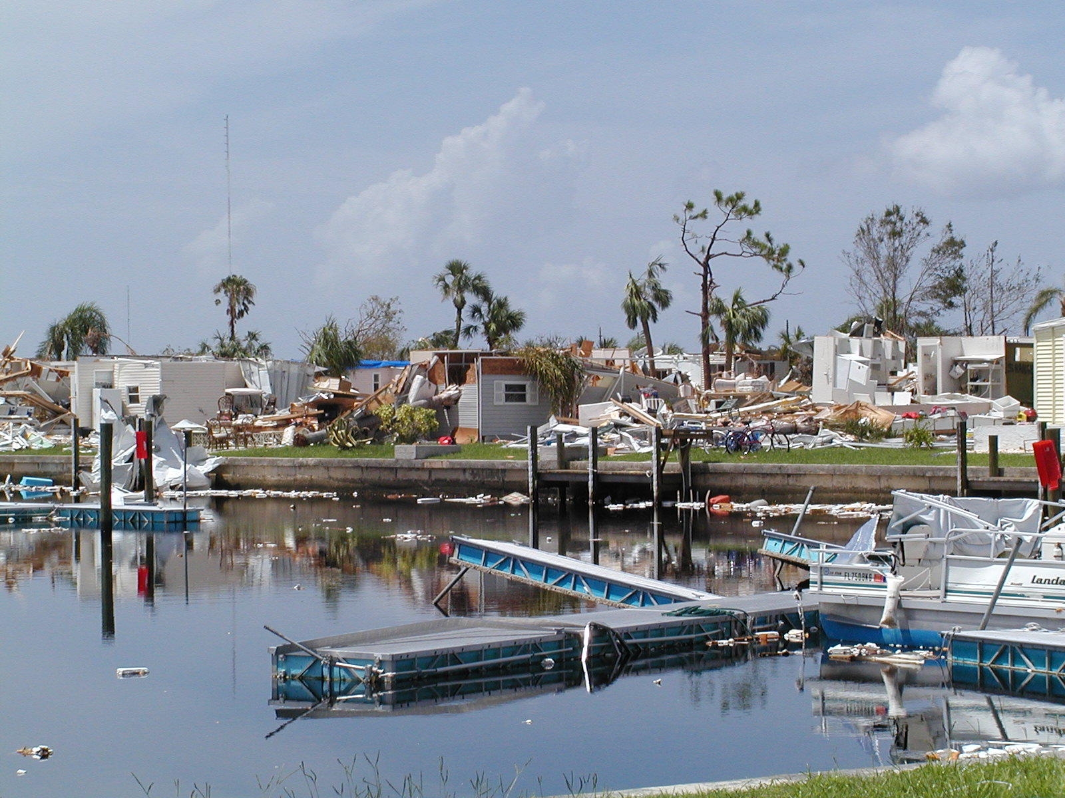
Good Framing

Slide 25
Exposure
Use the auto-exposure setting if possible
Note what is in the viewfinder!
  Don’t shoot into/directly towards the sun!
Try to take pictures when the sun is out
Try to avoid taking pictures at dusk or dawn

Slide 26
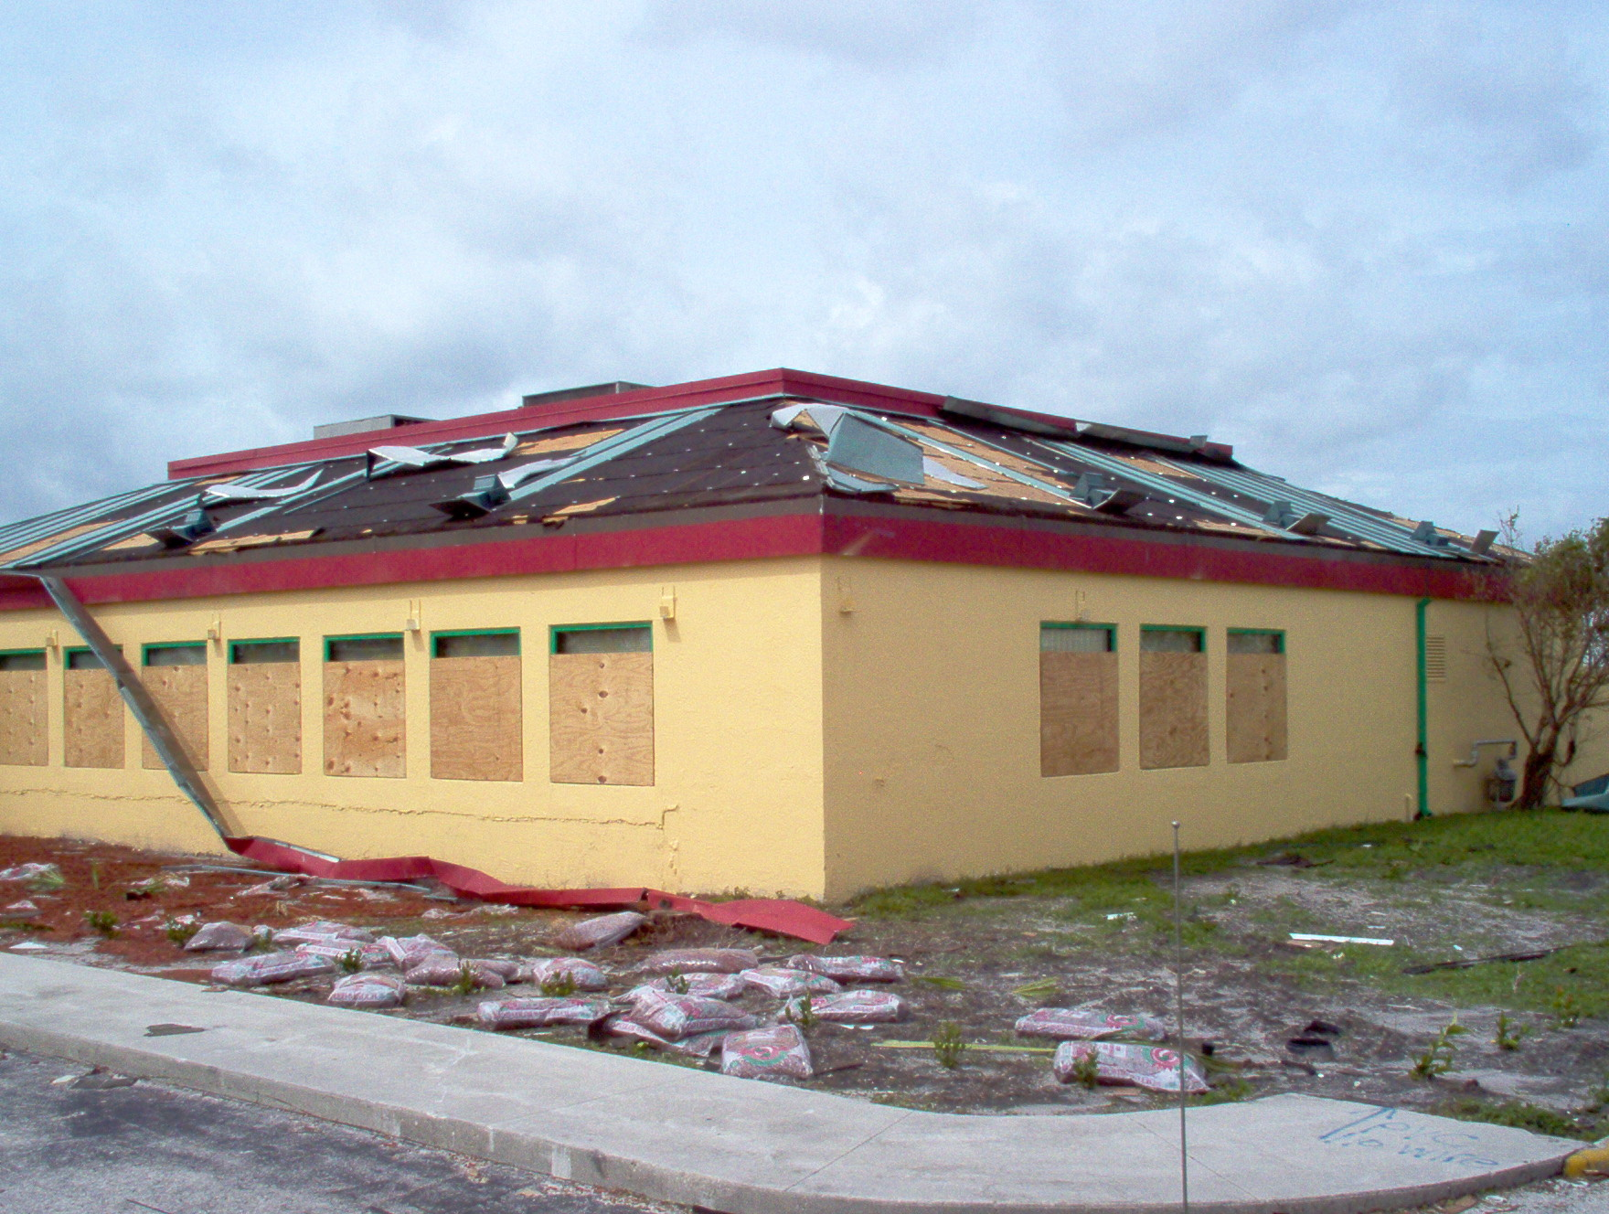
Good Exposure

Slide 27
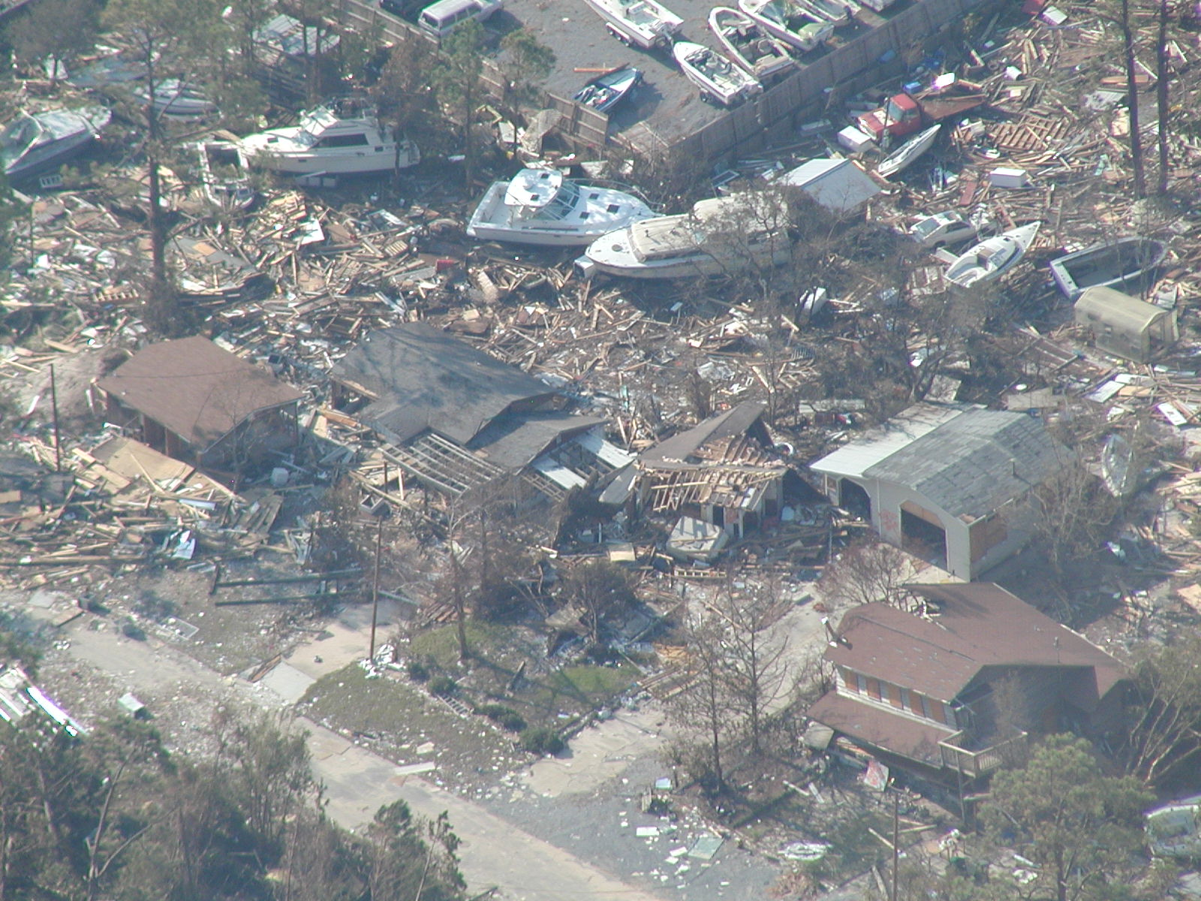
Bad Exposure

Slide 28
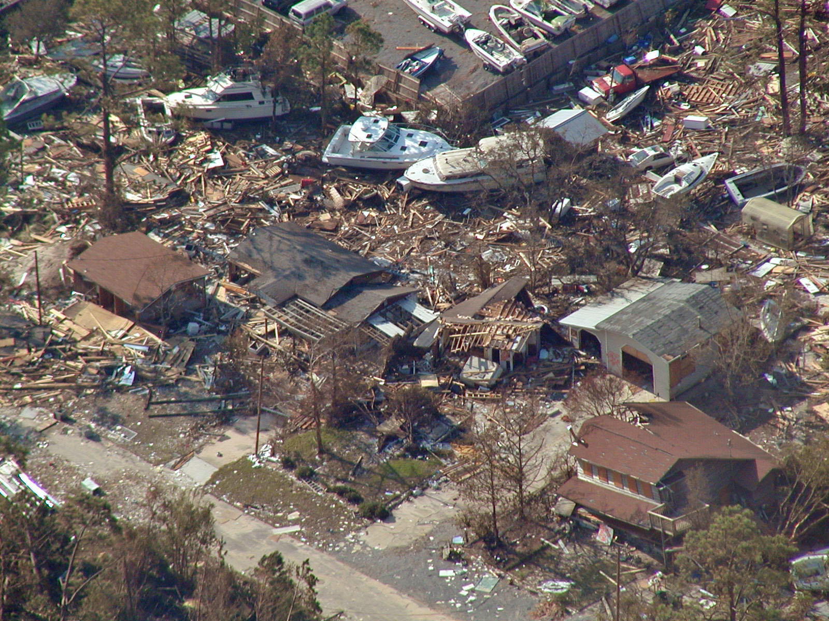
Fixed Exposure

Slide 29
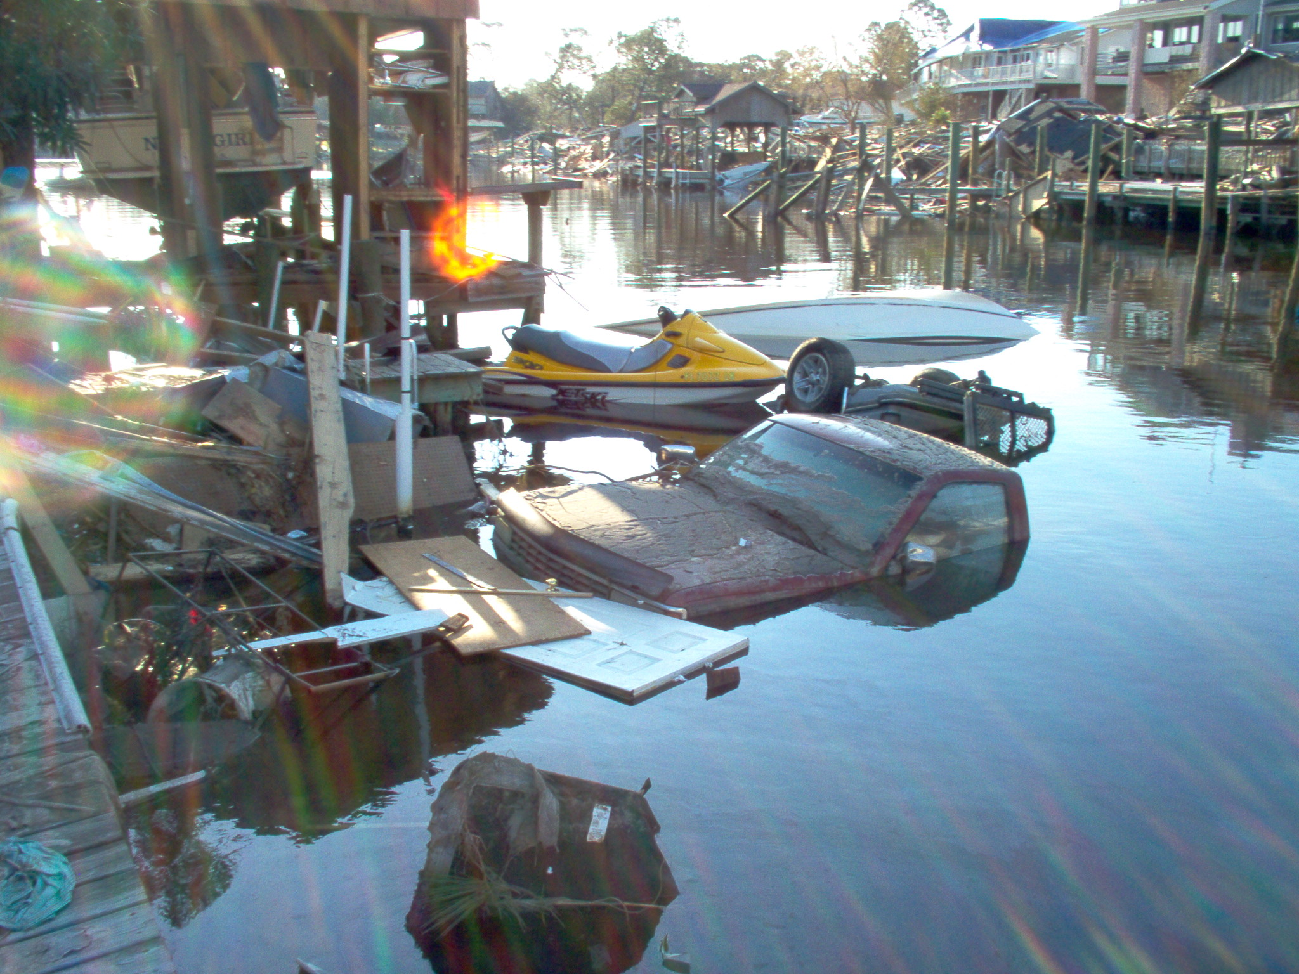
Ugly Exposure

Slide 30
Focus
Use the auto-focus setting
Try not to move while the shutter is open
  If in an aircraft use an optically-stabilized lens
Make sure the subject is not moving
Don’t take picture through glass or plastic

Slide 31
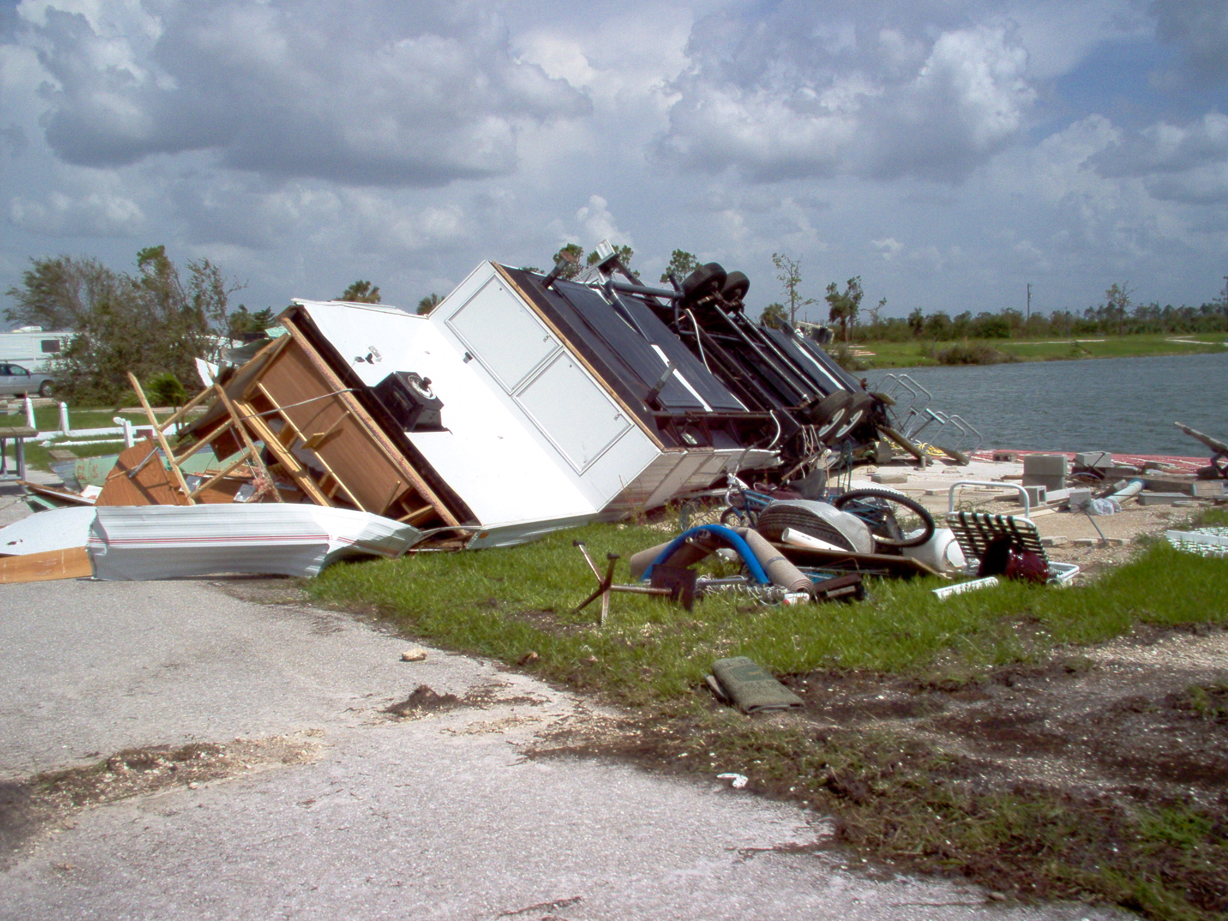
Good Focus

Slide 32
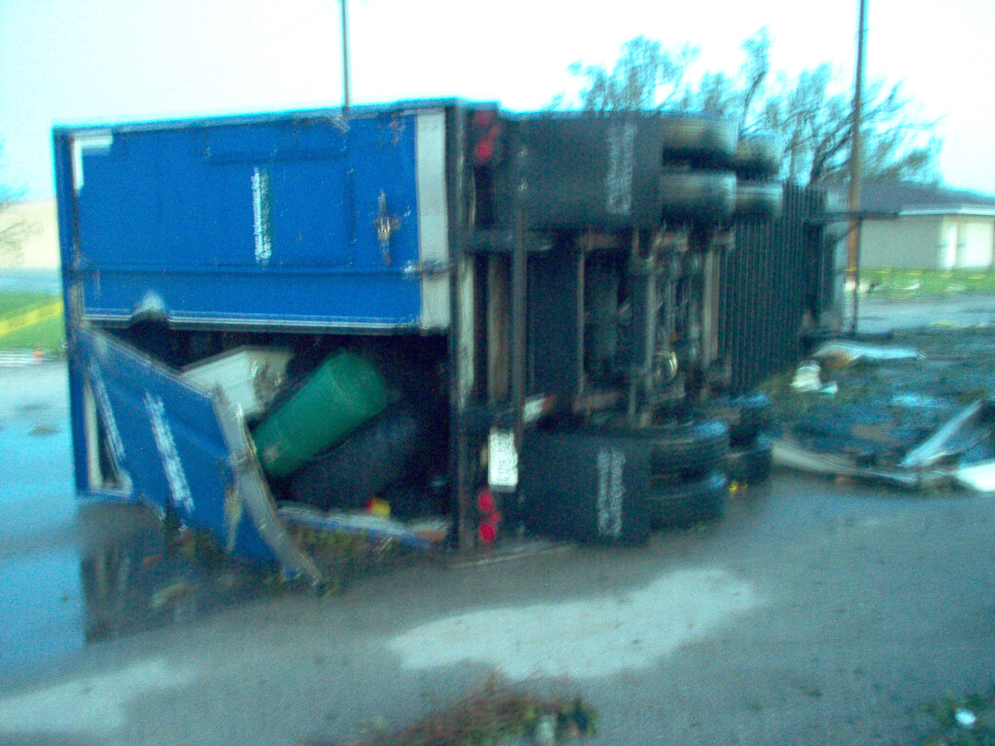
Bad Focus

Slide 33
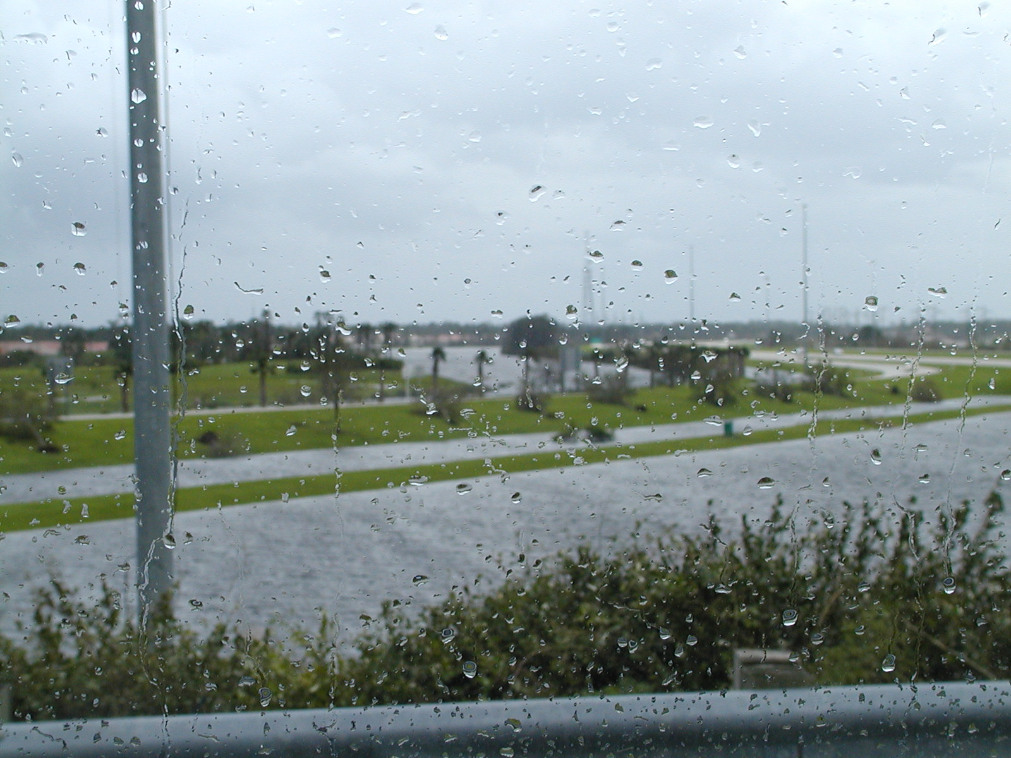
Bad Focus
Through glass

Slide 34
Perspective
Review from all sides, if possible, for the best
view
Far away and close up are often radically
different perspectives
Take multiple pictures to allow choice

Slide 35
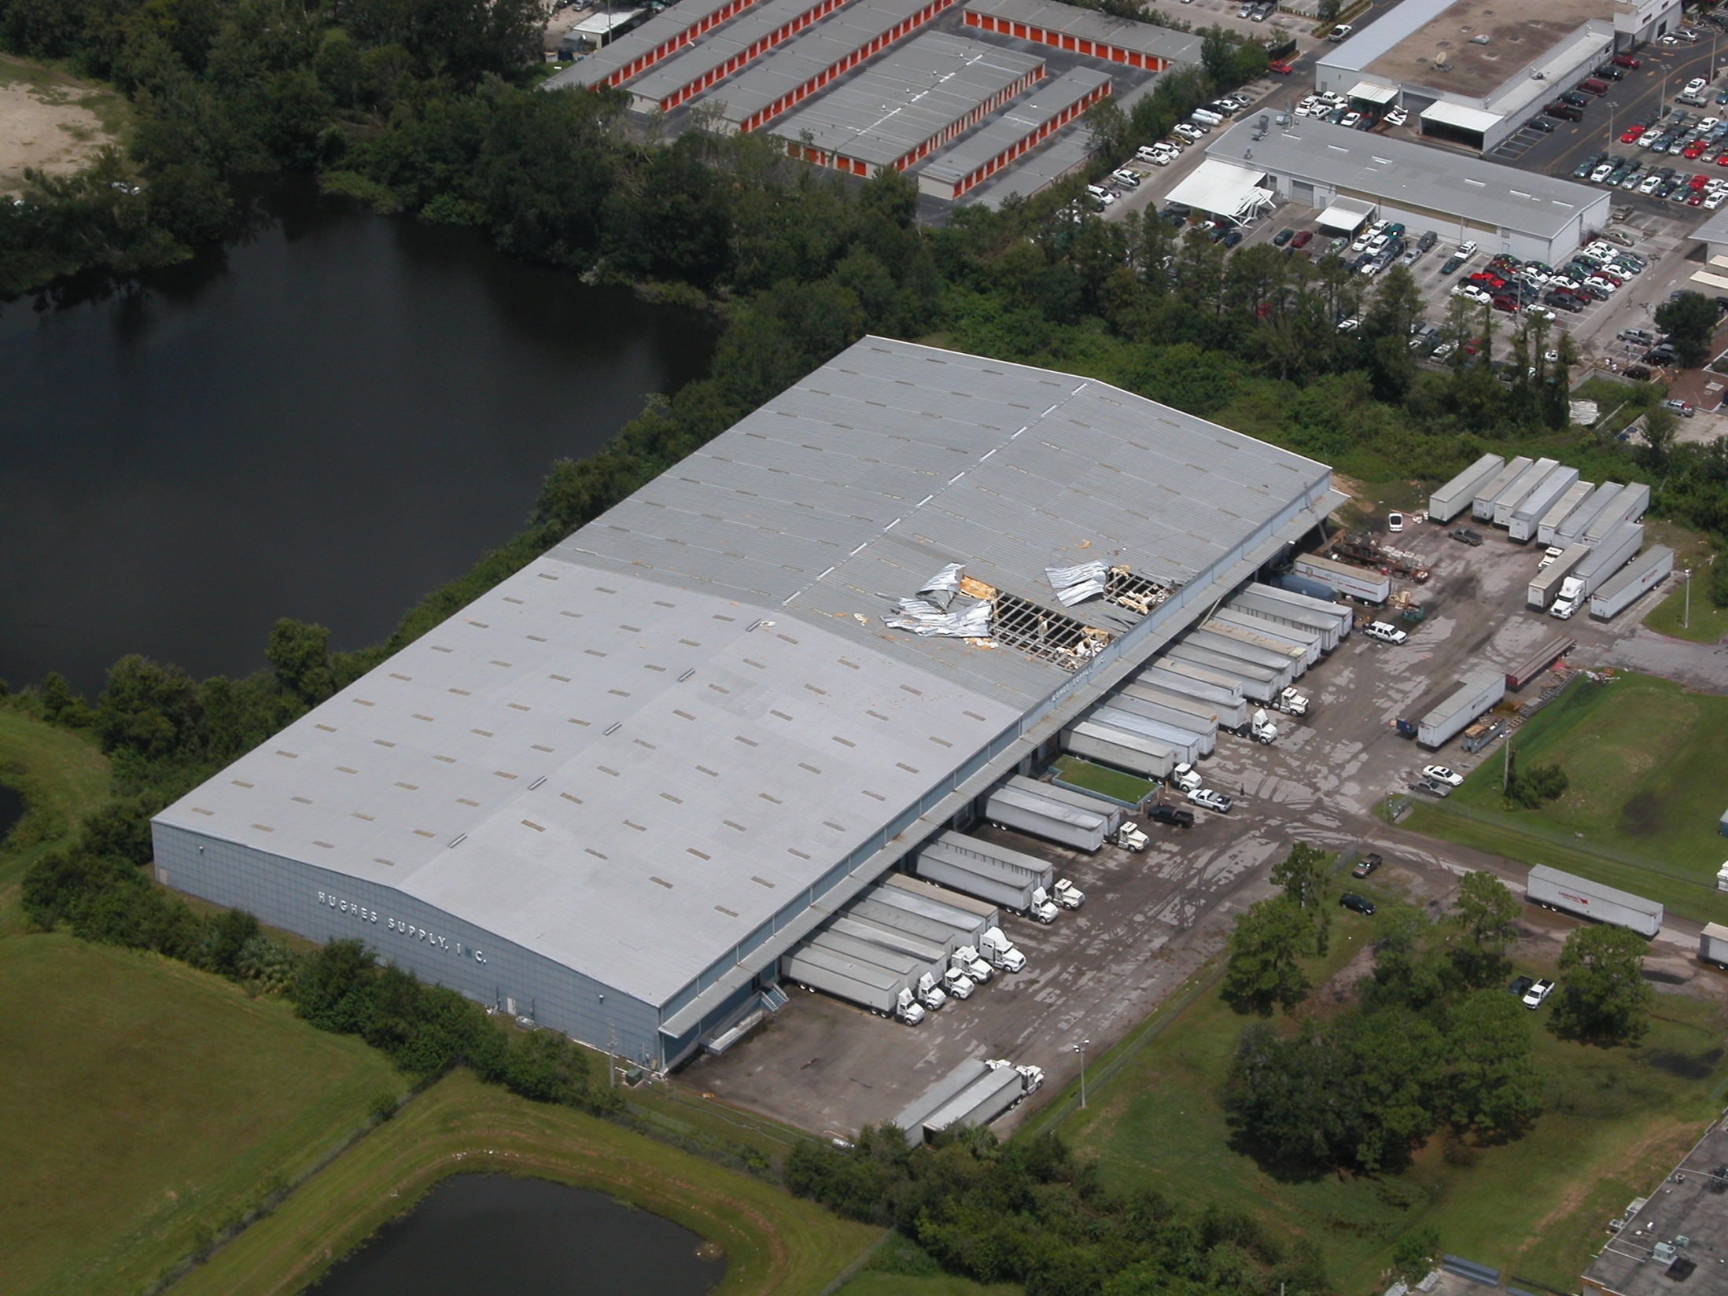
Good Far Perspective

Slide 36
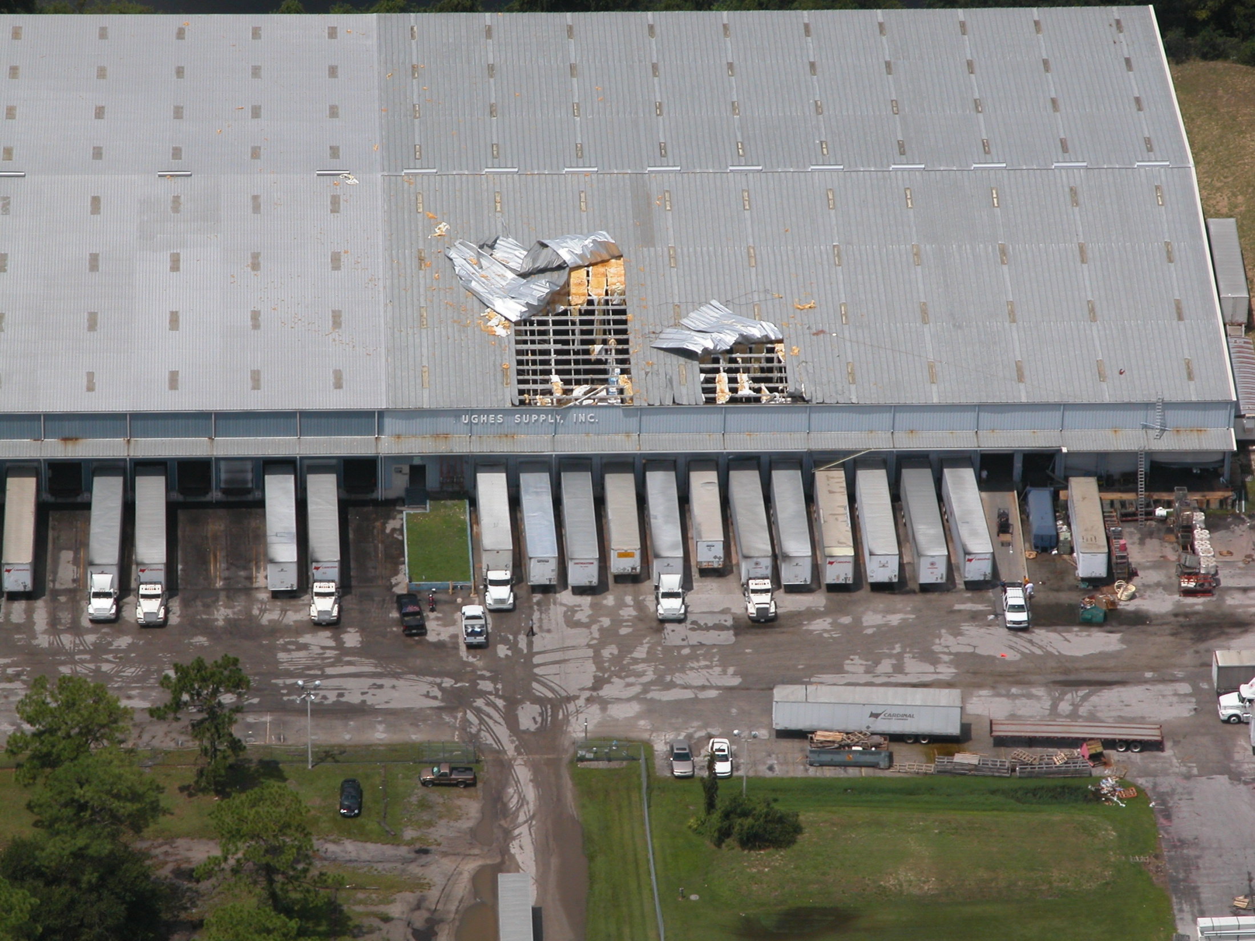
Good Close Perspective

Slide 37
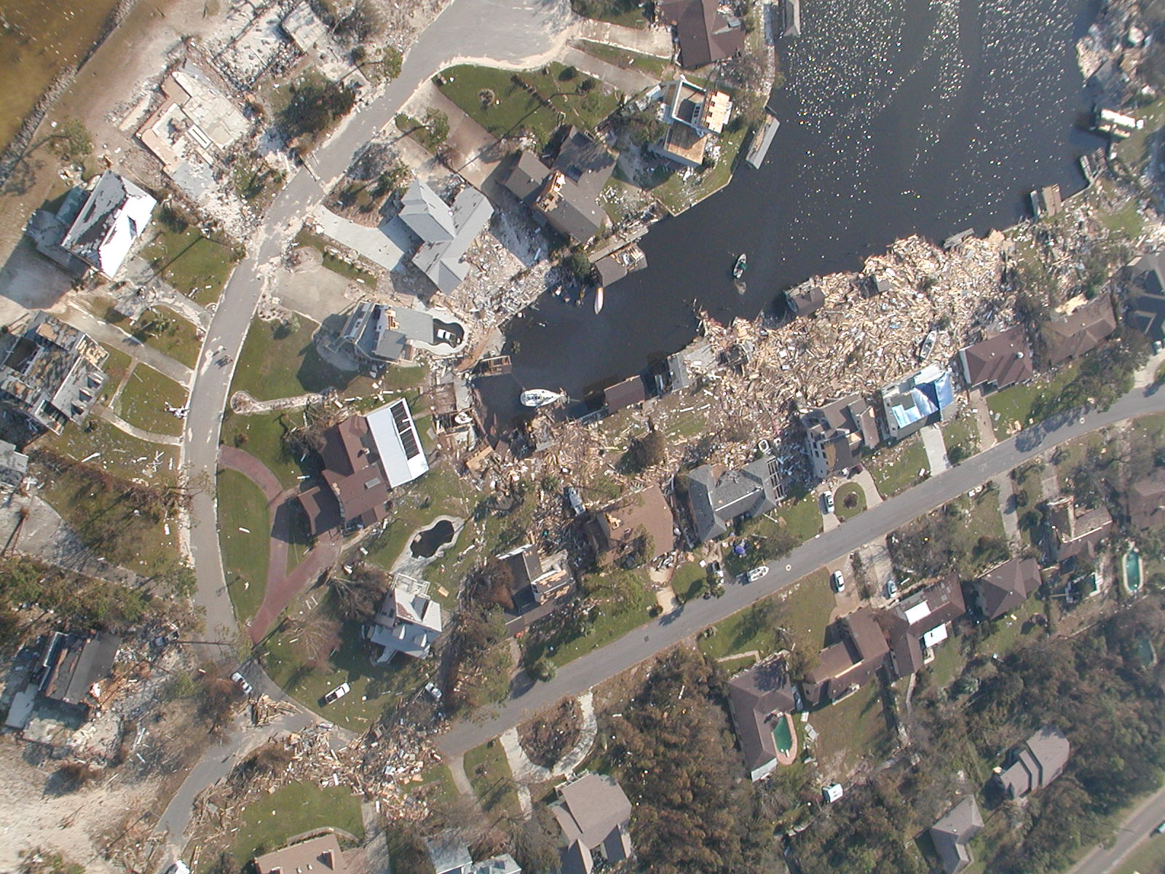
Bad Air Perspective

Slide 38
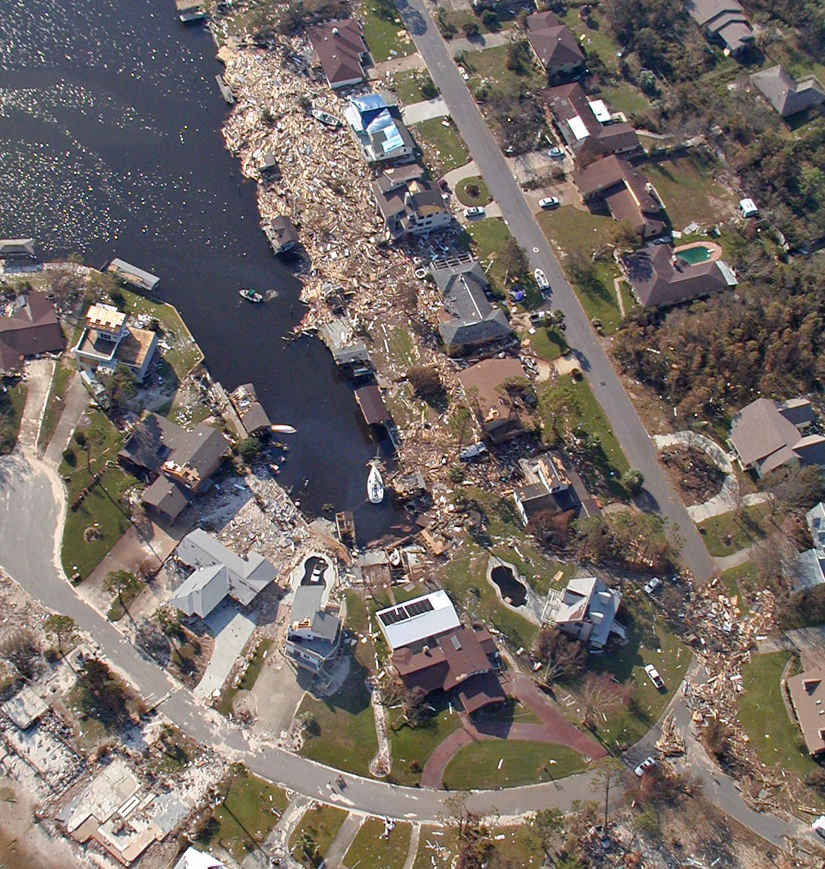
Good Air Perspective

Slide 39
Closer Air Perspective

Slide 40
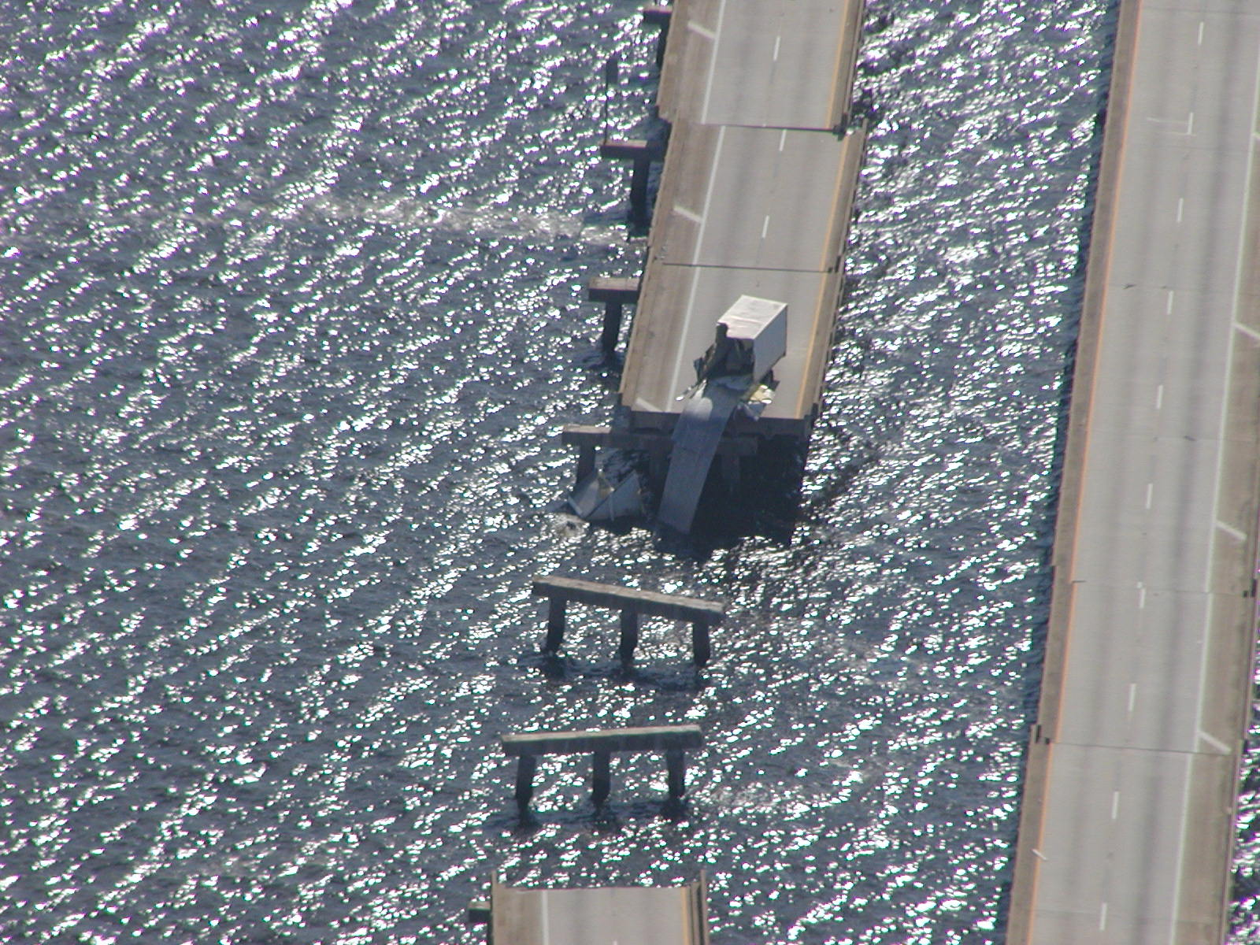

Slide 41
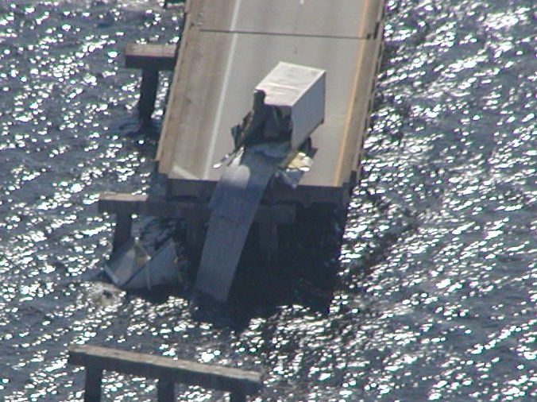

Slide 42
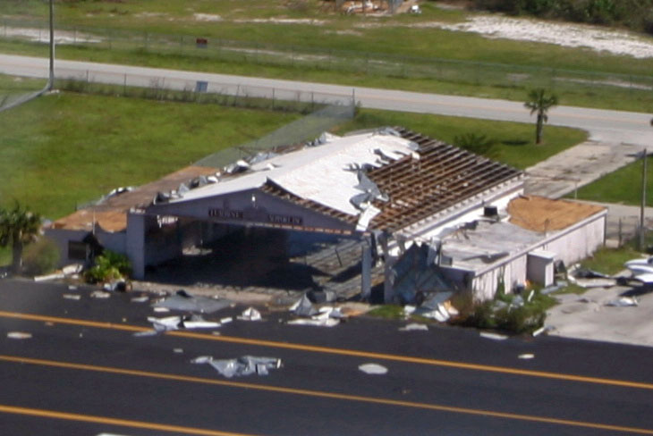

Slide 43
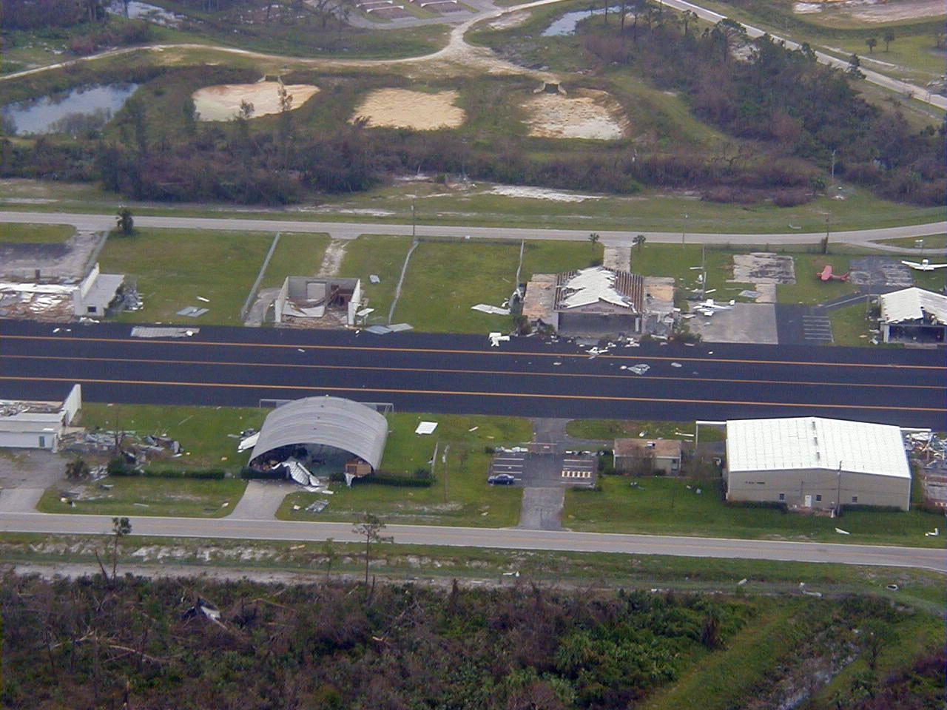

Slide 44
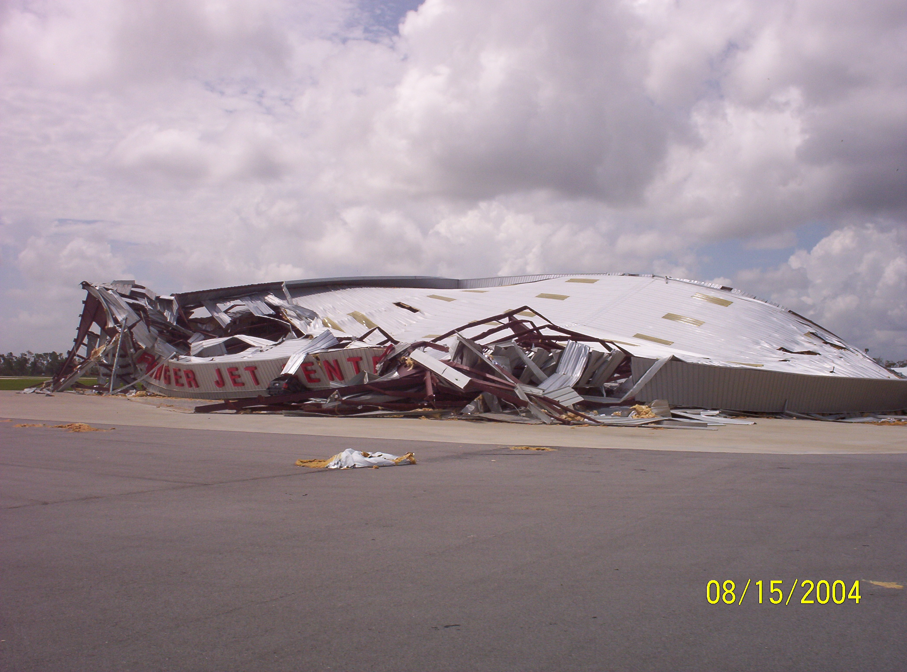

Slide 45
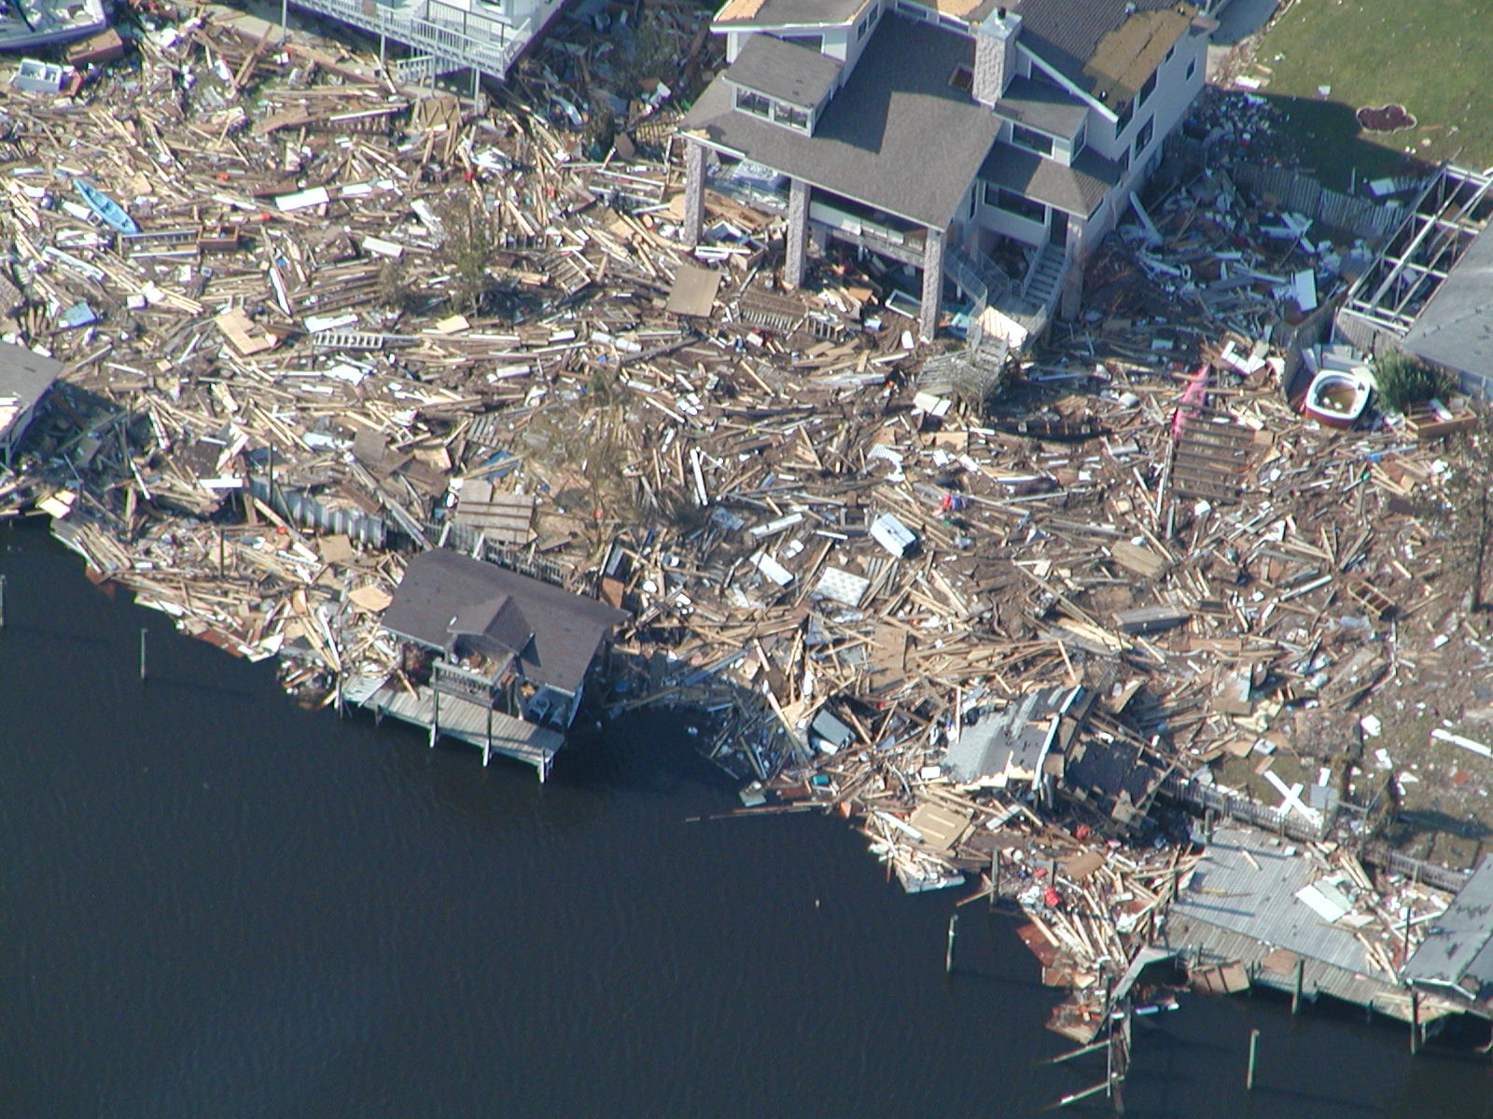

Slide 46
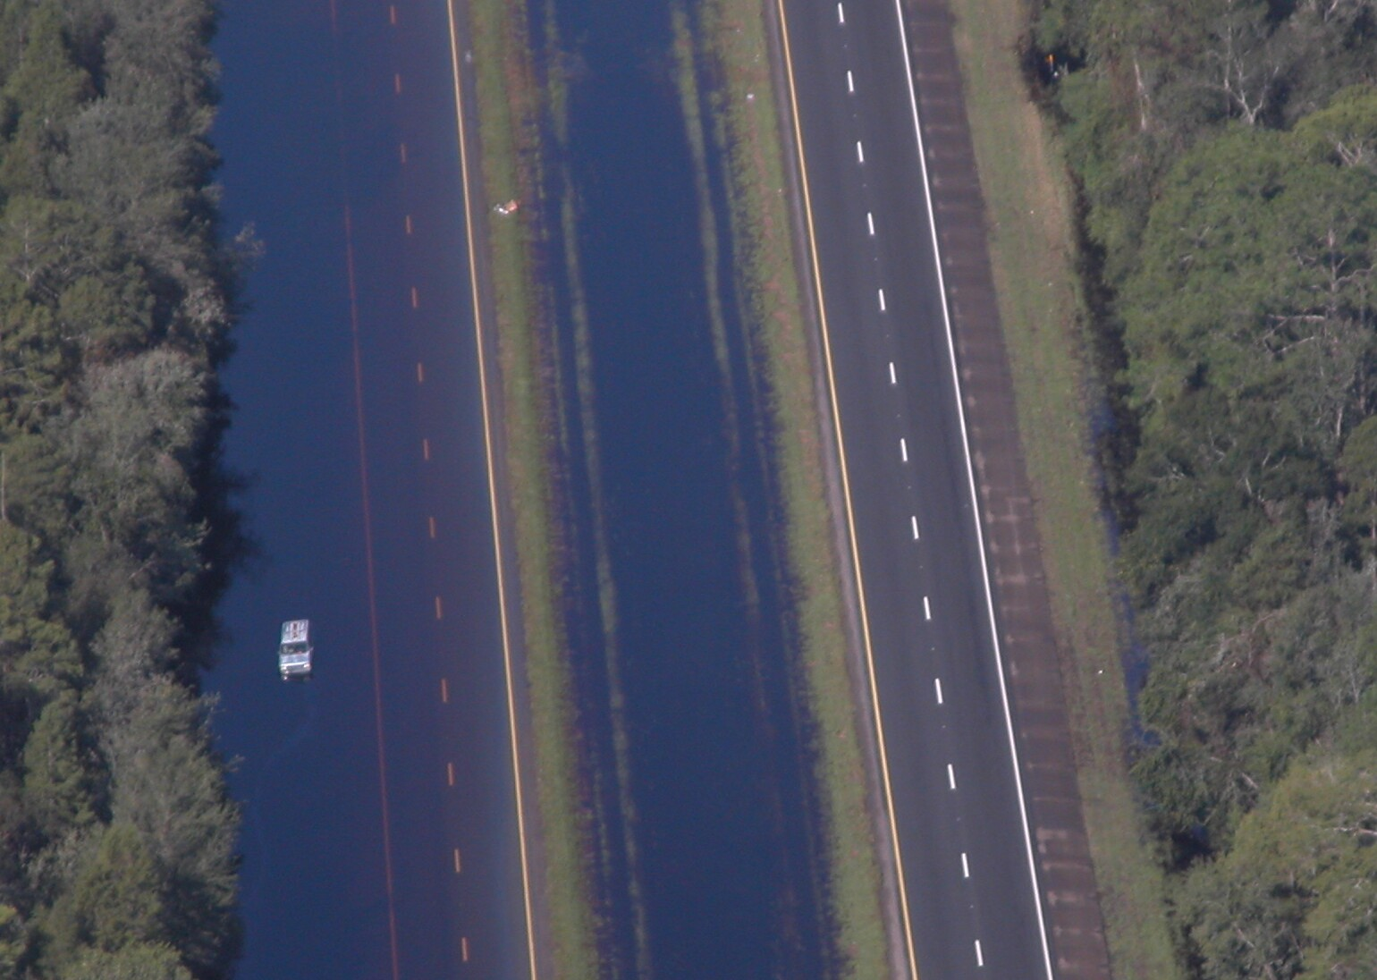
CAP Recon
I-10 Flooding

Slide 47
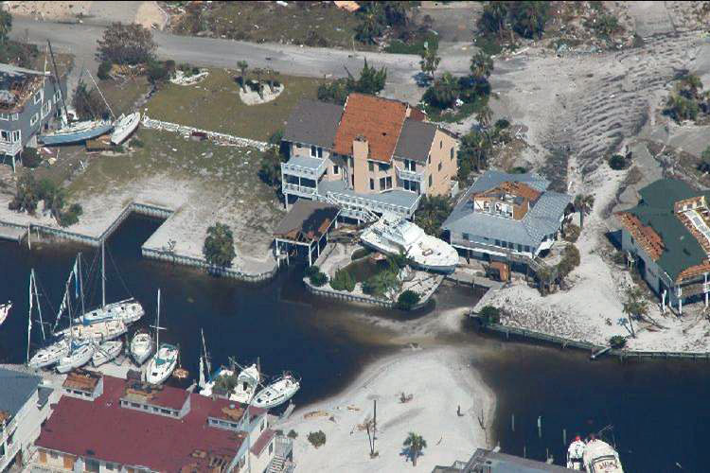

Slide 48
Picture Info
Location
  Latitude
  Longitude
Direction taken
Subject

Slide 49
QUESTIONS?
Notes:
49

