Slide 1
DEMES: Mutual Aid Program
Playbook

Slide 2

Table of Contents
Learning Objectives
Objectives
At the end of this course, you will be able to do the following:
Mutual Aid Enhancements Overview
Understand the Mutual Aid Portal enhancements
Create and complete Mission Ready Packages (MRP’S)
Manage Mission Ready Packages
Create Resource Service Agreements (RSA’s) from Mission Ready Packages
View and upload documentation to Claims
Mission Ready Package Manager
Creating and Completing MRP’s
Managing Existing MRP’s
Creating RSA’s from MRP’s
Viewing & Attaching Documentation to Claims

Slide 3
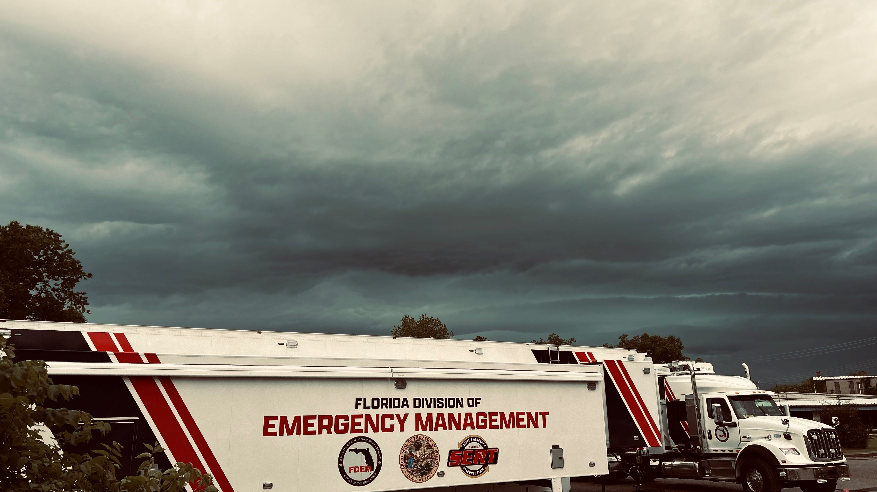
Mutual Aid

Slide 4
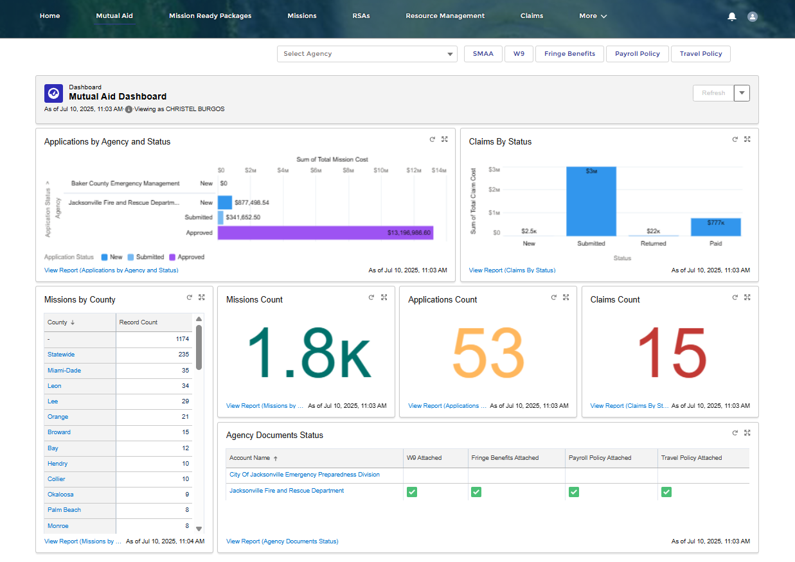
Mutual Aid Enhancements | External
FDEM has made several improvements to the DEMES experience for Mutual Aid users
Self-service process to request Mutual Aid access for Mutual Aid Partners without existing access
Added Contacts tab to more easily view and manage agency contacts
Enhanced functionality to make viewing and uploading attachments easier
Improved visibility into Claims and RSA submission deadlines through email notifications

Slide 5
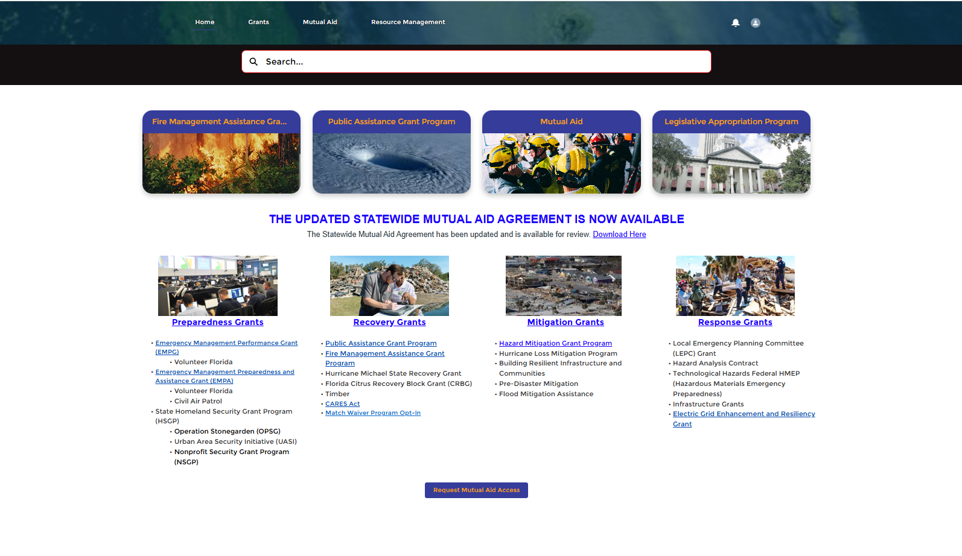
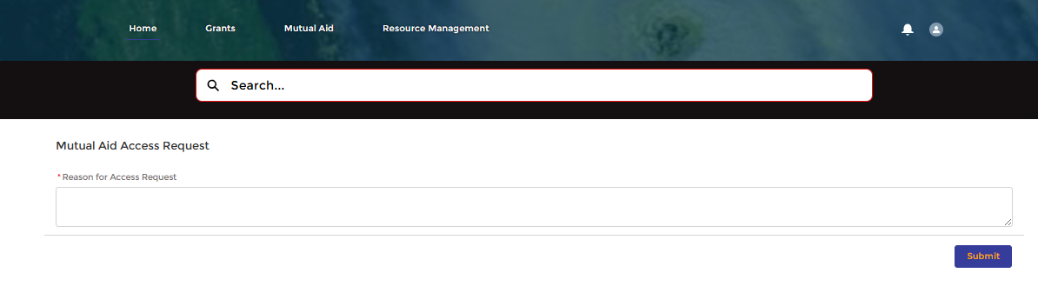
Mutual Aid Portal
Access Requests
Mutual Aid Partners who do not currently have Mutual Aid portal access, can now request it.
STEPS
From the DEMES home page, scroll to the bottom and select Request Mutual Aid Access.
A text box will appear at the top of the screen. Type in your reason for request (required field).
Click Submit.
A confirmation message will appear indicating your request has been submitted to FDEM. Click Close to exit.
1
2
3
NOTES
Agency and other info will be pulled from user record.
The Request Access button will not be visible to those individuals who already have access to the Mutual Aid portal.
Once the request is submitted, the Mutual Aid Coordinator will be notified to review the request, and a decision will be emailed to the requestor.
4
Notes:
Dev Approved
7629
As a Mutual Aid Coordinator, I want to collect required data from entities during Mutual Aid Portal Access requests, so that access can either be granted or denied in a timely manner.
As a Mutual Aid Partner, I want to enter key information when requesting access to the Mutual Aid Portal, so that access can be granted in a timely manner.
More data collection in portal means less manual follow up. Mutual Aid Partner – can self service the request and streamlines the process for the MAC.

Slide 6
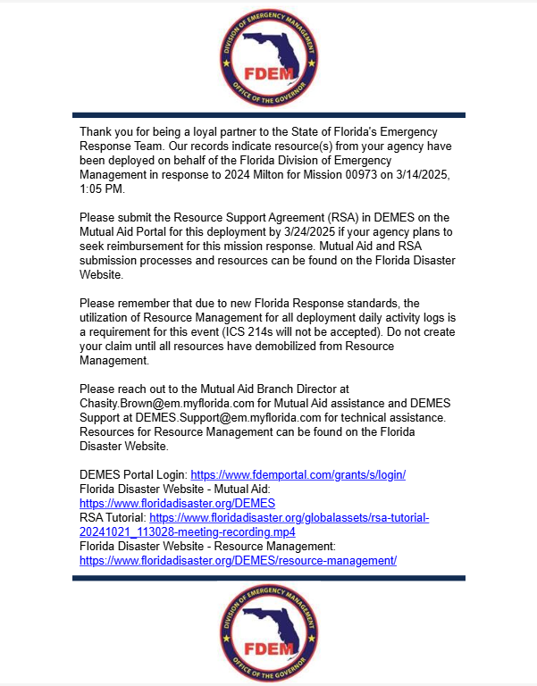
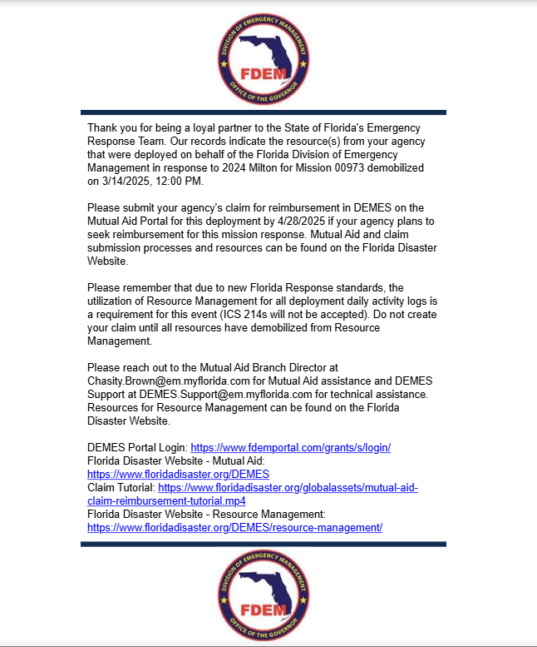
Notification Email for Assisting Agencies
Mutual Aid Partners will now receive email notifications about due dates
Previously: Mutual Aid Partners are not prompted about upcoming due dates for Claim and RSA submissions.
Enhancement: Mutual Aid Partners will now receive email notifications at mobilization and demobilization for claims and RSAs.
RSAs - Mutual Aid Partners will be notified at mobilization, 5 days after, and 10 days after mobilization, so Resource Support Agreements can be completed on time.
Claims - Mutual Aid Partners will be notified right after demobilization that the Claim is due in 45 days, 30 days, and then 15 days, and day of so that Claims can be submitted on time.
RSA
Claim
Notes:
BRD 7631
As a Mutual Aid Coordinator, I want Assisting Agencies to be notified at mobilization, 5 days after, and 10 days after mobilization, so that they can Resource Support Agreements can be completed on time.
As a Mutual Aid Coordinator, I want Assisting Agencies to be notified right after demobilization that it is due in 45 days, 30 days, and then 15 days, and then the day it’s due so that Claims can be submitted on time.
Improved efficiency and time savings by reducing manual email efforts.
Improved data visibility into status without logging in to check in DEMES.

Slide 7
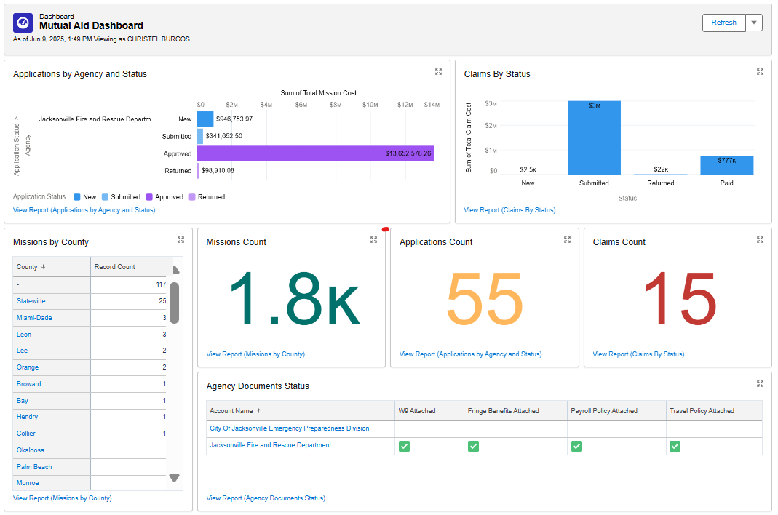
Mutual Aid Portal Dashboard
The home page of the Mutual Aid Portal displays a dashboard containing high level views of key metrics related to Mission data
Key metrics highlighted in the dashboard include:
Applications by Agency and Status
Claims By Status
Missions by County
Missions Counts
Application Count
Claims Count
Agency Documents Status
A
B
C
D
E
F
G

Slide 8
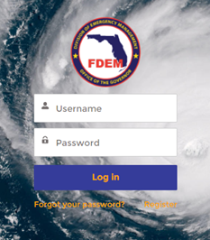
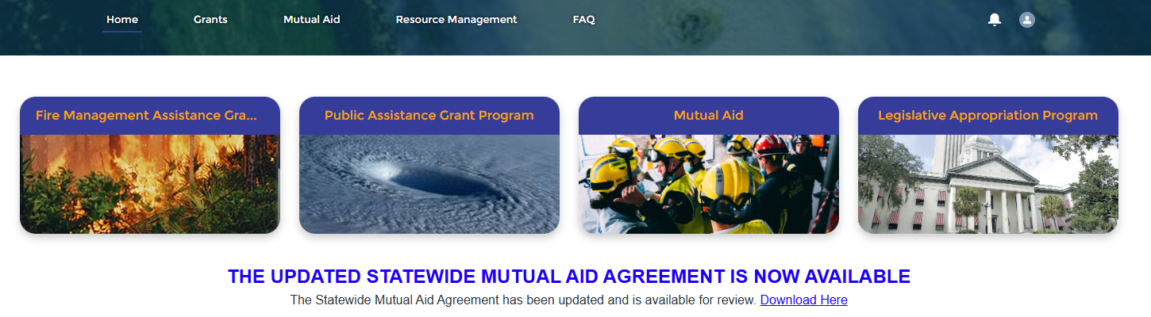
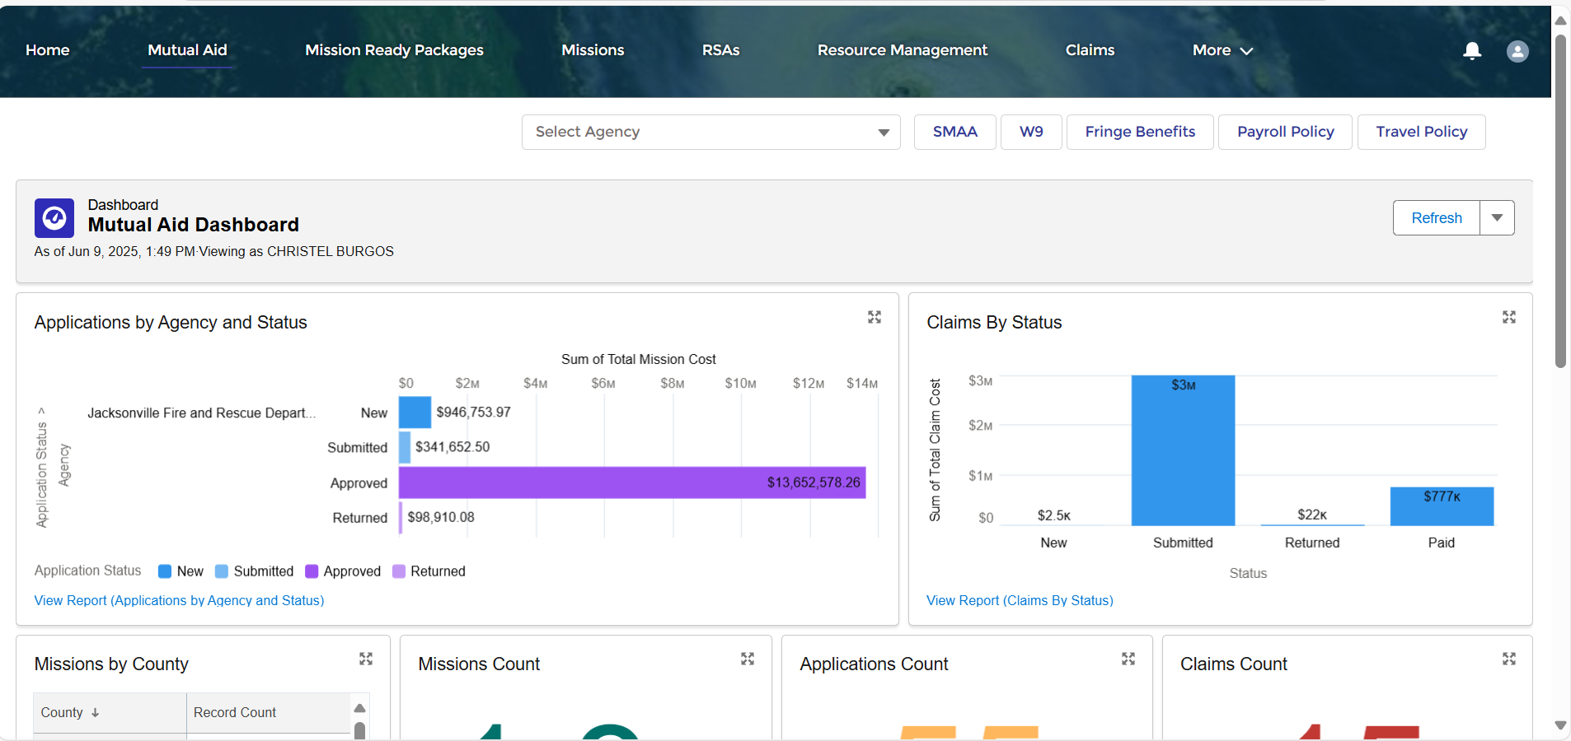
Mutual Aid Portal
Dashboard
1
The home page of the Mutual Aid Portal displays a dashboard containing key metrics related to Mission data
2
STEPS
Login into the Mutual Aid portal using your credentials
Once on the home page of the portal click on the Mutual Aid tab in the header bar
Upon clicking the tab, you will be directed to the Mutual Aid Dashboard
3
3
NOTES
Use the Refresh button at the top of the dashboard to load the latest data for all reports on the dashboard
Click on the expansion button on any of the reports to see a larger view of that report
Each report is hyperlinked at the bottom of the report component, users can click on these links to be brought to entire report within the portal
Notes:
Dev Approved
7629
As a Mutual Aid Coordinator, I want to collect required data from entities during Mutual Aid Portal Access requests, so that access can either be granted or denied in a timely manner.
As a Mutual Aid Partner, I want to enter key information when requesting access to the Mutual Aid Portal, so that access can be granted in a timely manner.
More data collection in portal means less manual follow up. Mutual Aid Partner – can self service the request and streamlines the process for the MAC.

Slide 9

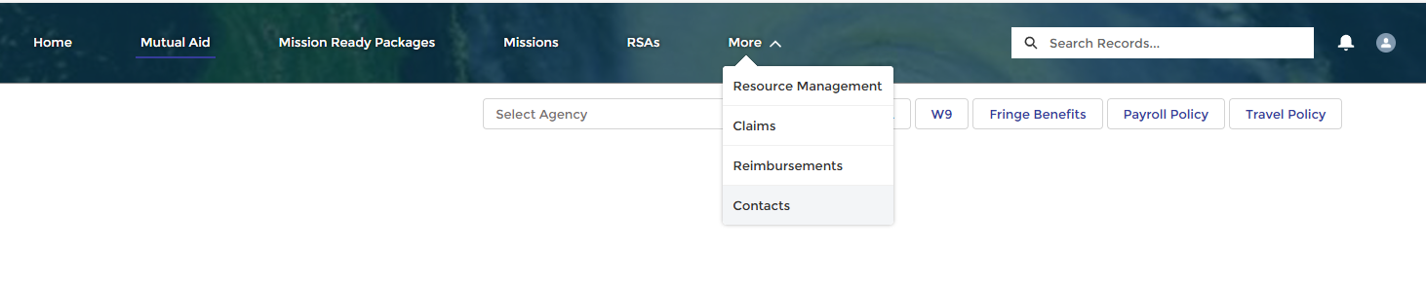
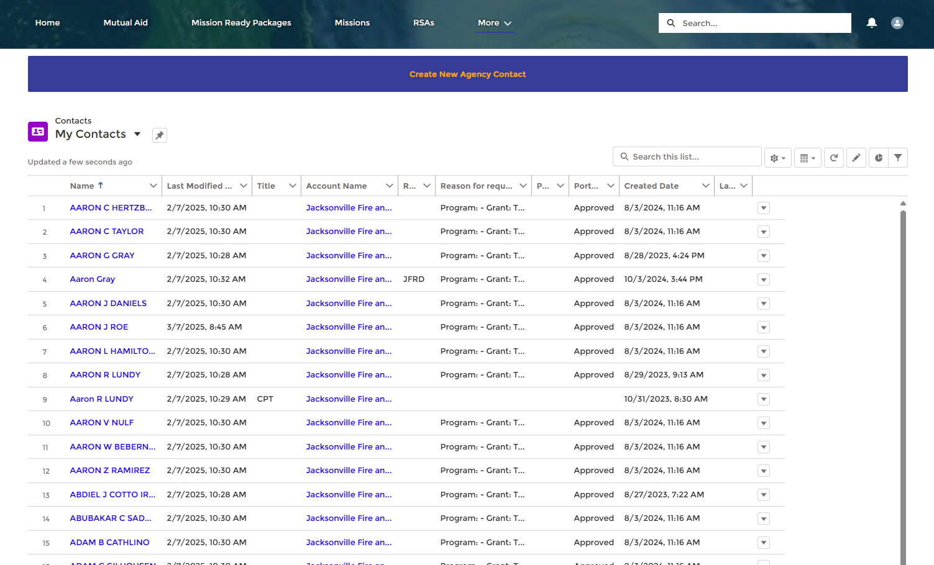
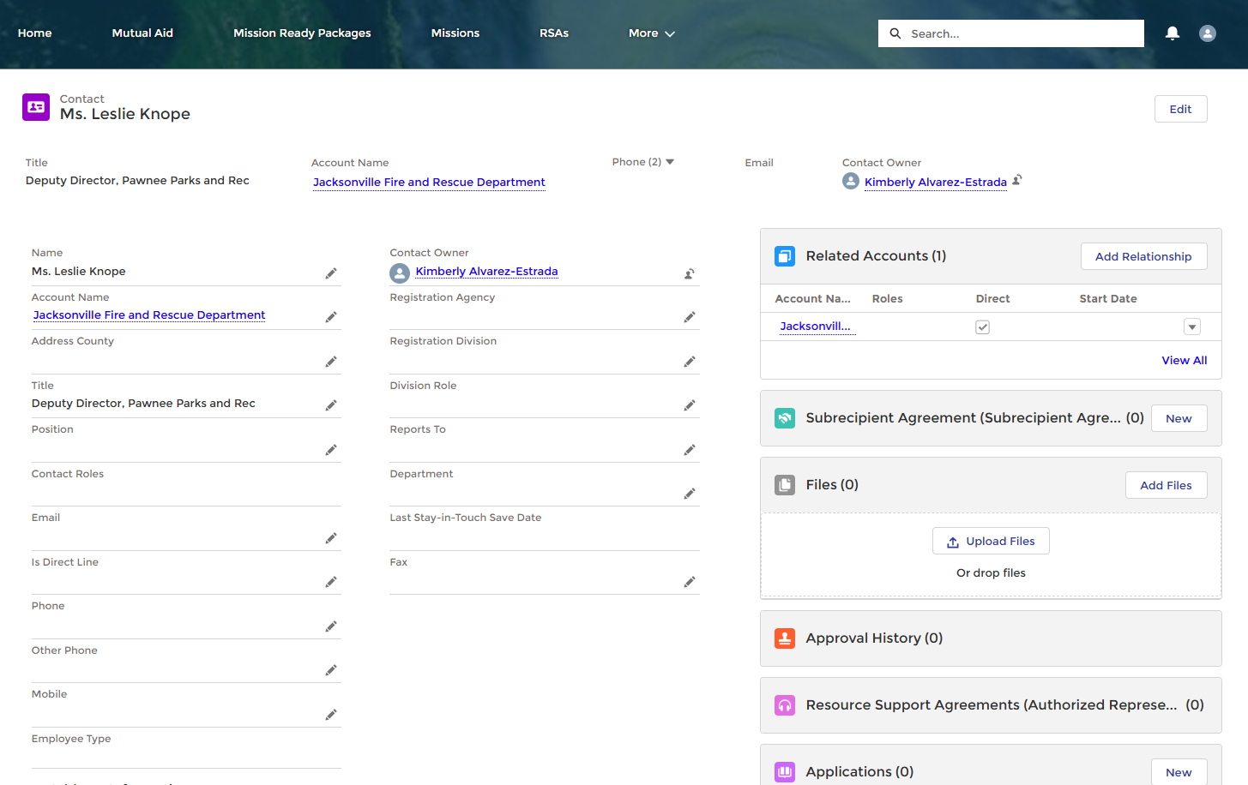
View Contacts from the Mutual Aid Portal
1
Mutual Aid Users can now view and edit their contacts from within the portal.
2
STEPS
Viewing Contacts
Once logged in to DEMES, click on the Mutual Aid tab in the header bar.
From the Mutual Aid landing page, select More and then Contacts.
The My Contacts page will appear.
Edit Contacts
Select the contact you want to edit by clicking their name.
The contact’s record page will appear. Edit fields as needed.
3
4
5
Notes:
7628
Is seeing My Contacts new for external users? If so, do we need to cover what info is in all columns?

Slide 10
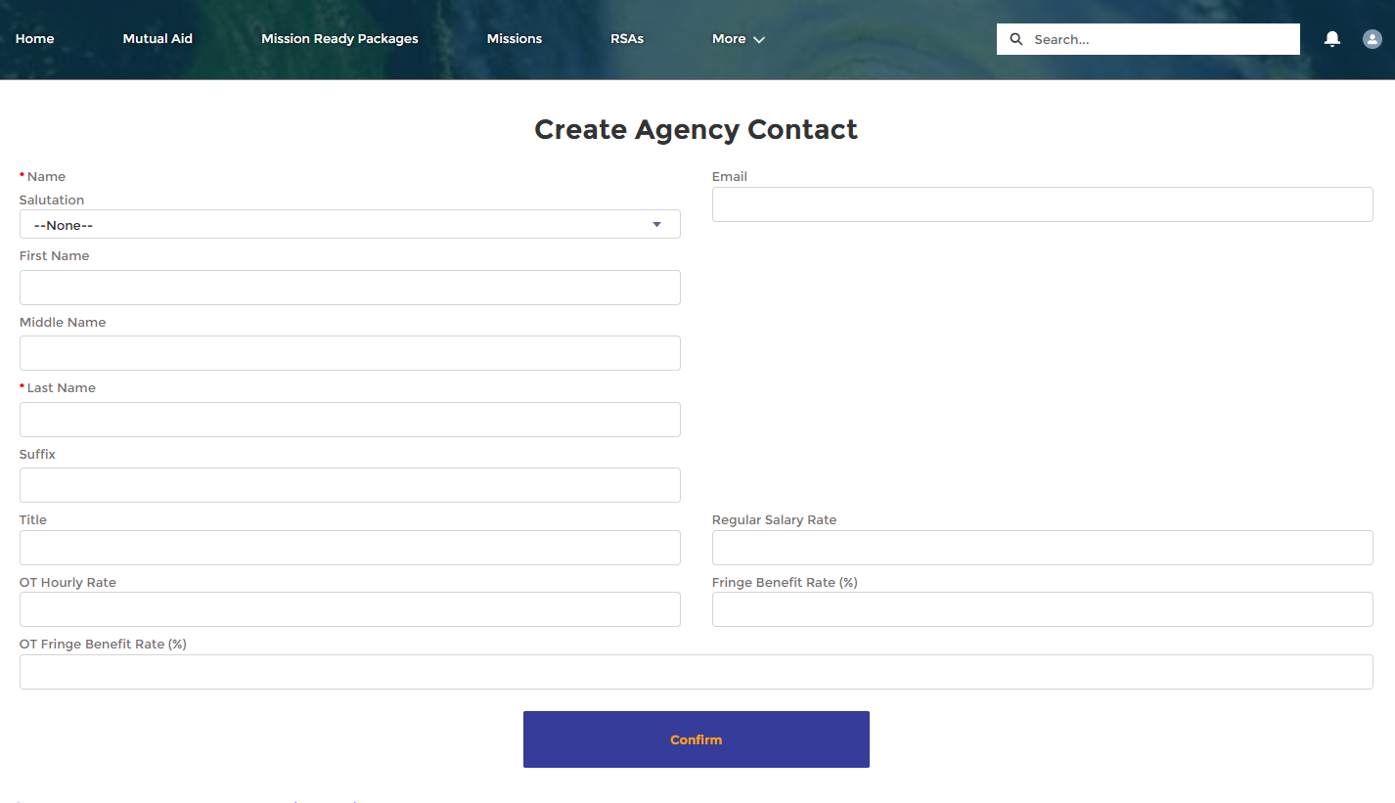
Add Contacts from the Mutual Aid Portal
1
Mutual Aid Users can now add a contact from within the portal.
STEPS
From the My Contacts page, select Create New Agency Contact at the top.
The Create Agency Contact page will appear. Complete all known fields.
Select Confirm to save the new contact.
The new contact’s record page will appear. Edit as needed.
2
3
NOTES
Agency and other info will be pulled from user record.
The Request Access button will not be visible to those individuals who already have access to the Mutual Aid portal.
Once the request is submitted, the Mutual Aid Coordinator will be notified to review and a decision will be emailed to the requestor.
3

Slide 11

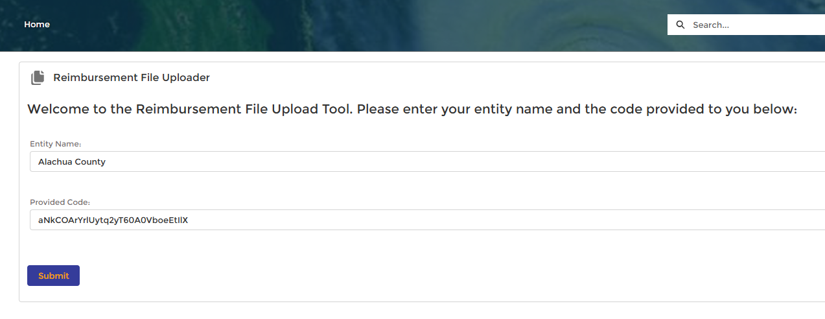

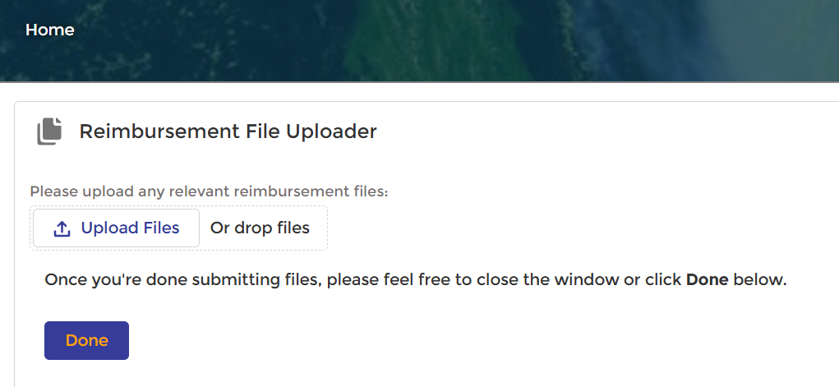
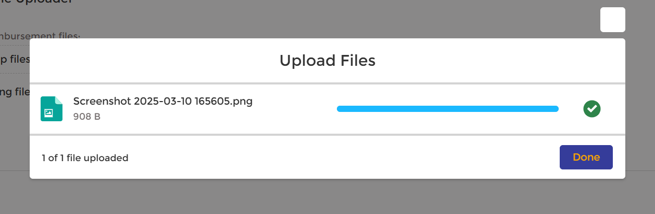
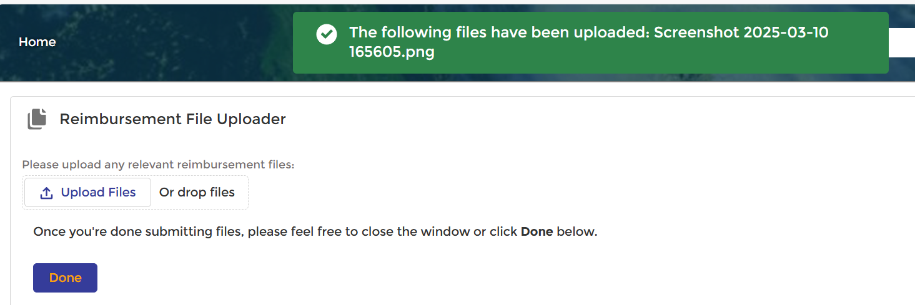
Reimbursement File Uploader (State Reps)
1
2
Assisting state reps will now upload files for reimbursement through a dedicated, secure portal. Previously, files were sent via email directly to the Mutual Aid Coordinator.
3
4
STEPS
Once a reimbursement email is received, select the link provided.
The Reimbursement File Upload Tool landing page will appear.
Enter in your Entity Name and the Provided Code from the email.
Select Submit.
The Reimbursement Filed Uploader will appear.
Select Upload Files.
Select files to upload and select Done once uploaded.
A confirmation notification will appear if successfully uploaded.
Once all files are uploaded, select Done.
5
6
7
8
NOTES
State Reps will need to contact the Mutual Aid Coordinator via email to be granted access to the reimbursement tool
Users do not need to have a DEMES account to upload reimbursements through the portal.
9

Slide 12
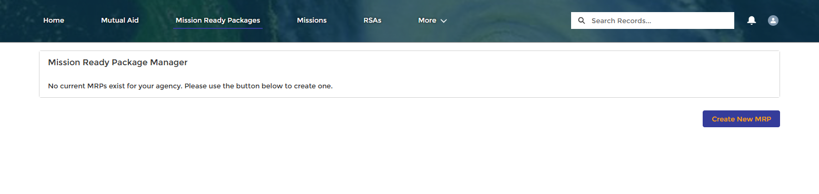
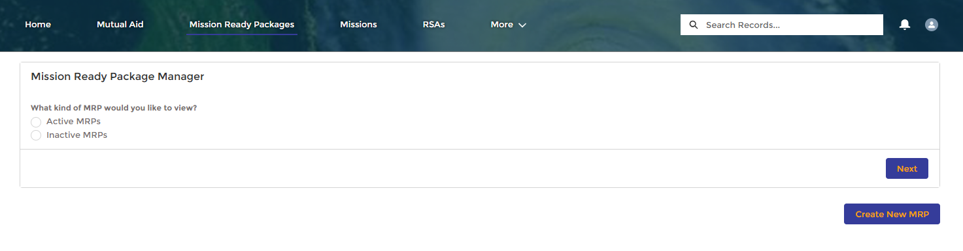
Mission Ready Package Manager
The Mission Ready Package Manager screen allows you to view and manage your existing MRPs.
Before an initial MRP is created, users will only have the option to Create New MRP.
Once an MRP is created, the Mission Ready Package Manager will be visible from the MRP landing page.
Users can choose to view either Active or Inactive MRPs from the MRP Manager screen.
Notes:
Update with new screen.

Slide 13
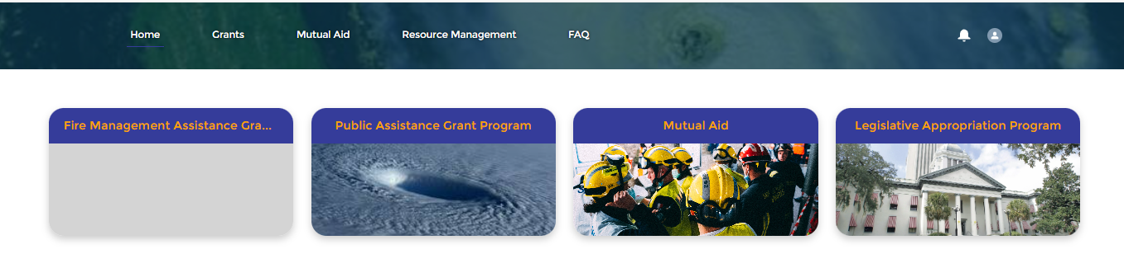
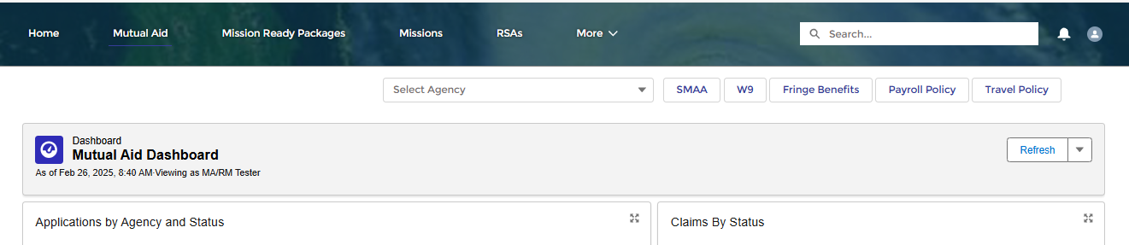

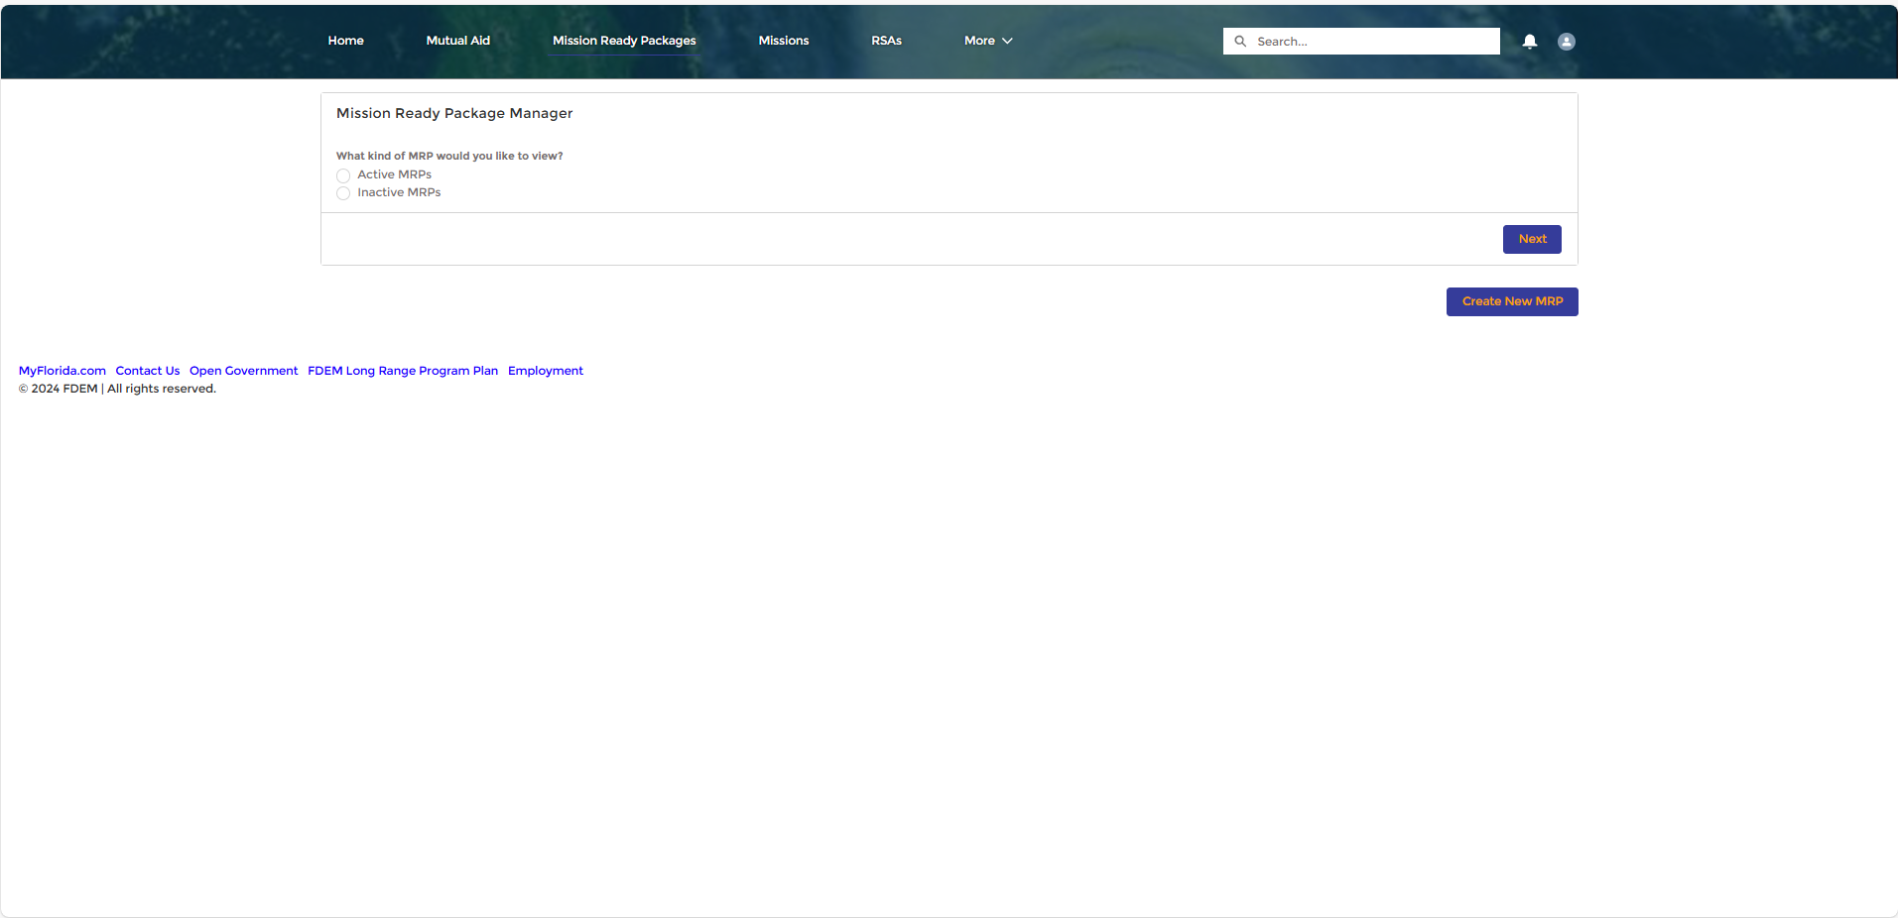
Mission Ready Packages
2
The MRP landing page gives users the option to create new MRPs or if there are existing MRPs, access the MRP Manager. You will need to be in the https://www.fdemportal.com/grants
1
STEPS
Enter your Username and Password, and click log in
Once logged in to DEMES, click on the Mutual Aid tab in the header bar.
Select the Mission Ready Packages tab in the header bar.
The Mission Ready Package landing page will appear.
  Users whose agency does not have an MRP created yet, will only see the option to create a new one.
  Users with existing MRPs will see the option to manage Active and inactive MRPs or Create New MRP.
3
4a
4b
NOTES
RSAs are only estimates, and the Mutual Aid Partner will still need to finalize the information by updating existing or completing missing information.

Slide 14
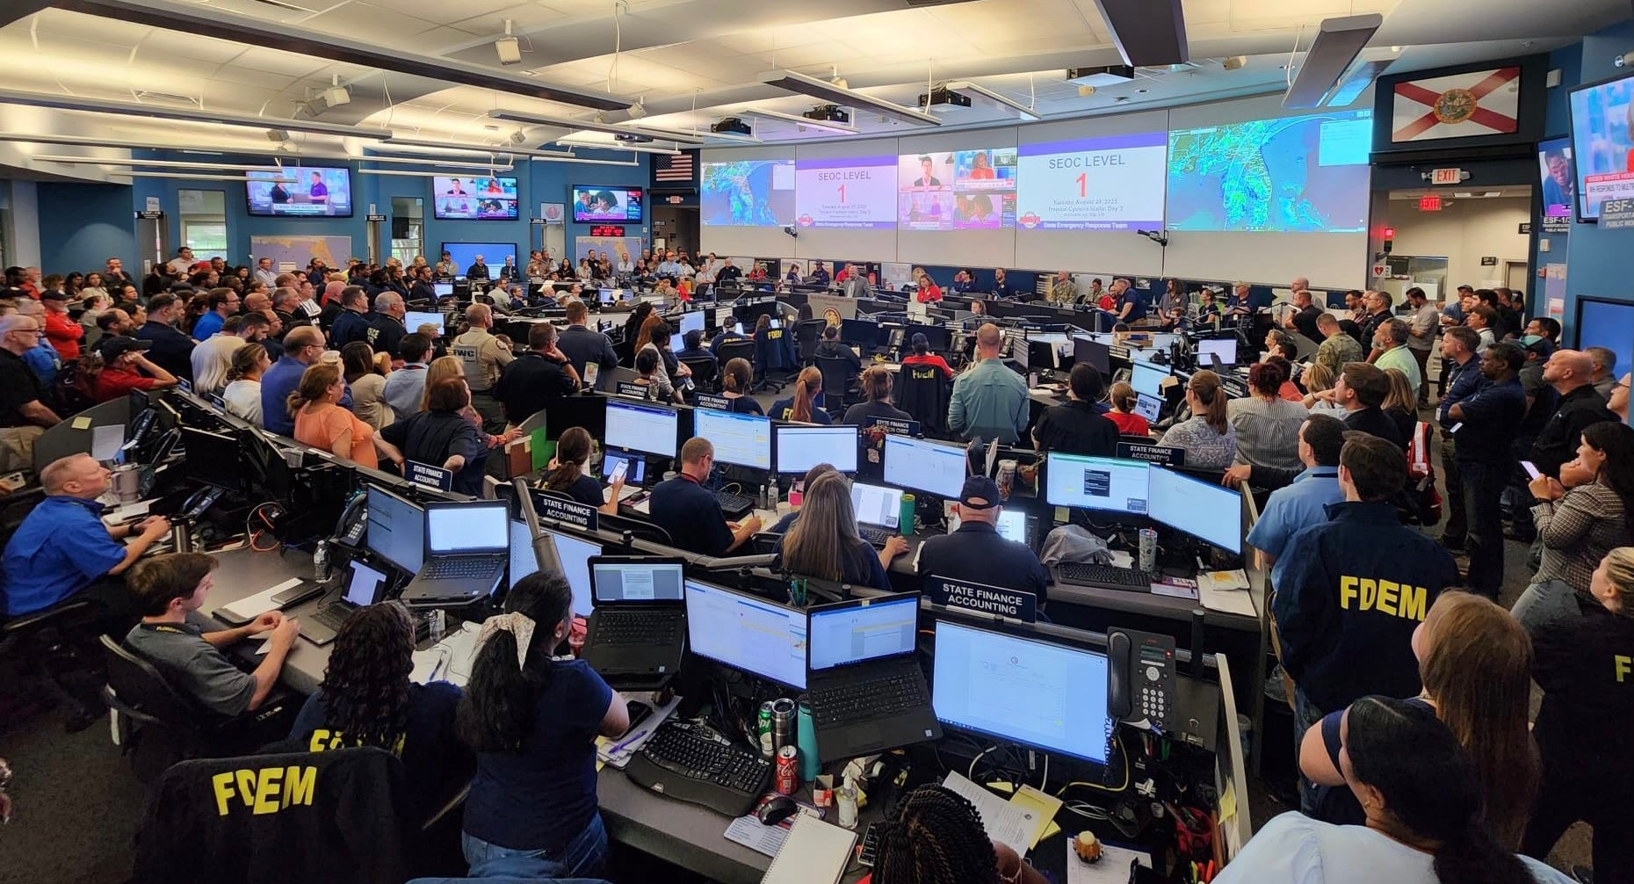
Creating a New Mission Ready Package

Slide 15
Creating MRPs – Single and Multiple Agency
Each agency will have its own unique set of Mission Ready Packages.
Single agency Mutual Aid Partners will select Create New MRP and classify it with a deployment type of their choosing.
Mutual Aid Partners with multiple agencies will first select which agency the MRP should be assigned and then will choose the classification of deployment type.

Slide 16
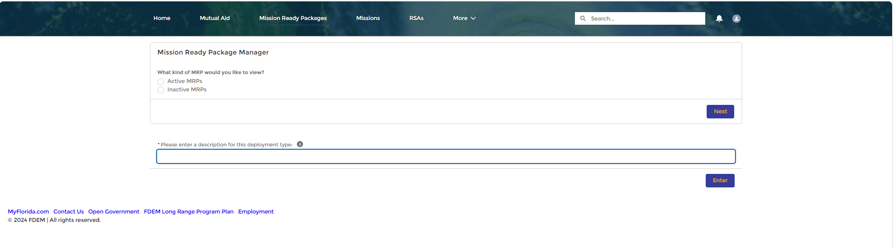
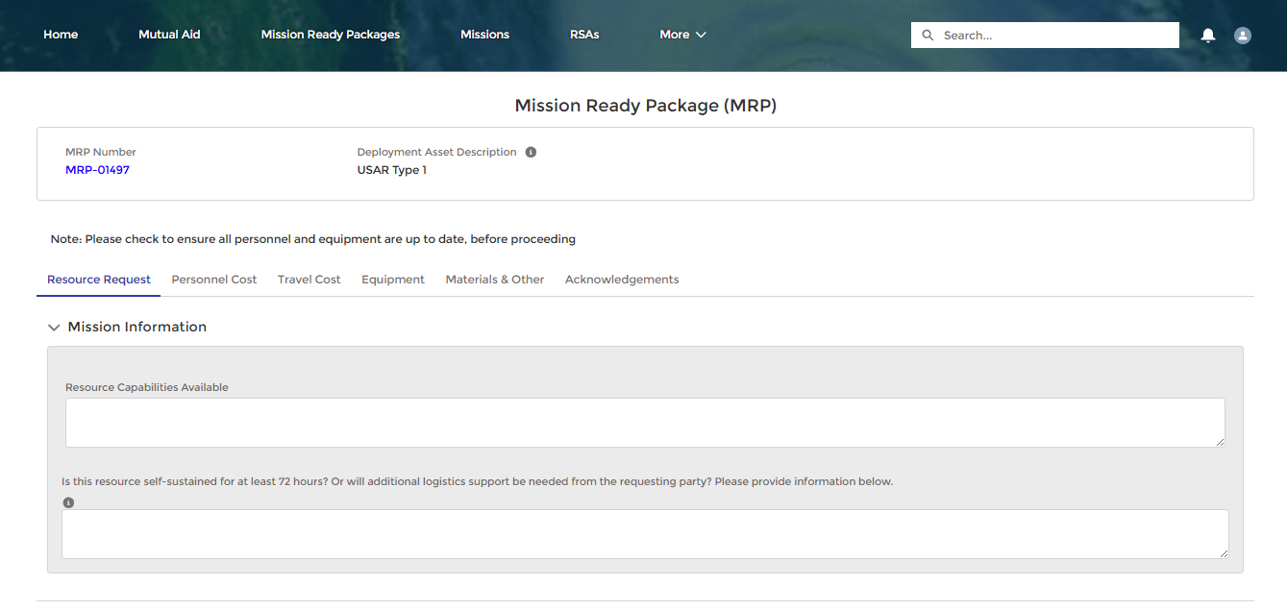
Create MRP: Single Agency
Follow this process to establish a new Mission Ready Package in DEMES if you only manage a single agency account.
1
STEPS
From the Mission Ready Package landing page, select Create New MRP.
Enter in a description of the deployment type.
Select Enter and the MRP page will appear.
Take note of the MRP # and record for future use.
  Best Practice: Complete the MRP by adding cost and resource information. Incomplete MRPs will be saved under Inactive in the MRP Manager until values are added to sections. See “Completing an MRP” in the training materials for detailed steps.
2
3
4
NOTES
The deployment type is a free form field. Mutual Aid Partners can name and organize the MRP by a deployment type relevant to their agency. An example of a deployment type would be “USAR Type IV Team 3”.
Take note of what deployment types you have used previously to keep your data consistent.
Notes:
Engine Strike Team
Law Enforcement Strike Team
Ambulance Strike Team

Slide 17
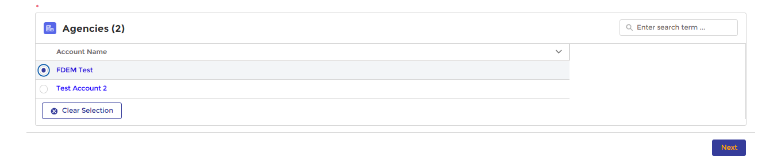
Create MRP: Multi-Agency
1
Follow this process to establish a new Mission Ready Package in DEMES if you manage multiple agency accounts. Mutual Aid Partners with multiple agencies will have unique MRP libraries with each agency having their own library of MRPs.
2
STEPS
Select Create New MRP.
Select which agency to create a new MRP for.
Select Next.
Enter in a description of the deployment type.
Select Enter and the MRP page will appear.
Take note of the MRP # and record for future use.
  Best Practice: Complete the MRP by adding cost and resource information. Incomplete MRPs will be saved under Inactive in the MRP Manager until values are added to sections. See “Completing an MRP” in the training materials for detailed steps.
3
4
5
6
NOTES
The deployment type is a free form field. Mutual Aid Partners can name and organize the MRP by a deployment type relevant to their agency. An example of a deployment type would be “USAR Type IV Team 3”.
Take note of what deploy
ment types you have used previously to keep your data consistent.
Notes:
Update with new look

Slide 18

Completing an MRP

Slide 19
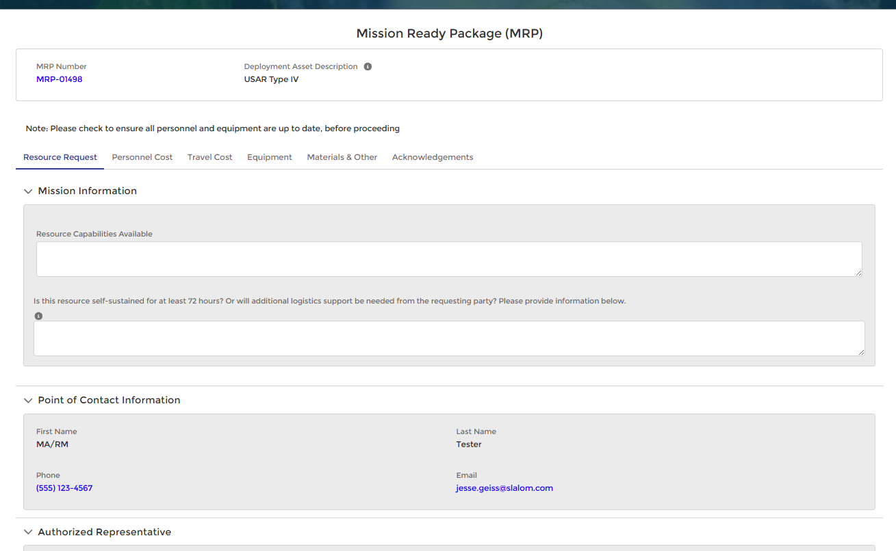
Completing an MRP Overview
Once an MRP is established, you can add additional data such as resources and costs to be saved to the template.
Each Mission Ready Package record includes:
MRP Number
Deployment Asset Description
Tabs for deployment details:
  Resource Request: General resources capabilities available and contact information
  Personnel Cost: Add individuals and associated cost
  Travel Cost: Enter general travel info, such as lodging and transportation
  Equipment: Add individual pieces of equipment with FEMA codes
  Materials & Other: Add materials with cost and amount for each
  Acknowledgements: Summary view of each tab indicating whether it’s been saved or not
A
B
C
The MRP is built to mirror the RSA form and requires the same steps to complete.
The Save button on each tab MUST be clicked to finalize the MRP.
Edits can be made to the information entered until the final submission step.
A check mark will appear next to the tab name once the submit button has been clicked and the information has been recorded.

Slide 20
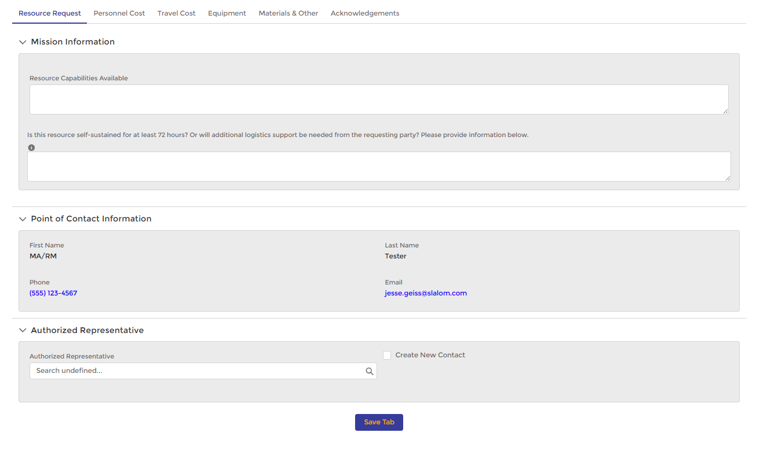
Resource Request
Follow this process to enter Resource Request details into an existing Mission Ready Package.
1
STEPS
Click the Resource Request tab from the MRP page.
Enter in Resource Capabilities Available and indicate if resources are self-sustained for 72 hours.
Confirm Point of Contact Information.
Type in the Authorized Representative’s name and select from the list.
  If you need to add a new Agency Authorized Representative, click the box to add a contact to your agency record.
Click Save Tab to record the entered information to the MRP.
2
3
4
a
5
NOTES
Edits can be made to the information entered until the final submission step.
A check mark will appear next to the tab name once the submit button has been clicked and the information has been recorded.

Slide 21
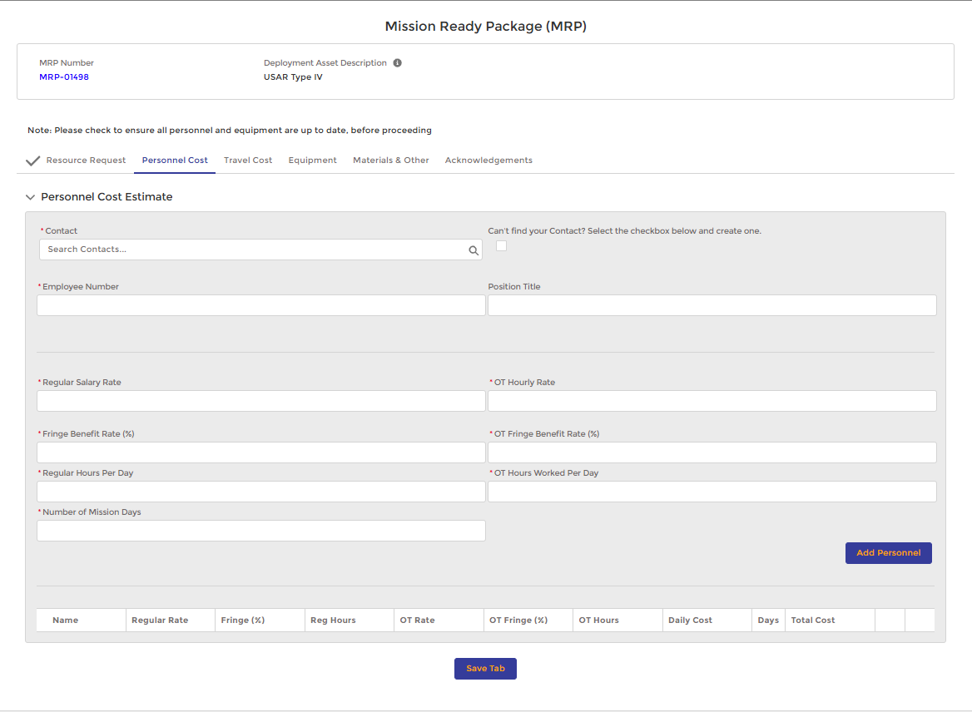
Personnel Cost
Follow this process to enter Personnel Cost details into an existing Mission Ready Package. Continue these steps for each contact that needs to be included in the MRP.
1
STEPS
Click the Personnel Cost tab
Type in Contact Name in the Search Contacts bar and select from the list. The employee number, position title, and rates will pre-populate
  Click the Create New Contact box if your agency needs to add a new Authorized Representative to DEMES
Enter in Regular Hours Per Day, OT Hours Worked Per Day, and Number of Mission Days
Click the Add Personnel button to record
  Contact will appear, along with the information entered, in a list view, confirming the contact has been added to the MRP.
Click Save Tab to record the entered information to the MRP
2
a
3
4
5

Slide 22
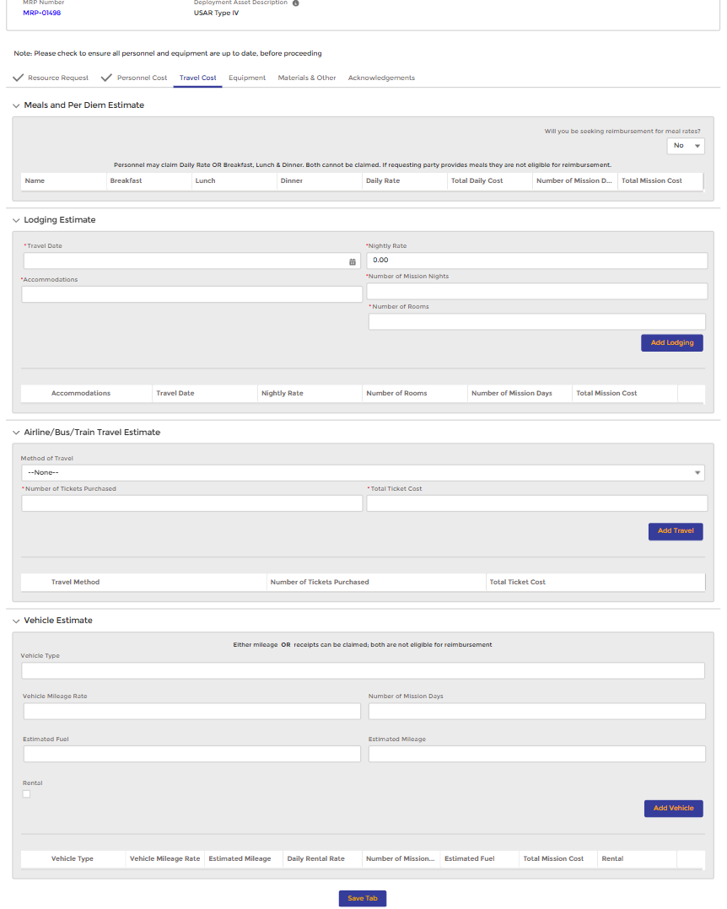
1
Travel Cost
Follow this process to enter Travel Costs into an existing Mission Ready Package.
2
STEPS
Select the Travel Cost tab
In the Meals and Per Diem Estimate section, switch to Yes, if seeking reimbursement for meals
In the Lodging Estimate section, enter Travel Date, Nightly Rate, Accommodations, # of Mission Nights, & # of Rooms
Select Add Lodging. Information entered will appear in a list view at the bottom of the section
In the Airline/Bus/Train/Travel Estimate section, enter Method of Travel, Number of tickets purchased, and total ticket cost
Select Add Travel. Information entered will appear in a list view at the bottom of the section
In the Vehicle Estimate section, enter Method of Travel, Number of tickets purchased, and total ticket cost
Select Add Vehicle. Information entered will appear in a list view at the bottom of the section
Select Save to record the entered information to the MRP
3
4
5
6
7
8
9

Slide 23
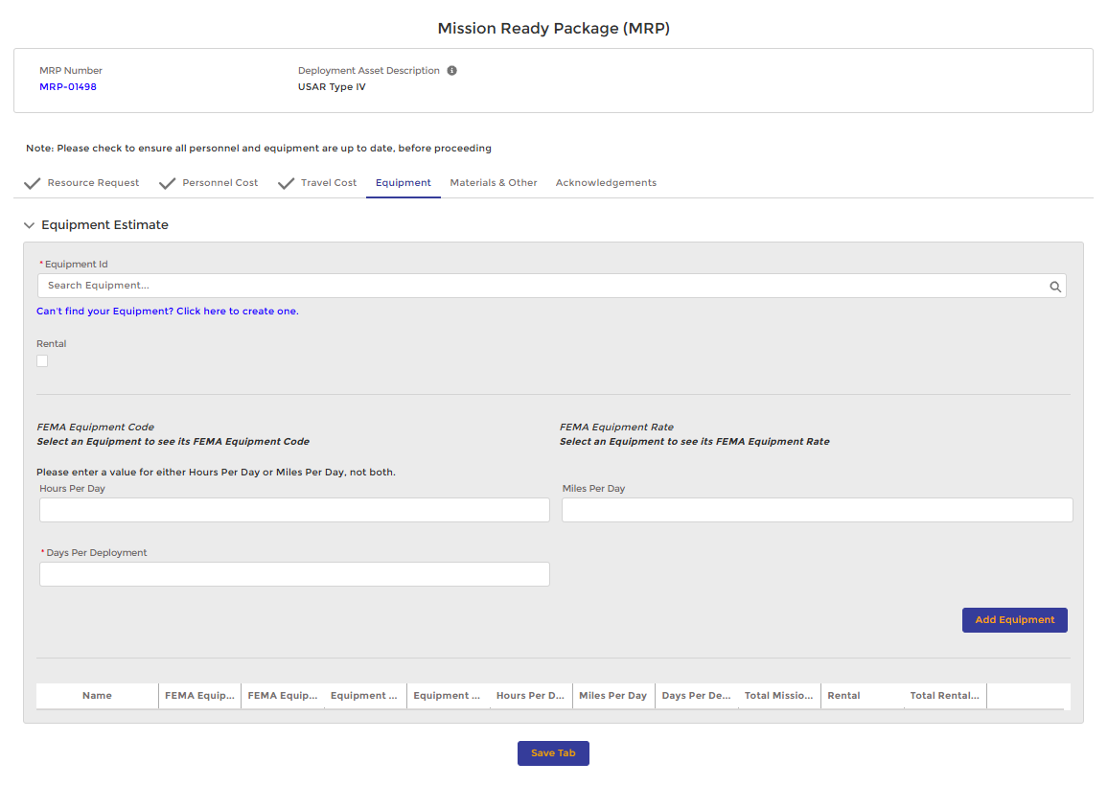
Equipment
Follow this process to enter Equipment into an existing Mission Ready Package.
STEPS
Click the Equipment tab
Enter Equipment ID name to search for options and select the desired equipment item from listing. The FEMA code will pre-populate below once selected
  If your equipment is not showing, select the hyperlink to create a new one
Enter Hours per Day, Miles per Day, Day per Deployment, and Agency Vehicle #
Click on the Add Equipment button. Information entered will appear in a list view at the bottom of the section
  Continue the above steps for each piece of equipment that needs to be included in the MRP
Select Save Tab to record the entered information to the MRP
NOTES
If the equipment was a rental, indicate by clicking the Rental box.
Examples of equipment types include a truck, a van, etc.
2
1
a
3
4
5

Slide 24
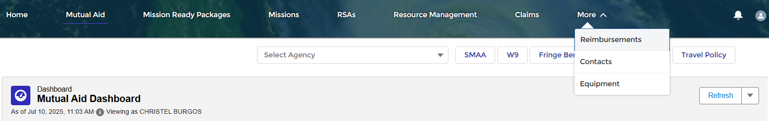
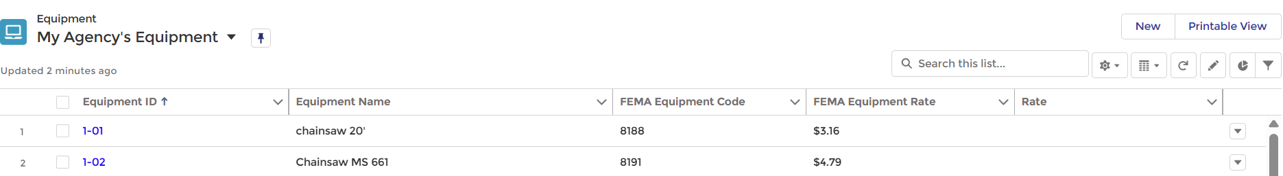
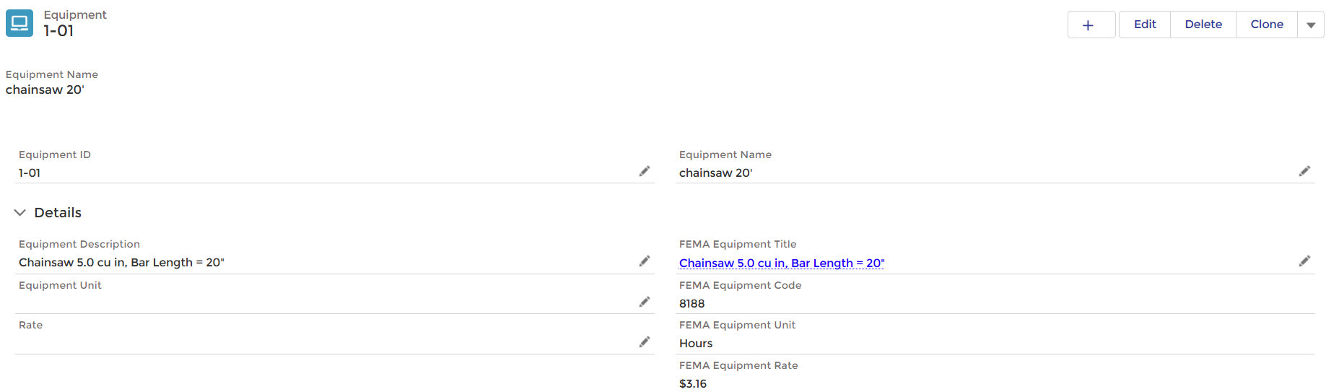
Managing Equipment in the Mutual Aid Portal
Follow this process to manage your agencies Equipment within the Mutual Aid Portal.
1
STEPS
Login to the Mutual Aid Portal using your login credentials
Navigate to the Equipment tab
Once on the My Agency’s Equipment list view, click on one of your agency’s Equipment ID
After entering on to the Equipment record, view or modify the record using the pencil icon
  When modifying equipment records ensure to click the Save button upon completion
NOTES
Agencies can create new equipment via the New button on the My Agency’s Equipment list view
2
3
3
4

Slide 25
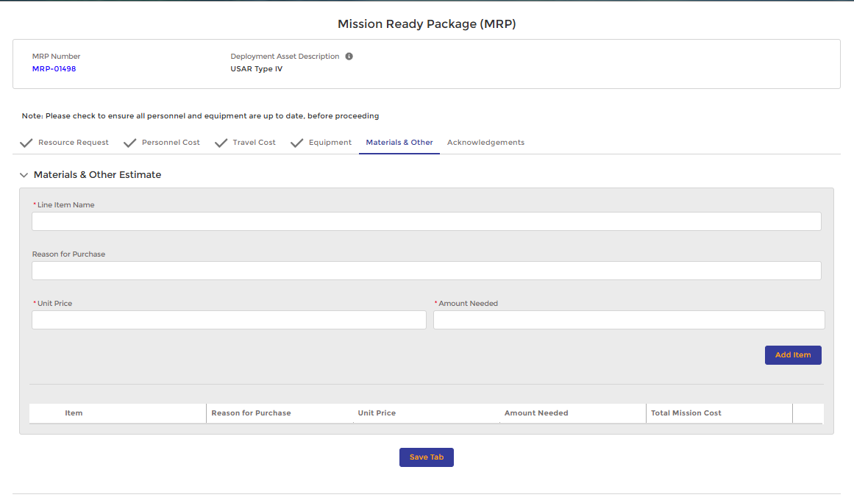
Materials & Other
Follow this process to enter Materials & Other into an existing Mission Ready Package.
STEPS
Select the Materials & Other tab
Enter in the Line Item Name, Reason for Purchase, Unit Price, and Amount Needed
Click on the Add Item button - information entered will appear in a list view at the bottom of the section
  Repeat the above steps for each item that needs to be included in the MRP
Select Save to record the entered information to the MRP
NOTES
Examples of materials include water, tarps, tools, etc.
1
2
3
4

Slide 26
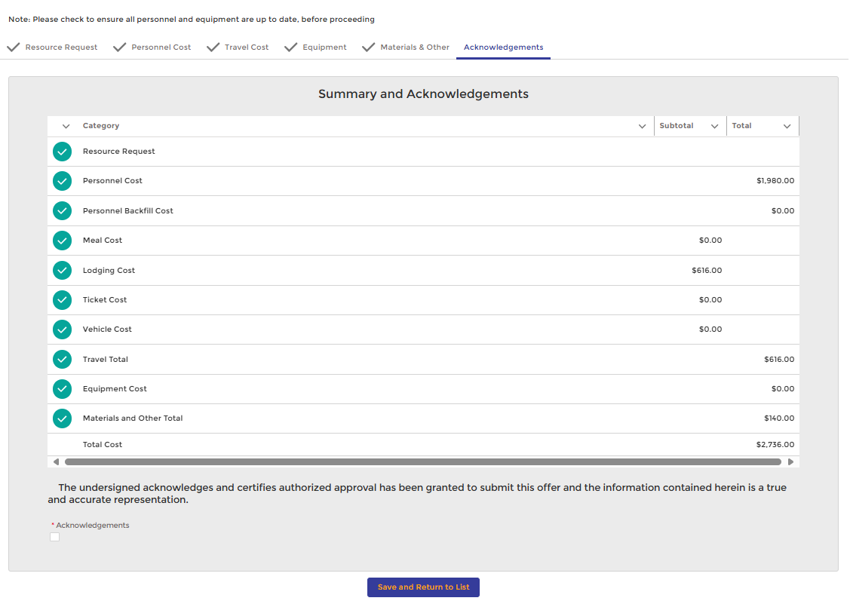
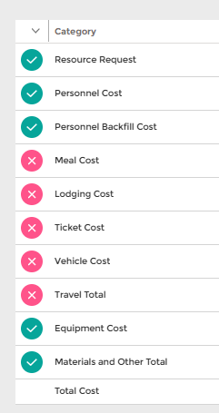
Acknowledge & Save
1
Follow this process to Acknowledge and Save a Mission Ready Package.
2
3
STEPS
Select the Acknowledgements tab once all other tabs have been populated to review a summary of the estimated costs entered in the MRP
Confirm total costs for each category match your anticipated estimate for the MRP
For all sections saved, a green check mark will appear next to the section name (left side) - a red X will appear if any sections are not finalized (left side)
  Mutual Aid Partner must navigate to any red X tabs and click the Save button to obtain a green check for that tab
  An MRP CANNOT be submitted until all tabs have a green check
Scroll to the bottom and click the Acknowledgements box to submit the MRP
Select the Save and Return to List button to create the MRP
NOTES
Check to ensure all personnel and equipment are up to date (rates, etc.) before proceeding
An MRP can be modified after it has been created. Access the MRP from the MRP Manager page
Up until an RSA is submitted you will be notified about the deadline for submitting via email
4
5
Alternate View –
A red ‘X’ will appear if a section is not saved.

Slide 27
Managing Existing Mission Ready Packages

Slide 28
Mission Ready Package Manager
The Mission Ready Package Manager screen allows you to view and manage your existing MRPs.
Once an MRP is created, the Mission Ready Package Manager will be visible from the MRP landing page.
Users can choose to view either Active or Inactive MRPs from the MRP Manager screen.
Notes:
Update with new screen.

Slide 29
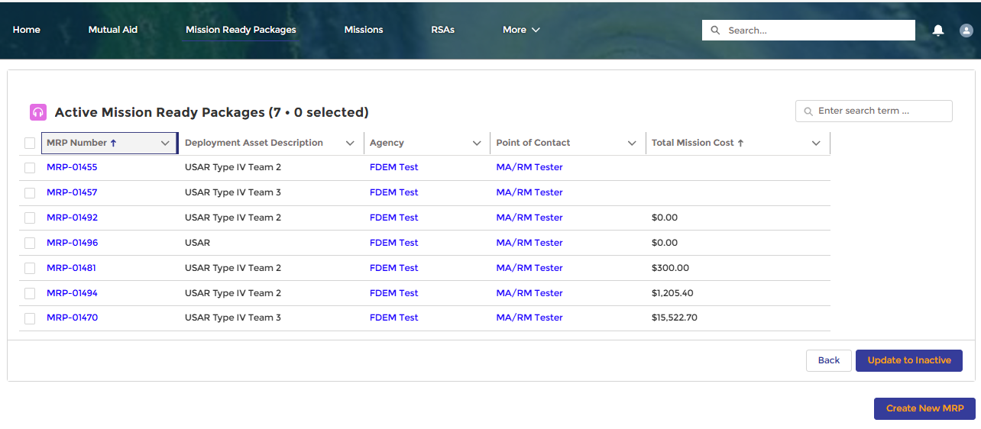
Mission Ready Package Manager
1
The Mission Ready Package Manager allows you to view and manage your existing MRPs.
2
STEPS
View Active and Inactive MRPs
Select either Active MRPs or Inactive MRP
Select Next to be taken to the MRP Library
Deactivating and Activating existing MRPs
Select one or multiple MRPs you want to update to the opposite status
Select Update to Inactive (or if on alternate view select Update to Active)
1
NOTES
Once created, Mission Ready Packages will always be stored as either Active or Inactive. An MRP that has been created but not completed will automatically be added to the inactive library.
2

Slide 30
Access & View a Mission Ready Package
The Mission Ready Package library page displays a list of Active or Inactive MRPs depending on your previous selection from the MRP landing page.
Components
MRP Library Dashboard – Existing MRPs are shown in a Table view with high-level data.
Search bar – Search using key terms to locate a specific MRP.
Update to Inactive – Check the box to the left of an MRP number and select ‘Update to Inactive’ to move it to the Inactive folder.
Create New MRP – Select this option to create a new Mission Ready Package from scratch.
A
B
c
c
MRP Number - Click the MRP Number to access the individual MRP
Deployment Asset Description
- Describes the deployment type
Agency - Indicates the agency associated with the MPR
Point of Contact - Indicates the creator of the MRP
Total Mission Cost –
Displays total cost associated with the MRP
D

Slide 31
Creating an RSA from
Mission Ready Packages

Slide 32
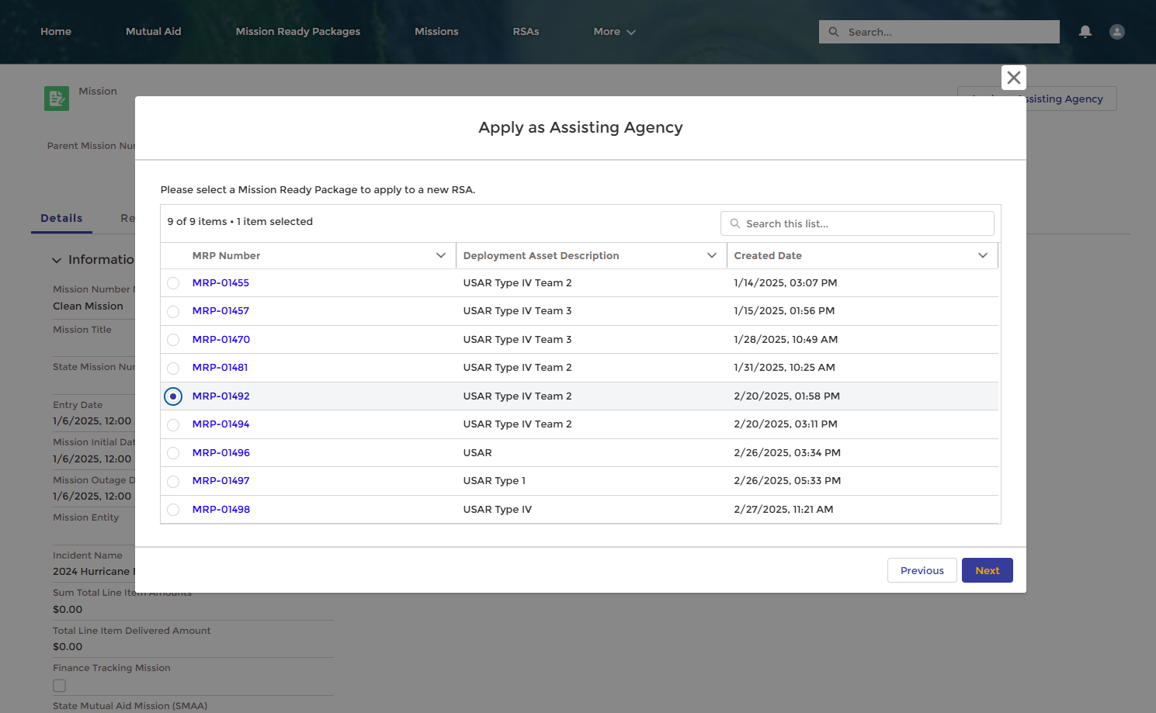
Creating an RSA from MRPs
RSA creation is now easier by using the Mission Ready Package functionality
When using a Mission Ready Package to create an RSA, users can select which information is brought over to the RSA from an MRP.

Slide 33
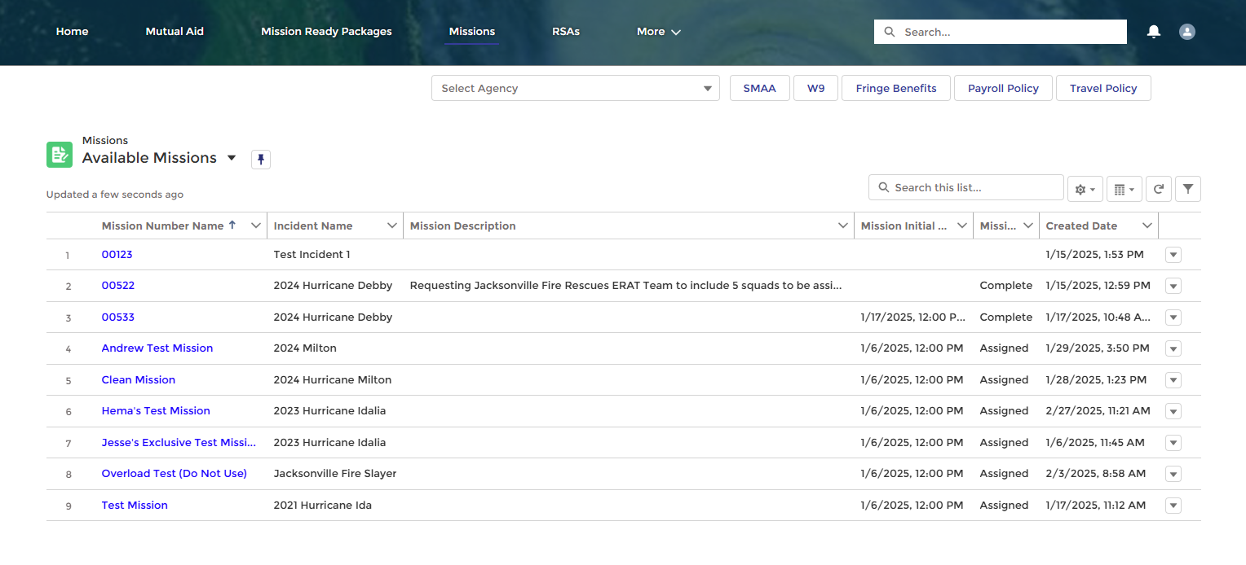
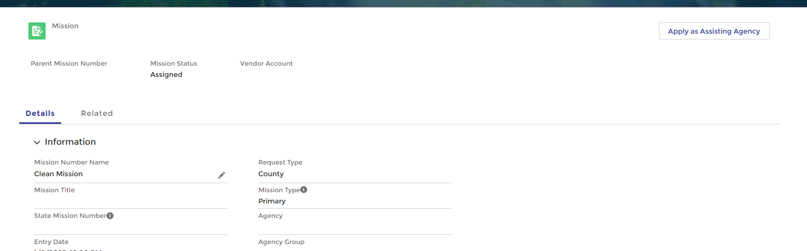
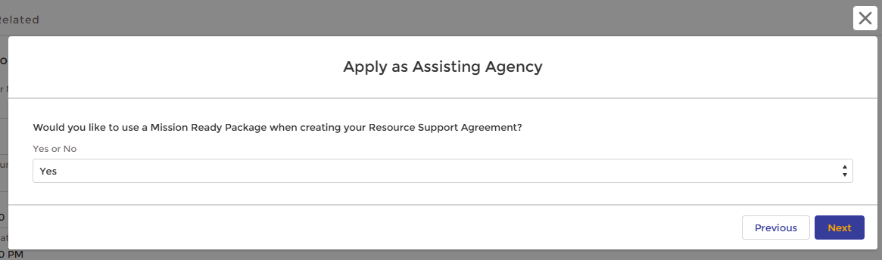
Create an RSA from an Existing Mission Ready Package (1 / 2)
1
Follow this process to create an RSA from an existing Mission Ready Package in DEMES.
2
3
STEPS
Select Missions from the header bar
Choose an available Mission by selecting the Mission hyperlink
Once the Mission details page is open, select Apply as Assisting Agency
Select Next on the pop-up box if you would like to use a Mission Ready Package when creating your Resource Support Agreement
Choose the MRP you would like to use
Select Next
4
5
6

Slide 34
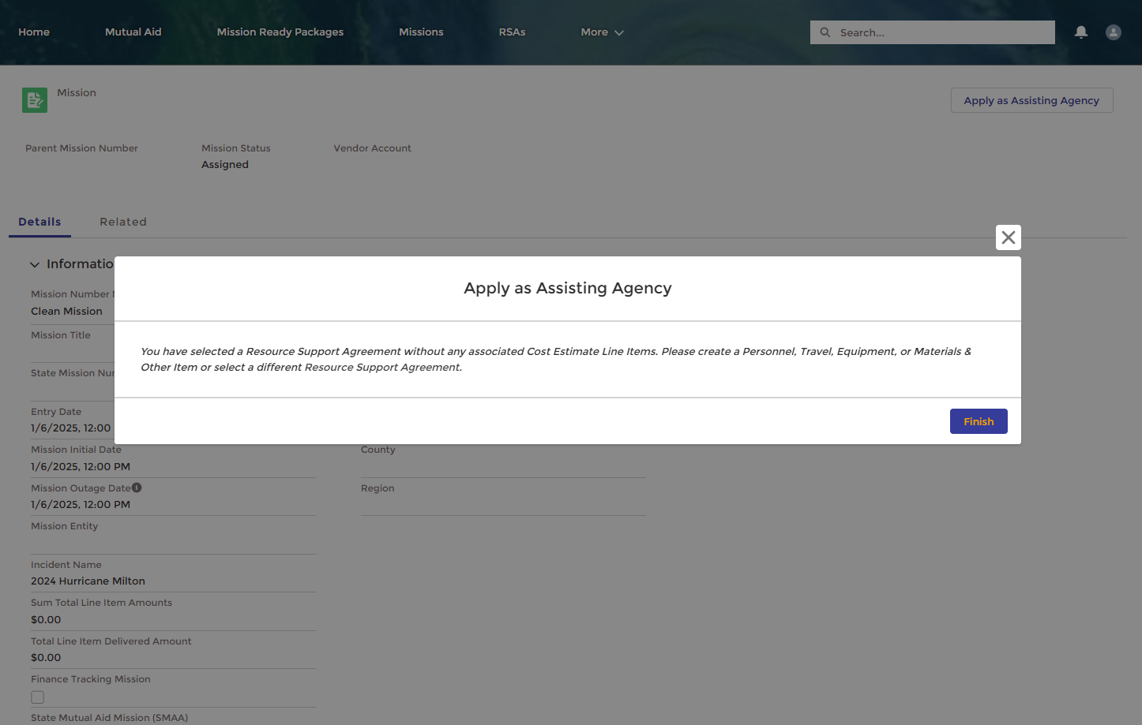
Receive Error Message with Inactive Resources
An error message will appear when trying to attach a Mission Ready Package that does not have resources attached to it.
If a Mutual Aid Partner tries to select a Mission Ready Package that does not have any associated resources, the system will prompt the user to either add items to the MRP or select a different MRP that already has items included.

Slide 35
View and Upload Attachments to a Claim

Slide 36
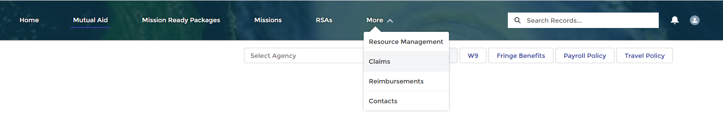
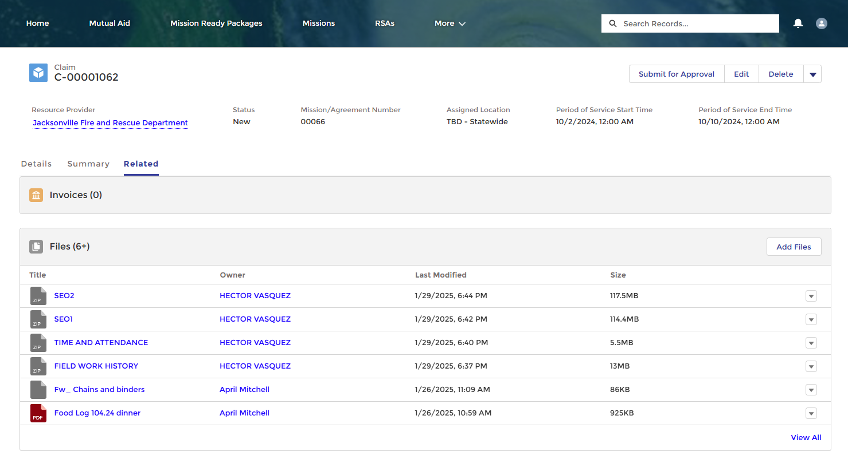
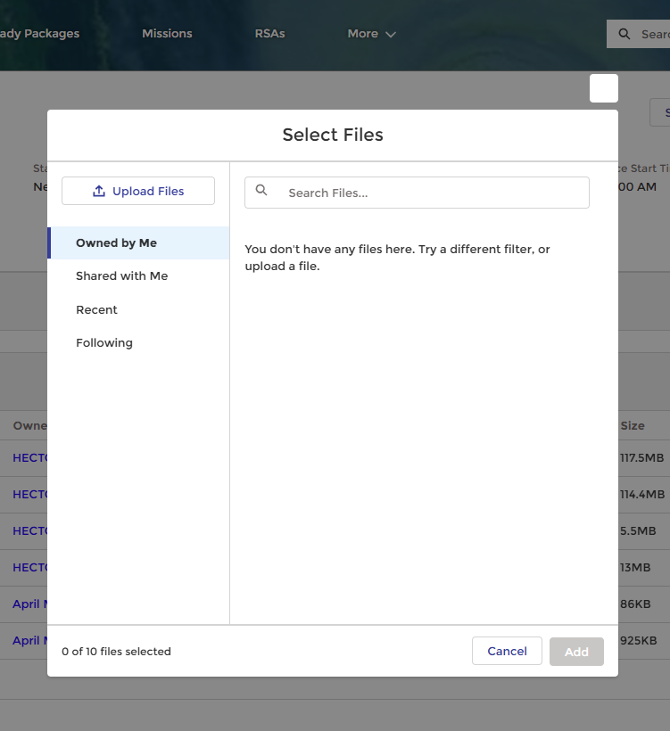
View and Upload
Attachments to a Claim
1
Users can view attachments associated with a claim and upload new ones
STEPS
Viewing Attachments
Once the claim is created, go to the claim record
From the claim record, click on the Related tab
Files will automatically be populated under the Files bar for any mission resource associated with the RSA
Uploading Attachments
To add additional files after the claim has been created, select Add Files from the Files section on the Claim Record
A pop-up will appear to Select Files for Upload. Once chosen, select Add
2
3
4
NOTES
When files are initially uploaded, they are saved under the mission resource record.
Once a claim is created by the external users, DEMES automatically reviews the mission resources associated with the claim and links all files over to the claim.
Files can still be viewed and accessed from the mission resource. They are not deleted in this process.
5
Notes:
7623 and 7630

