Slide 1
Environmental Planning and Historic Preservation (EHP) Compliance
February 12, 2024

Slide 2
Instructor
Somalia James

Slide 3
Goals
Demonstrate how to prepare the screening form with pertinent information needed for EHP compliance review.
Provide an overview of a good scope of work and documents needed to support the scope of work.
Review requirements of environmental and historic preservation laws, executive orders, and regulations.
Review triggers of when Headquarters versus Region 4 EHP completes compliance review.
Notes:
After this slide, add a pole of what the state thinks EHP does.

Slide 4
The Truth About EHP

Slide 5
EHP Supports all FEMA Programs
EHP supports entire FEMA family
Public Assistance
Mitigation
Individual Assistance
Logistics
Grant Programs
IPAWS CSEPP Planning
PA
FMAG
JFO Leasing
Staging Areas
Notes:
MIT: FMA, HMGP, LPDM, NFIP, PDM, BRIC, HHPD
GPD: AFG, BZPP, EMPG, EOC, HSGP, IBSGP, LETP, MICG, PSGP, TSGP, UASI +more
IA: Temporary Housing, Private Access Roads,

Slide 6
EHP Mission Deliverables
Complete legally-defensible project EHP reviews for FEMA programs within appropriate, agreed-upon timeframes
Give technical assistance that supports informed decision-making and legally-defensible outcomes, while incorporating consideration or stewardship of natural and cultural resources
Develop processes, resources or tools to help EHP staff and our customers more effectively integrate natural and cultural resource considerations in community planning efforts and while formulating legally-defensible and timely FEMA-funded projects
Notes:
Mission deliverable.. Or should I say what we expect to have at the end of our compliance review.

Slide 7
Preparation of the Screening Form

Slide 8
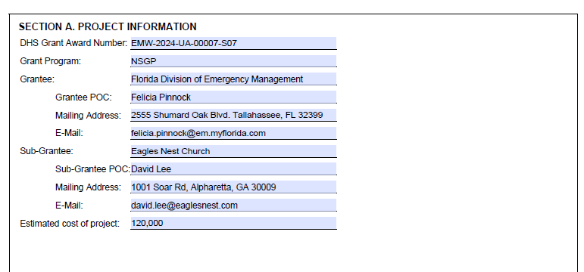
Screening Form
Notes:
Estimated Cost of Project: Should cover the award amount; total amount being rewarded.

Slide 9
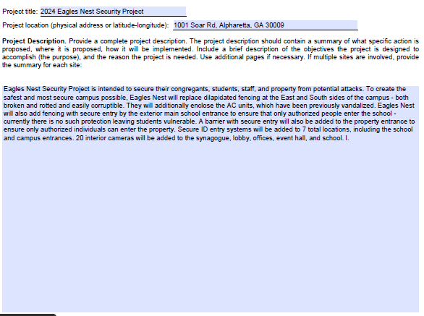
Screening Form
Physical Security Enhancement
Notes:
Any training that will be provided with funds needs to be included into the project description. Include all activities that will be apart of the funding.

Slide 10
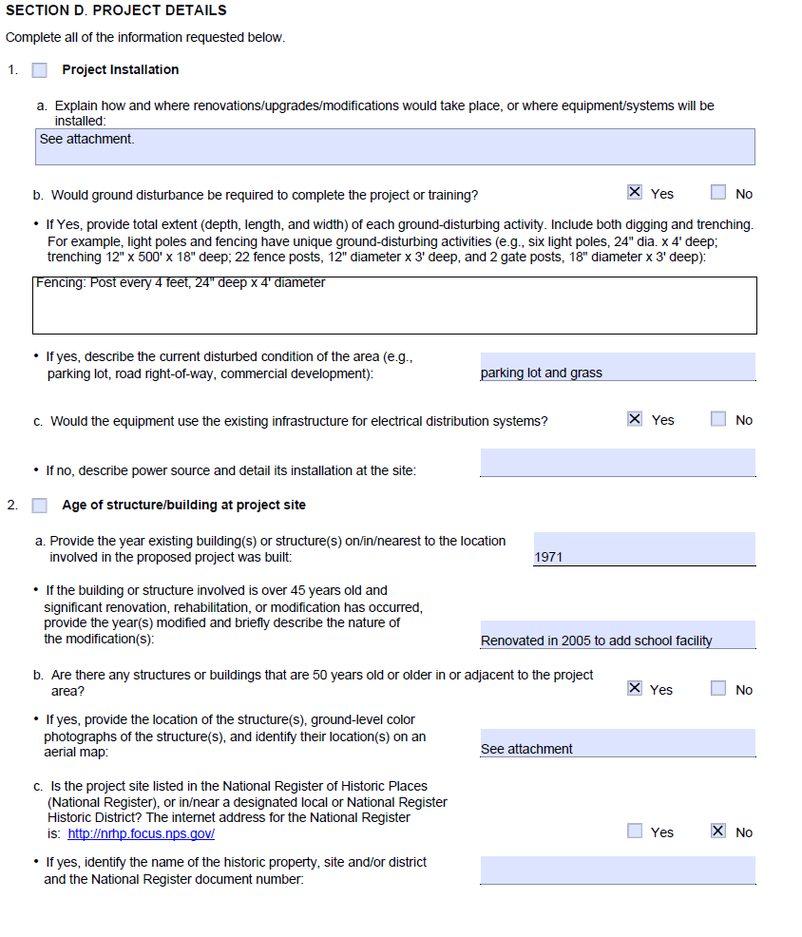
Screening Form

Slide 11
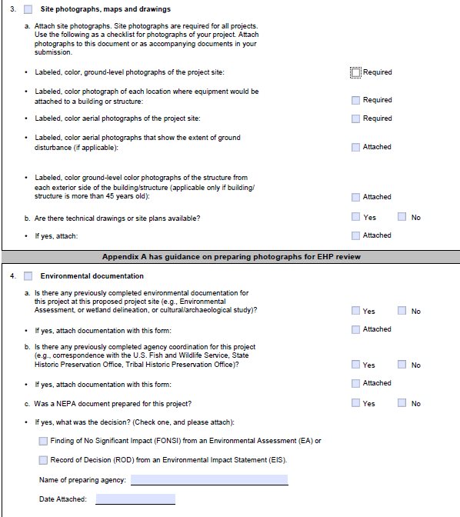
Screening Form

Slide 12
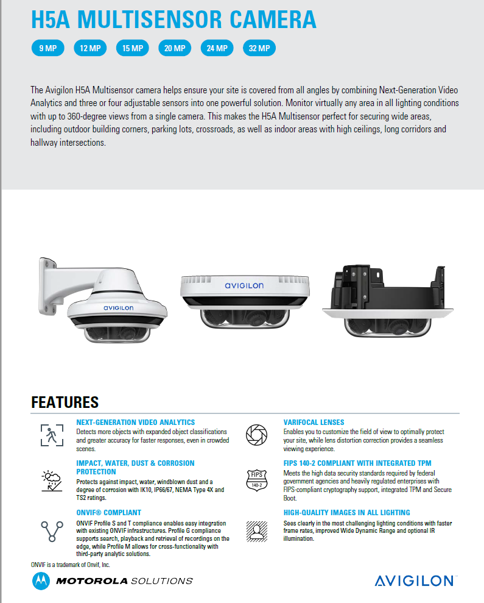
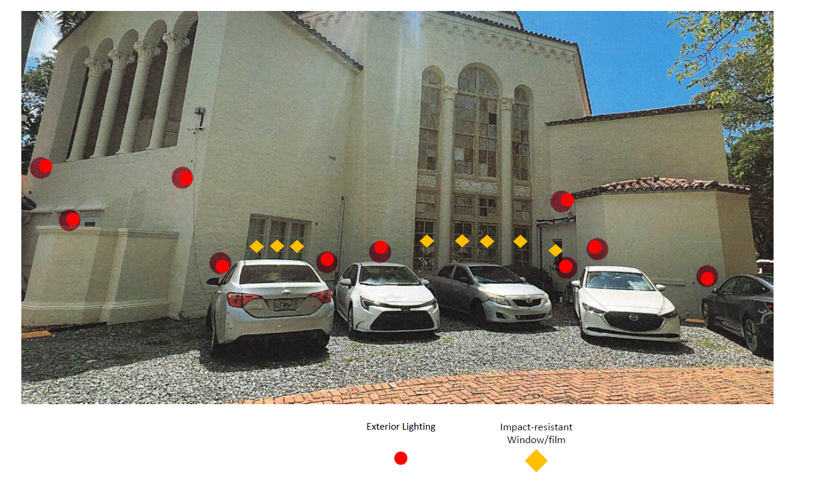
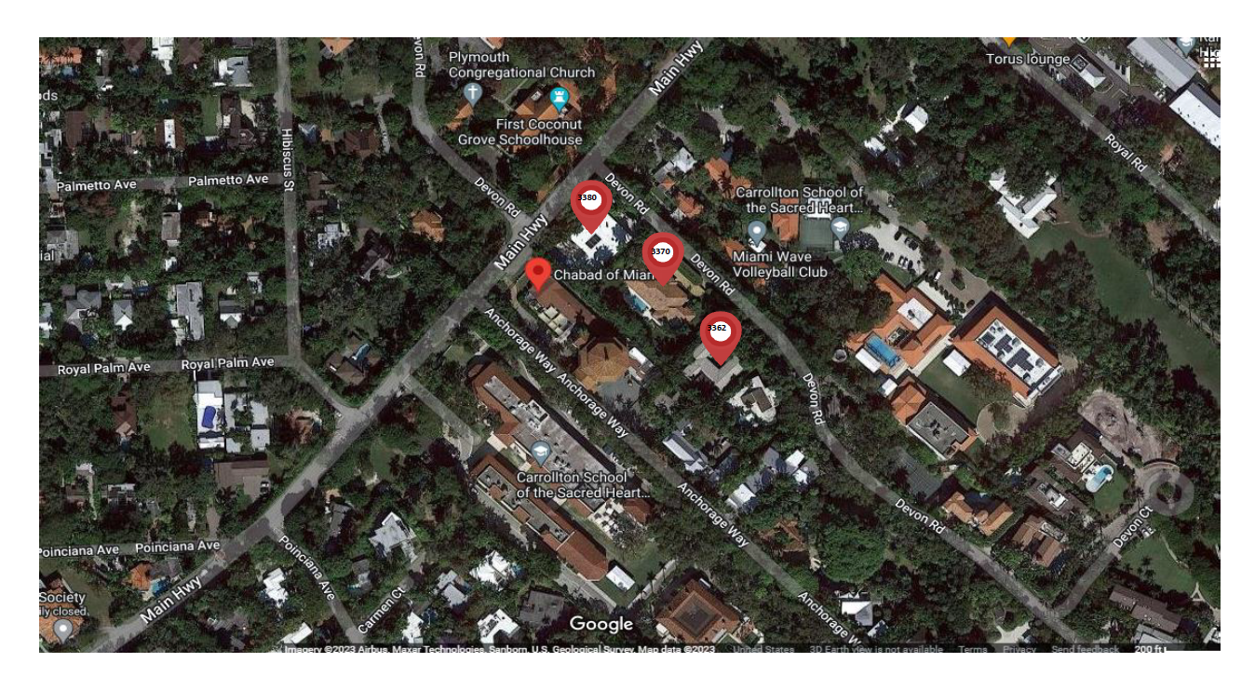
Attachments
Spec Sheet
Equipment Locations
Aerial Photo

Slide 13
Complete and Accurate Scope of Work

Slide 14
Required Project Information:
Federal Grant Award ID
Subrecipient name
Equipment to be installed or purchased
Project Purpose and Need
Project Alternatives Considered
Basic Site Information
  Address
  Latitude/Longitude (decimal format)
  Area and max depth of ground disturbance for each project component

Slide 15
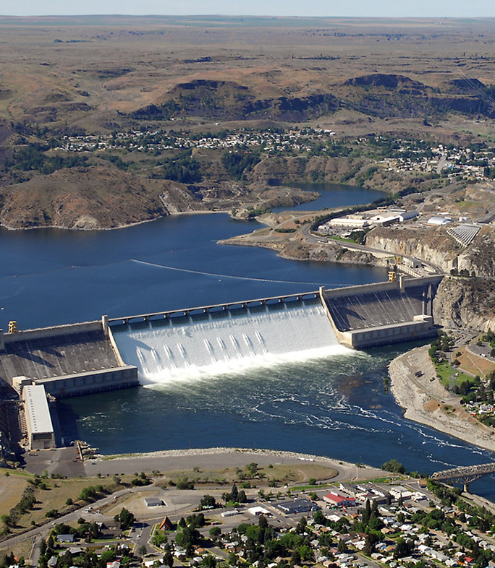
Required Project Information
Basic Structure Information (if applicable)
  Build Year: ALL structure types
  Type of foundation (slab on grade, basement, crawlspace, piers)
  Any major modifications or additions made to the structure
  Current and historic uses of the existing structures
  Any previous ground disturbing activities
  Characteristics of the surrounding area
    Example: Rural farming community
This Photo by Unknown Author is licensed under CC BY-SA

Slide 16
Additional Project Information
All Proposed project activities (if applicable) including but not limited to:
  Equipment spec sheets
  Proposed staging areas
  Grading
  Location of fill source
  Method of construction
  Vegetative removal

Slide 17
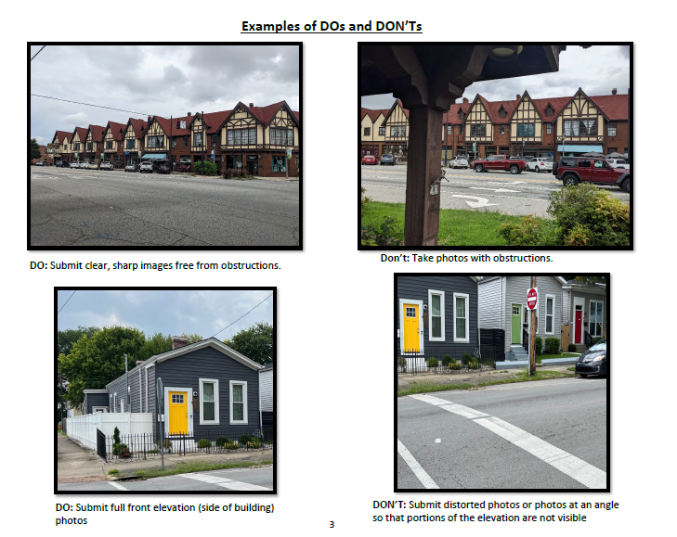
Required Supporting Documents
COLOR Photos

Slide 18
Overview of EHP Compliance

Slide 19
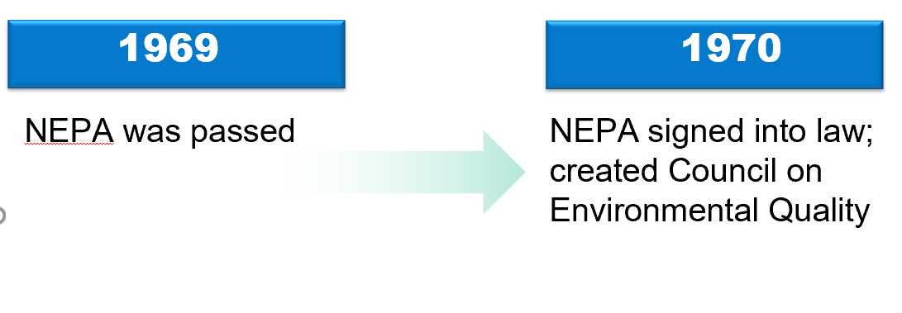
National Environmental Policy Act

Slide 20

National Environmental Policy Act
Clean Water Act
Clean Air Act
Resource Conservation and Recovery Act
Migratory Bird Treaty Act
Magnusson-Stevens Act
National Historic Preservation Act
Endangered Species Act
Executive Orders
Public Law 91-190

Slide 21
National Environmental Policy Act
Triggered when federal agencies permit, license, or fund a project (≥$1)
Congressional mandate that before federal agencies make decisions, they must consider the effects of their actions on the quality of the human environment
Environment defined:
  Biological
  Physical
  Social
  Cultural
  Economic

Slide 22
Section 106:
FEMA and the National Historic Preservation Act
Notes:
Title slide + Image Option 2

Slide 23

Objective
To explain the Section 106 process, when it is triggered, and how to evaluate eligibility and effects.
Notes:
This will be a lecture.
By the end of this presentation, you should know the S106 process, be able to evaluate a resource’s eligibility for listing in the NRHP and determine the effects of a federally funded projects

Slide 24
The National Historic Preservation Act (NHPA)
Section 106 of the National Historic Preservation Act of 1966 (36CFR § 800)
What: Section 106 of the National Historic Preservation Act requires Federal agencies to take into account the effects of their undertakings on historic properties and afford the Council a reasonable opportunity to comment on such undertakings. The procedures in this part define how Federal agencies meet these statutory responsibilities.
When: The section 106 process seeks to accommodate historic preservation concerns with the needs of Federal undertakings through consultation among the agency official and other parties with an interest in the effects of the undertaking on historic properties, commencing at the early stages of project planning.
Why: The goal of consultation is to identify historic properties potentially affected by the undertaking, assess its effects and seek ways to avoid, minimize or mitigate any adverse effects on historic properties.
Who: FEMA EHP Secretary of the Interior Qualified Staff review projects for compliance with Section 106.
Notes:
David:
Just read slide
An undertaking is, “A project, activity, or program funded in whole or in part under the direct or indirect jurisdiction of a Federal agency, including those carried out by or on behalf of a Federal agency; those carried out with Federal financial assistance…”
Review of projects-FEMA SPECIFIC-Grant funding agency-WE DO NOT DELEGATE CONSULTATION OR NHPA COMPLIANCE REVIEW.

Slide 25

Section 106 of the NHPA Compliance Review
Stipulation
NHPA Review by SOI Qualified Specialists
Compliance Review Complete
Allowance
Consultation
THPO(s)
SHPO
Interested Parties
Notes:
Stipulations – limited or no potential to affect historic properties
Allowances – FEMA Funded activities that based on FEMA’s experience have no or minimal effect on historic properties and will not require review from FEMA
Tier I
Tier II

Slide 26

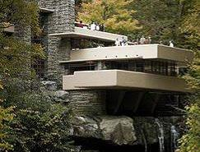

What is a Historic Property?
© Edwards Air Force Base
A historic property is listed in or eligible for listing in the National Register of Historic Places
To be listed in the National Register, a property must be:
  One of the five defined resource types:
    Building, structure, object, site, or district
  At least 45 years old (with exceptions)
  Significant within its historic context
  One that retains its integrity such that it can convey its significance
© Architectural Digest
© History.com
Notes:
So let us look at what constitutes a historic property
The Term Historic Property has a very specific meaning in relation to the National Historic Preservation Act
[Read Slide]

Slide 27
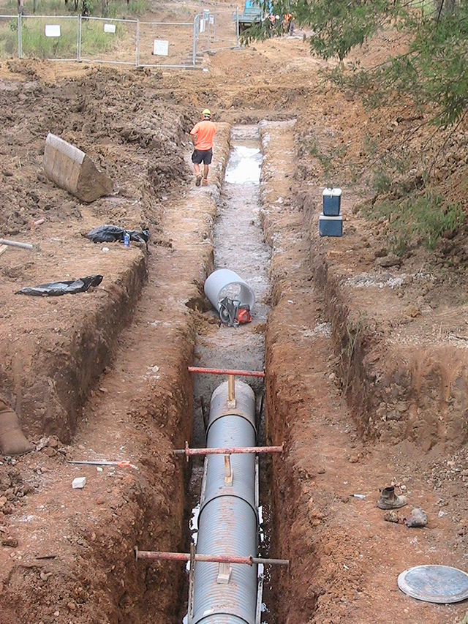
Exploring Ground Disturbance
Location of ground disturbance
Area being disturbed
Depth of disturbance
Associated Actions
© unknown
Notes:
Ground disturbance has the potential to impact buried archaeological resources which are eligible for listing in the National Register. Often times we will receive projects for the repair or replacement of linear features such as utilities.
Not only is the location of the utility important – the length from A to B
To fully assess potential impacts, we need to consider the area of ground disturbance, the depth of ground disturbance and any connected actions – tree removal, ground disturbance from heavy equipment, temporary approach roads etc.
If the subrecipient wants to place perimeter fencing into the project specify that and explain which part is being funded.

Slide 28
Laws, Regulations, and Executive Orders

Slide 29



Protection of Species
This Photo by Unknown Author is licensed under CC BY-NC-ND
This Photo by Unknown Author is licensed under CC BY-NC-ND
This Photo by Unknown Author is licensed under CC BY-SA-NC
Endangered Species Act
Migratory Bird Treaty Act

Slide 30





Definitions
Endangered Species:
  animal or plant in danger of extinction
Threatened Species:
  animal or plant likely to become endangered
Critical Habitat (DCH):
  specific geographic area essential for conservation and management
This Photo by Unknown Author is licensed under CC BY-SA
This Photo by Unknown Author is licensed under CC BY-NC-ND
This Photo by Unknown Author is licensed under CC BY
This Photo by Unknown Author is licensed under CC BY-SA
This Photo by Unknown Author is licensed under CC BY-SA-NC

Slide 31


Consulting Agencies
U.S Fish & Wildlife Service (USFWS)
National Marine Fisheries Service (NMFS)
This Photo by Unknown Author is licensed under CC BY-NC
This Photo by Unknown Author is licensed under CC BY-SA

Slide 32
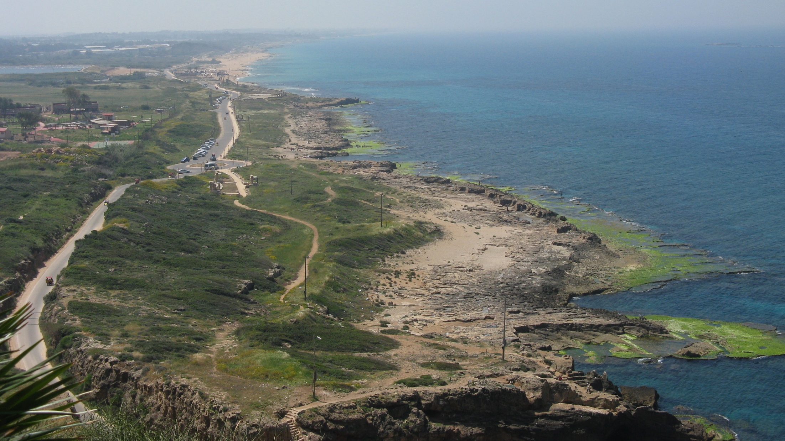
Protection of Water Resources
Coastal Zone Management Act
Clean Water Act
This Photo by Unknown Author is licensed under CC BY-SA

Slide 33

Protecting the Environment
EO 12898: Environmental Justice
EO 11988: Floodplains
EO 11990: Wetlands

Slide 34

Executive Order 12898
Its purpose is to focus federal attention on the environmental and human health effects of federal actions on minority and low-income populations with the goal of achieving environmental protection for all communities.
Notes:
Notes: Here we can address the following – describe the purpose, provide equal access to the decision-making process, how EHP uses EJ in the decision making process,

Slide 35
EO 11988: Floodplains & E0 11990: Wetlands
  Per 44CFR Section 1: Each agency shall
    Take action to reduce flood loss
    Minimize the impact of floods on human safety, health and welfare, and
    Restore and preserve the natural and beneficial values served by floodplains

Slide 36

The 8 Step Decision- Making Process
1. Determine applicability - location
2. Provide an initial public notice
3. Identify & evaluate practicable alternatives.
4. Identify impacts of proposed action
5. Minimize adverse impacts, restore and/or preserve floodplains.
6. Reevaluate alternatives identified in #3.
7. Publish the final public notice.
8. Assure appropriate implementation of the action.

Slide 37
Step #1
Applicability Determination
Locate proposed action on map (FIRM)
  Is it in Special Flood Hazard Area (A/AE, V/VE, Shaded X)
  Is the project in or adjacent to a wetland

Slide 38
Public Notice
Applies to all floodplain related actions,
except those which are exempt.
Provides the public with critical information
about the proposed action.
  Allows sufficient time for meaningful input
  from interested public.

Slide 39
44CFR Part 9: Step #2 & 7
Public Notice Requirements
Description and explanation of the proposed action
Project alternative considered
Name of reviewing agency and official
Map of location
Where to obtain additional information
Comment period and process
Notes:
Project Alternatives considered will need to be thoroughly explained in this slide.

Slide 40
Step #2 & 7
Proof of Public Notice
Publish in newspaper or website
Post at the proposed action site
Broadcast on radio, or TV
Public meetings
Social media sites
Must be posted for at least 15 days or more

Slide 41
Confirmation of Proof of Posting
Newspaper affidavit
Broadcast log
Photo or snippet of the posting with date stamp
Public Meetings
  Attendance and meeting minutes

Slide 42
EHP Compliance Triggers

Slide 43
DHS vs. R4 Compliance Review
Complex Projects
  Projects that do not meet CATEXs
Needs Consultation
  NHPA (S106)
  ESA (Section 7)
8 Step
  Affects the wetland or within a SFHA

Slide 44
Examples
Project meets an allowance but needs a public notice
01
Project not located in a SFHA but needs consultation
02
Project needs consultation and within a SFHA
03

Slide 45
EHP Review Process
Triage
Consultation
REC
Send RFI
Create maps
Draft documentation
Review each law and reg for compliance
Draft up detailed narrative for consultations;
Request Consultation and distribution to consulting parties; and
Next steps will be determined by consulting parties’ responses
Send REC to Headquarters EHP.

Slide 46

Questions?
Contact Information:
Felicia Pinnock
Felicia.Pinnock@em.myflorida.com

