Slide 1
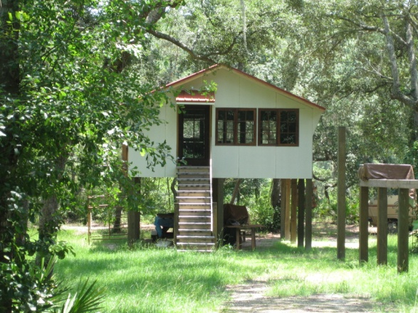
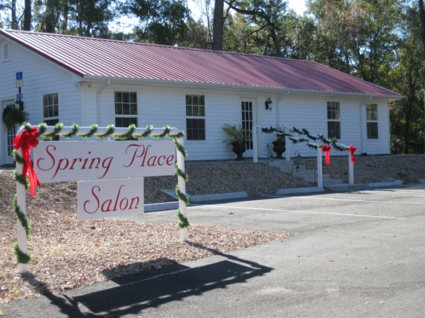
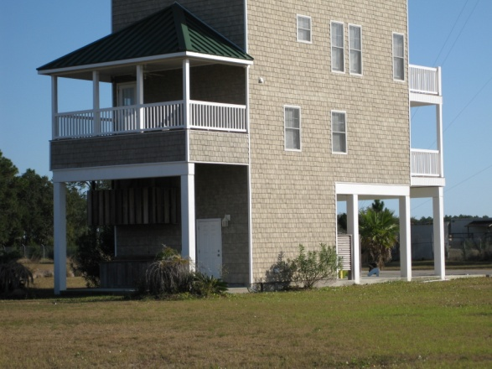
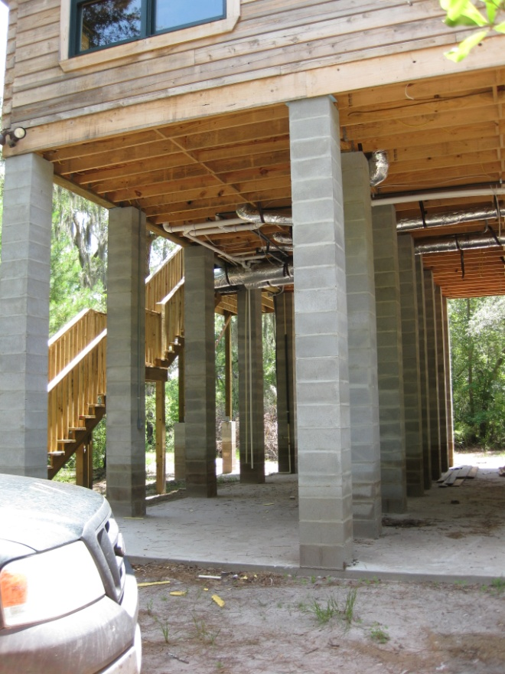
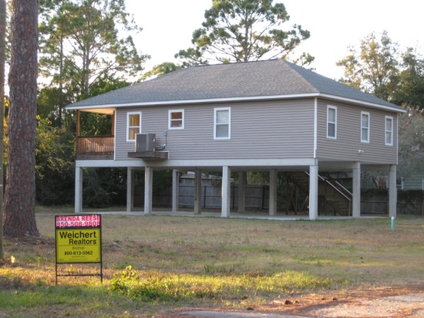
Floodplain Management Regulations and the Florida Building Code
Notes:
DEM’s code resources webpage has Frequently Asked Questions, excerpts of the flood provisions in the FBC, “Highlights of ASCE 24,” explanations for several higher standards, and sample forms.
Please review the FAQs before you take your ordinance for planning review or to first reading. If you still have questions, get in touch with flood.ordinance@em.myflorida.com
http://www.floridadisaster.org/Mitigation/SFMP/lobc_resources.htm

Slide 2
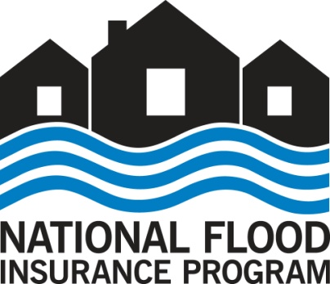
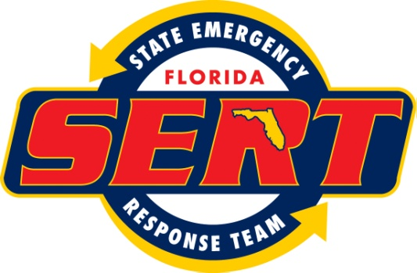
National Flood Insurance Program
A Partnership:
FEMA
provides flood maps and sets minimum regulations
provides federal flood insurance
Florida DEM, State Floodplain Management Office
provides technical assistance
Communities
adopt flood maps
adopt and enforce regulations
Notes:
The National Flood Insurance Program (NFIP) enables property owners in participating communities to purchase insurance protection from the government against losses from flooding.
All but a very small number of all Florida communities participate in the National Flood Insurance Program. There are nearly 2 million flood insurance policies in Florida which represents nearly 37 percent of total policies in effect nationwide.
Look up number of policies in your community: http://bsa.nfipstat.fema.gov/reports/1011.htm#FLT
Participation in the NFIP is based on an agreement between local communities and the federal government which states that if a community will adopt and enforce a floodplain management ordinance to reduce future flood risks to new construction in Special Flood Hazard Areas (SFHA), the federal government will make flood insurance available within the community as a financial protection against flood losses.
The SFHAs and other risk premium zones applicable to each participating community are depicted on Flood Insurance Rate Maps (FIRMs).

Slide 3
Florida Building Code
The Florida Building Code governs the design of buildings
Appropriate to address all hazards in the code, including flood loads
The FBC includes design and construction requirements for buildings in flood hazard areas
Notes:
When the 2001 FBC was developed, the Florida Building Commission made an administrative decision to remove the flood provisions from the model I-codes that are the basis for the FBC. Instead, the code referred to local floodplain management ordinances.
That changed with the 2010 FBC, which included flood provisions that FEMA states are consistent with the NFIP requirements for buildings and structures. The 5th Edition FBC retains flood provisions and thus is also consistent with the NFIP requirements for buildings and structures. By law, only the FBC governs the design of buildings – which creates potential for conflict with building provisions in local floodplain management ordinances. This, and numerous inconsistencies identified by DEM and FEMA in previously-adopted local ordinances prompted DEM to develop the new model, and to work to get FEMA approval.

Slide 4
Why Change Local Regulations?
Commitment to FEMA and the National Flood Insurance Program to maintain adequate regulations and procedures
Coordinate the Florida Building Code with local floodplain management regulations to avoid redundant or conflicting requirements
DEM’s Frequently Asked Questions: http://www.floridadisaster.org/Mitigation/SFMP/lobc_resources.htm
Notes:
Action is required by our community to repeal and replace our local floodplain management regulations.
The FBC contains all laws and rules that pertain to and govern design and construction of buildings. This means the flood provisions of the FBC that govern flood-resistant design of buildings in mapped flood hazard areas supersede local regulations that are not consistent with the FBC.
Inconsistencies and possible conflicts occur if local floodplain management regulations are not coordinated with the FBC.
FAQ: Are we required to use the new model? No, but the model ordinance is carefully crafted to meet NFIP requirements and to explicitly coordinate with the FBC. While the model that DEM prepared is not the only way a community could achieve NFIP compliance and coordinate with the FBC, technical support provided by DEM will be allocated on a priority basis for the communities that choose to use the model. DEM is not preparing guidance to modify local FPM regulations that were based on a model used by most Florida communities several years ago. Taking this approach is a time- and labor-intensive effort. Since DEM began this initiative, fewer than 10 communities out of nearly 300 have elected to modify their existing regulations and some of them are exploring moving to the model ordinance (as of May 2016).

Slide 5
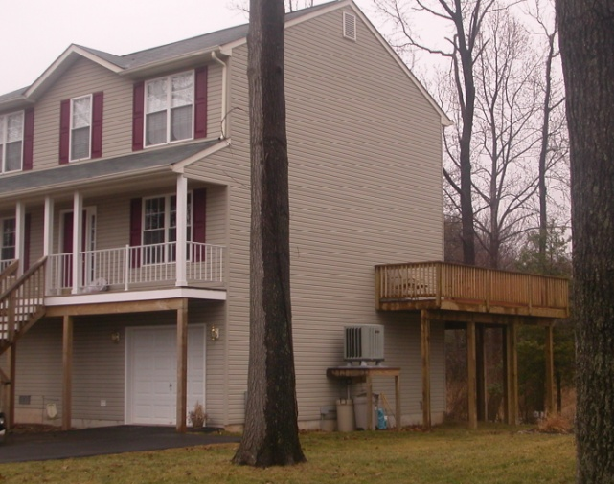
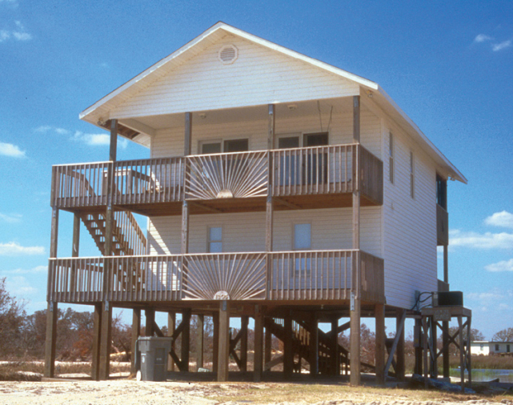
Why Use State Model Ordinance?
Developed by Florida Division of Emergency Management
Explicitly coordinated with the FBC
Approved by FEMA
Reviewed by the Building Officials Association of Florida
Reviewed by the Florida Floodplain Management Association
Notes:
The model ordinance, which also contains language for local administrative code amendments, is specifically designed to repeal and replace existing regulations, to satisfy the NFIP, to coordinate with the FBC, and to meet the requirements of section 553.73(5), F.S.
In addition, the new model is improved in several respects:
Incorporates floodplain management provisions that are clearer and more detailed, including administrative provisions and requirements for development other than buildings.
These provisions are based largely on various FEMA guidance documents which makes it easier for both communities and applicants to apply NFIP-consistent requirements.

Slide 6
State Model FPM Ordinance
More specific administrative provisions
Definitions match the FBC
Recaptures and regulates buildings exempt from the FBC
Coordination between the Building Official and Floodplain Administrator
Notes:
Examples of more specific administrative provisions: determining BFEs where none on FIRM; making and documenting Substantial Improvement/Substantial Damage determinations
FEMA requires all buildings to be regulated for flood – the ordinance simply says buildings exempt from the FBC (that are within the community’s jurisdiction) have to comply with ASCE 24 (the same standard that the FBC, Building references for specific requirements for buildings). FEMA requires all development to be regulated, including buildings exempt from the FBC such as farm buildings on farms. Local FPM regulations were always intended to regulate all buildings.
The BO and the FPA may be the same person/office. FAQ: Must the community’s Building Official also be designated the Floodplain Administrator? No. Communities should designate the position of a qualified staff member who is knowledgeable about floodplain management to fulfill the broad range of responsibilities of the Floodplain Administrator. It is common to designate a department head, planning manager, building official, or a town manager, who then delegates functions. By law, the building official is responsible for enforcing the building code. If designated as the Floodplain Administrator, the building official functions under the authority of the FPM regulations.

Slide 7
New State Model Ordinance
Has provisions for development other than buildings
Manufactured homes, recreational vehicles, tanks, floodplain fill, channel alterations
Incorporates long-standing FEMA policies and guidance, facilitating interpretation and compliance
Notes:
Examples of more specific provisions for “Development” (broadly defined):
MFH
RVs
tanks
floodplain fill
channel alterations
FEMA requires all development to be regulated, including buildings exempt from the Florida Building Code, such as farm buildings on farms. Local floodplain management regulations were always intended to regulate all buildings.

Slide 8
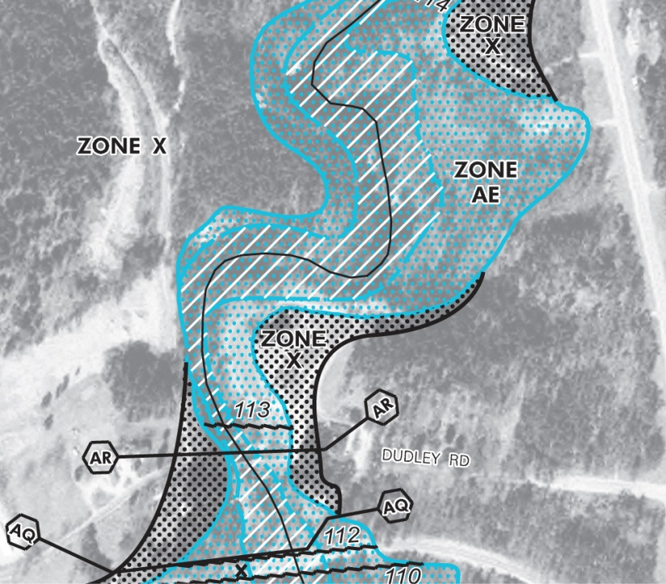
Tailored for Our Community
Adopts our [effective or revised] Flood Insurance Study and Flood Insurance Rate Maps
Specific for the Flood Zones on our maps
Includes language to auto-adopt future map revisions
Notes:
First bullet, use “effective” (and delete “or revised”) unless the community has a formal Letter of Final Determination from FEMA that establishes the effective date for the “revised” FIS and FIRMs.
As our community is remapped by FEMA in the future, the auto-adopt language contained in the model ordinance, protects us from having to re-adopt a new ordinance with a new map date each time.

Slide 9
Tailored for Our Community
Maintain CRS rating through previously-adopted higher standards, including:
{list here, as appropriate – see slides at the end if you’d like to insert explanations}
Includes new higher standards
{list here – see slides at the end}
Note: 553.73(5), F.S., allows local adoption of higher standards as technical amendments to the Florida Building code without sunset every 3 years
Notes:
Delete this slide if the community has no higher standards/not CRS
First bullet: List the CRS activities (if any) that are retained: most common is freeboard (higher elevation)
Second bullet: list any new higher standards adopted by THIS ordinance – or delete this bullet
As a result of higher standards, hundreds of thousands of property owners are better protected from flood damage. Nearly half of Florida’s 458 communities that participate in the NFIP are in the NFIP’s Community Rating System (CRS). These communities gain recognition of various activities that reduce damage, including higher standards for buildings, yielding discounts on NFIP flood insurance premiums that range from 5% to 25%.
To allow communities the ability to retain or adopt higher standards, a change in State law in 2010 specifies that MOST local code amendments for floodplain management do not sunset every three years.
Local code amendments adopted pursuant to 553.73(5), F.S. must be transmitted to the Commission within 30 days after adoption.
See slides 11 through the end for additional information on individual higher standards.

Slide 10
Process
DEM reviewed the draft ordinance
Verified correct dates
Checked our community-specific modifications
Helped with language for higher standards [if any]
After adoption
Send to DEM for final review and concurrence
[DEM sends to FEMA Region IV]
Community submits code amendments to the Florida Building Commission [if any]
Notes:
Top set of bullets – keep 3rd subbullet (turn black) only if you have some higher standards; remove if you don’t
Next set of bullets -- Retain (turn black) the text in brackets ONLY if the community has received a formal Letter of Final Determination establishing effective date for revised FIS and FIRMs. Remove if you’ve not received LFD

Slide 11
Higher Standards
If your community is not adopting any higher standards, delete the rest of the slides.
The following slides provide additional information on selected higher standards for which DEM provides sample language.
Whether you’re retaining existing higher standards or adopting new ones, elected officials and the public may find the applicable slides useful.
Notes:
This is an instructional slide and should be deleted for final presentation.

Slide 12
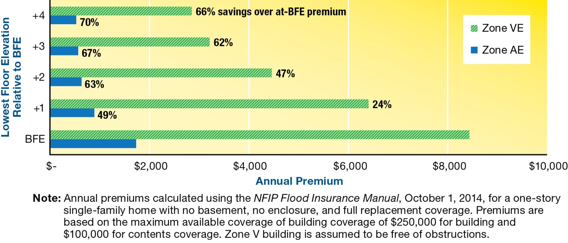
Higher Standards - freeboard
Build Higher
Require lowest floor above base flood elevation
Reduces frequency & severity of flooding
Lower NFIP flood insurance premiums
Notes:
The Florida Building Code, Building (all buildings other than dwellings) refers to ASCE 24 for specific requirements. Virtually all buildings within the scope of the FBC, B are required to be higher than the minimum base flood elevation. See the “Highlights of ASCE 24” on DEM’s code resources webpage.
The 2015 I-Codes, on which the 6th Edition FBC will be based, require minimum freeboard of BFE + 1 foot in all flood zones for all buildings, including dwellings. Changes reflecting the addition of 1-foot freeboard will be in the 6th Edition FBC, R.

Slide 13
Higher Standards - freeboard
Reduce Damage
Quicker reoccupation after floods
Less burden on government & nonprofits for assistance
More money spent locally to help tax revenues recover
Property owners use less savings & borrow less for repairs
Small businesses more likely to stay open

Slide 14
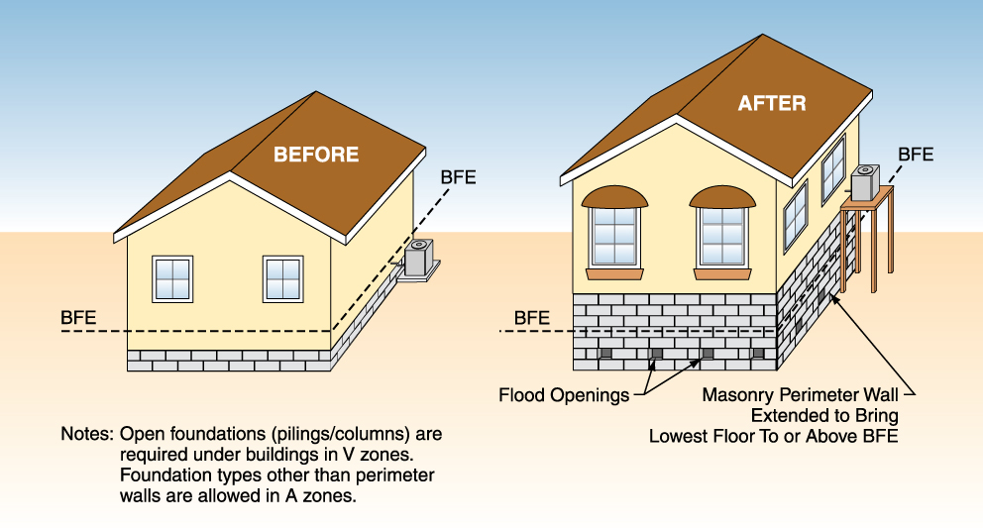
Higher Standards – cumulative substantial improvement
When TOTAL VALUE of improvement and repairs permitted over specified time period exceeds 50% of building’s market value:
Trigger compliance with FBC flood design requirements for new structures
Notes:
See FEMA P-758, Substantial Improvement/Substantial Damage Desk Reference, for a complete explanation of the SI/SD determination. Section 5.7.2 of the Desk Reference has a description of cumulative substantial Improvement.
Community must specify a time period in the ordinance, both the starting point (date the first ordinance requiring cumulative SI is adopted) and the number of years over which the this time-dependent requirement will be tracked.
There are pros and cons for selecting longer periods (such as 10-years or the life of the structure) and for selecting shorter periods (such as 1-year or 5-years). The period of time also determines the number of Community Rating System points. Please also see FEMA P-758 to consider how market value over time will be handled. Communities that adopt this provision should have written administrative procedures in place.

Slide 15
Higher Standards – cumulative substantial improvement
Reduces likelihood of deliberately phasing improvements to avoid “50% rule”
Credited under CRS
Speeds up bringing all flood-prone structures into NFIP compliance
Reduces future flood damage
Requires extra record-keeping & administrative procedures

Slide 16
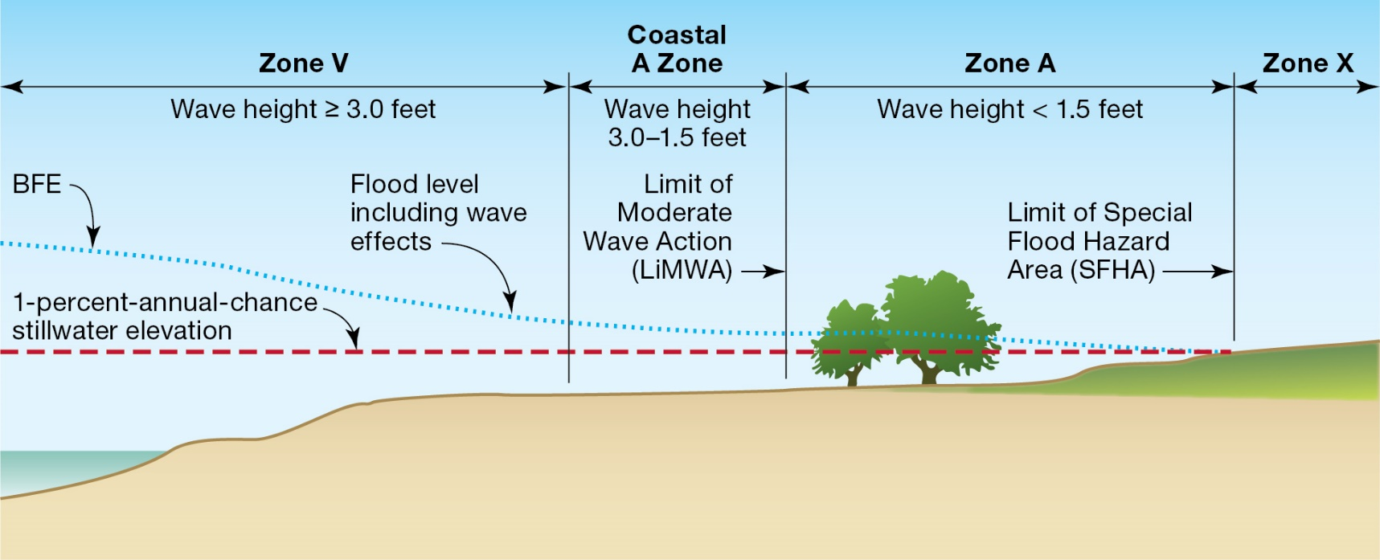
Higher Standards – Coastal A Zone
Post-flood evaluations, calculations & tests show conventional construction sustains considerable damage when exposed to waves between 3 feet and 1.5 feet.
Notes:
What is the “Coastal A Zone”?
Post-flood evaluations, engineering calculations and laboratory tests indicate that conventional construction sustains considerable damage when exposed to waves between 3-ft and 1.5-ft. FEMA draws the inland boundary of the coastal high hazard area (Zone V) where analyses and modeling indicate waves will be less than 3 ft high during the base flood. The NFIP minimum requirements for buildings do not recognize the risk associated with waves less than 3 ft high.
Several years ago FEMA adopted a policy that new studies to revise maps in coastal communities would determine if areas are subject to waves between 3-ft and 1.5-ft. If such conditions are identified, FEMA will delineate the inland extent of the 1.5-ft wave as the Limit of Moderate Wave Action (LiMWA).
Although not labeled as such on FIRMs, these areas between the LiMWA and the Zone V boundary (or shoreline) are referred to as “Coastal A Zones” (CAZ).
Keep in mind that even if your current effective Flood Insurance Rate Maps do not show a LiMWA now, the maps may be revised in the future as part of FEMA’s nationwide initiative to update FIRMs.

Slide 17
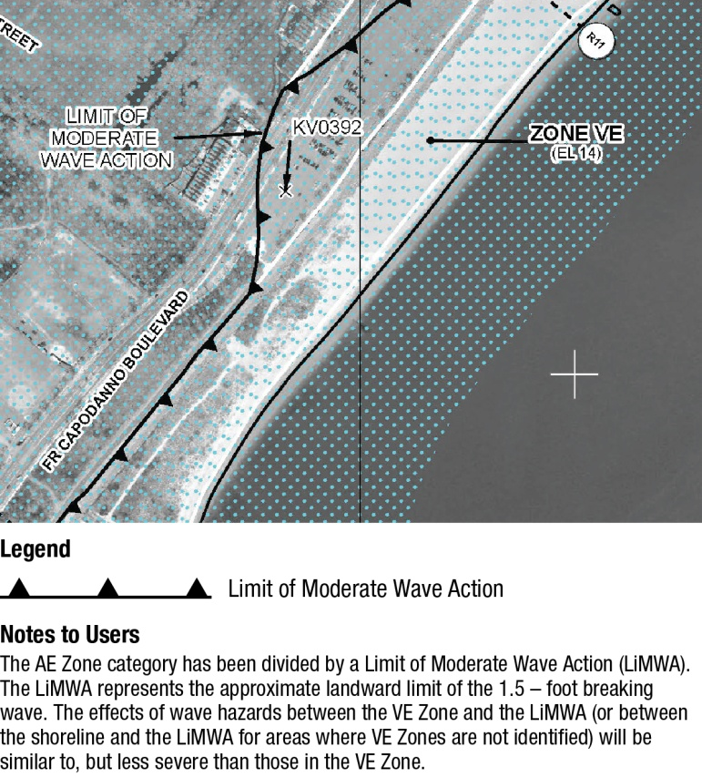
Higher Standards – Coastal A Zone
[select the one you’re using]
FEMA delineated the Limit of Moderate Wave Action on our FIRMs. The area seaward of that line to the Zone V boundary is Coastal A Zone
Or
We define the Coastal A Zone as [insert description of how you delineate it, remove or replace the FEMA LiMWA graphic]
Note! The 6th Edition FBC (2018) will treat CAZ like Zone V.
Notes:
{You may choose to customize this slide based on the method used in your community.}
How the FBC, Building addresses CAZ: The FBC Building, by reference to ASCE 7 (for loads) and to ASCE 24, requires the designer to determine if Coastal A Zone conditions exist at a site. ASCE 24 defines the Coastal A Zone as follows: “Area within a special flood hazard area, landward of a V Zone or landward of an open coast without mapped V Zones. In a Coastal A Zone, the principal source of flooding must be astronomical tides, storm surges, seiches, or tsunamis, not riverine flooding. During the base flood conditions, the potential for breaking wave heights shall be greater than or equal to 1.5 ft.”
If a site is determined to have CAZ conditions, then ASCE 24 requires buildings to be treated the same as buildings in coastal high hazard areas (Zone V), with one exception – openings are required in breakaway walls.
How the FBC, Residential specifies CAZ: The FBC, R does not require determination of CAZ conditions. However, R322.2 does specify that areas that have been “delineated as subject to wave heights between 1 ½ ft (457 mm) and 3 feet (914 mm) shall be designated as Coastal A Zones.” This means the CAZ applies only if a LiMWA is delineated on the FIRM or if a community otherwise designates an area as subject to such wave conditions.
In terms of allowable foundation types and enclosures, the FBC, R treats CAZs like Zone A (i.e., solid foundations (perimeter walls, stem walls) and elevation on fill are permitted, along with open foundations such as pilings, columns, and piers). The only provision specific to CAZ requirement is in R322.2.1, elevation requirements, which specifies that if the CAZ has been designated, then lowest floors shall be elevated to or above the base flood elevation plus 1 foot, or the design flood elevation, whichever is higher. [Note: in communities that use the FIRM, the DFE is the same as the BFE.]

Slide 18
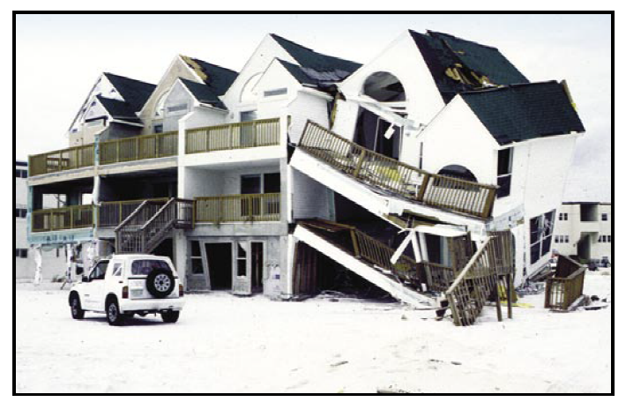
Higher Standards – Coastal A Zone
Regulating Coastal A Zone like Zone V:
Reduces damage to conventional walls and foundations
Better protects against wave effects, debris, velocity flows, erosion, scour
Yields CRS points
Notes:
Picture from “Design and Construction in Coastal A Zones”, http://www.fema.gov/pdf/rebuild/mat/coastal_a_zones.pdf

Slide 19
Higher Standards – repetitive loss
Makes more structures eligible for NFIP Increased Cost of Compliance (ICC) coverage
Change the definition of “substantial damage”
Include damage on 2 occasions in 10-yr period with cost of repair ≥ 25% of market value before damage
Language set by federal law
Requires extra record-keeping and administrative procedures
Notes:
Repetitive Loss (to qualify for Increased Cost of Compliance insurance claim payment)
Federal flood insurance policies include coverage called Increased Cost of Compliance (ICC). Owners of NFIP-insured buildings that are located in special flood hazard areas (SFHA) and are determined to meet the basic definition of “substantial damage” due to damage by flooding are eligible to file ICC claims for up to $30,000 towards the cost of bringing buildings into compliance with the floodplain management requirements for new construction.
In communities that adopt specific language for “repetitive loss” structures, such structures may be eligible for the ICC claim even if they do not meet the standard 50% threshold for substantial damage by a single event. To qualify, communities must adopt and enforce the provision on all buildings in SFHAs, not just those that are covered by federal flood insurance. The specific language that defines “repetitive loss” is specified in the federal law that authorized the ICC coverage. [Source: FEMA 301, Increased Cost of Compliance Coverage: Guidance for State and Local Officials.]

